Slide 1
Microsoft PowerApps in Transportation
Powerful tools to enable business and IT champions to accelerate digital transformation
© Microsoft Corporation PowerApps
Notes:
[Speaker Introduction]

Slide 2





Digital transformation aspirations
Personalized experiences
79% of consumers only consider brands that understand and care about “me” before making a purchase decision¹
Embracing a digital culture
50% of transportation and logistics organizations identify lack of digital culture and training as their biggest challenge²
Streamlined execution
10-30% increase in efficiency would translate into €100-300 billion in cost savings³
Manage risk across the organization
Deeper automation and analytics will drive cost reductions of 25% or more in operational risk⁴
Intelligent Supply Chain
Same-day and instant delivery will likely reach a combined share of 20-25% of the market by 2025⁵
Strengthen relationships and build loyalty
Leverage IoT and other smart technology for future innovation
Lower costs in overall technology investment to gain efficiency
Maintain data integrity while empowering the business
Produce the right things at the right time for the right price
¹DXC.technology. “Five keys to improved customer loyalty in travel and transportation.” January 25, 2018
²PwC. “The future of the logistics industry.” 2016
³Ibid
⁴Ganguly, Saptarshi, et al. “Digital risk: Transforming risk management for the 2020s.” McKinsey & Company, February 2017
⁵Joerss, Martin, Neuhaus, Florian, and Schroder, Jurgen. “How Customer demands are reshaping last-mile delivery.” McKinsey & Company, October 2016
© Microsoft Corporation PowerApps
Notes:
Digital transformation means different things to different industries. For transportation and logistics, it requires a complete transformation of how customers can experience these services .
Today, the customer journey begins with knowing and understanding your customers needs and preferences to deliver a personalized experience. We have a wealth of information about our customers today and nearly 80 percent of consumers expect us to use that information to deliver a personalized experience that meets their unique individual needs and demonstrates a genuine interest in them – or they’ll take their business elsewhere.
Embracing a digital culture is another important aspiration, yet half of transportation and logistics organizations today say the lack of a digital culture and training are among their biggest challenges. These organizations need to deliver innovative services and solutions using IoT and other smart technology, but must first overcome these challenges.
Streamlining execution to increase productivity and efficiency with smart investments in technology is another goal. PwC estimates that a 10 to 30 percent increase in efficiency could result in between 100 and 300 billion Euros in cost savings.
Managing risk across the organization is a critical focus in today’s complex regulatory environment and rapidly evolving cybersecurity landscape. McKinsey and Company estimates that deeper automation and analytics will drive cost reductions of 25 percent or more in operational risk.
Finally, an intelligent supply chain enables same-day and instant delivery, among other near real-time services, that consumers are increasingly demanding.
-----------------------------
¹DXC.technology. “Five keys to improved customer loyalty in travel and transportation.” January 25, 2018: https://blogs.dxc.technology/2018/01/25/five-keys-to-improved-customer-loyalty-in-travel-and-transportation
²PwC. “The future of the logistics industry.” 2016: https://www.pwc.nl/nl/assets/documents/pw-shifting-patterns-the-future-of-the-logistics-industry.pdf
³Ibid.
⁴Ganguly, Saptarshi, et al. “Digital risk: Transforming risk management for the 2020s.” McKinsey & Company, February 2017: https://www.mckinsey.com/business-functions/risk/our-insights/digital-risk-transforming-risk-management-for-the-2020s
⁵Joerss, Martin, Neuhaus, Florian, and Schroder, Jurgen. “How Customer demands are reshaping last-mile delivery.” McKinsey & Company, October 2016: https://www.mckinsey.com/industries/travel-transport-and-logistics/our-insights/how-customer-demands-are-reshaping-last-mile-delivery

Slide 3
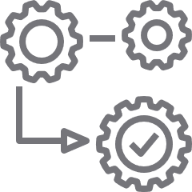



Digital gaps in today’s functional model
Operations
Reservations
Sales/Mktg/ Loyalty
Field/Ground Services
ERP
Commerce
CRM
Maintenance
Paper/Excel
Ad hoc DB
Functional business silos create digital process gaps
Changing business processes also create digital gaps within functions
© Microsoft Corporation PowerApps
Note: This model is presented for discussion purposes only, is not meant to be a formal or comprehensive industry IT architecture
Notes:
However, digital gaps exist in today’s functional IT model that create barriers to fully achieving digital transformation in transportation. Current investments in legacy LOB systems across operations, reservations, sales and marketing, and field and ground services to name a few, as well as various ad hoc paper-based, Excel, and Access databases cannot effectively digitize all of your business processes.
In many cases, these systems are inflexible and cannot be easily customized to meet changing business needs. They are also difficult to integrate, maintain, and upgrade. Today, competitive advantage lies not in your systems, but in your IT strategy and capabilities.
Now, let’s look at some common digital gaps in three key areas of transportation: personalized experiences, streamlining execution, and maximizing IT investments and reducing risk.
-------------------------------------
Icons credits:
<div>Icons made by <a href="https://www.flaticon.com/authors/eucalyp" title="Eucalyp">Eucalyp</a> from <a href="https://www.flaticon.com/" title="Flaticon">www.flaticon.com</a> is licensed by <a href="http://creativecommons.org/licenses/by/3.0/" title="Creative Commons BY 3.0" target="_blank">CC 3.0 BY</a></div>

Slide 4

Common digital gaps in personalized experiences
Disparate systems don't bring a full view of customer to first line employees
Lack of integration and identification of VIP customers prevents differentiation
Duplication in reports slows processes down and creates poor customer experience
© Microsoft Corporation PowerApps
Notes:
The first gap is in being able to provide personalized experiences to customers. Core systems and applications are disconnected and don’t provide staff with a single complete view of the customer. In many cases, employees find it easier to use paper-based workflows and processes in the short-term, but this workaround is inefficient, can’t scale, doesn’t provide a complete view, and creates a poor impression for the customer. This lack of integration keeps valuable information out of the hands of your employees that are directly interacting with your customers. For example, an airline might be unable to quickly and easily identify top clients to ensure a personalized VIP experience. Likewise, slow processes and duplication of effort can create an overall poor customer experience.

Slide 5

Common digital gaps in streamlining execution
Paper-based processes slow down work
Ad hoc manual and error-prone processes
Changing workflows leave gaps in existing tech
© Microsoft Corporation PowerApps
Notes:
Another common gap exists in streamlining execution. Manual processes that are paper-based are slow, error-prone, and reduce productivity. Organizations that have implemented digital processes are able to differentiate their business in key ways to provide personalized service for their customers.

Slide 6

Common digital gaps in managing risk
Hard to keep up with changes in compliance guidelines
Reporting of issues is often verbal which slows correction time & risk elimination
Critical alerts and notifications aren’t automatically escalated or distributed
© Microsoft Corporation PowerApps
Notes:
Finally, managing risk is a critical digital gap that commonly exists for many transportation and logistics organizations today. Keeping up with complex regulations and compliance requirements is challenging. The European Union’s General Data Protection Regulation (GDPR) is one example that mandates changes to the way businesses around the world process, store, and handle the personal information of EU citizens, regardless of where they are located. Beyond the regulatory landscape, simply managing operational risk is an ongoing challenge. Safety issues are often reported verbally or using ad hoc paper processes, which slow the response and increase the organization’s risk exposure over time. Critical alerts and notifications that aren’t automatically escalated or distributed in real-time are another example of operational risk in the transportation and logistics industry that needs to be addressed effectively through digital transformation.

Slide 7


Business and IT status quo
Business Perspective
IT Perspective
Closest to the issue, best understanding of process improvement opportunities
Want the ability to solve business problems and challenges ourselves
Agility is key to increasing productivity
Can’t get access to siloed data in operational technology and IT systems
Data safety and security are important issues, but so are flexibility and timeliness
Looking for opportunities to partner with operations but workload is a limiting factor
Shortage of app developers to build and integrate custom business solutions
Fast pace of business requires greater flexibility
Integrating disparate systems and data sources is challenging
Security and compliance are critical issues – a single incident can shut us down
© Microsoft Corporation PowerApps
Notes:
To close these digital gaps and enable real digital transformation in transportation, the traditional business and IT collaboration model needs to evolve.
From the perspective of the business, the people that are closest to the issues and have the best understanding of process improvement opportunities – including line of business users, Firstline Workers, and other customer-facing employees - should be empowered to solve business problems and challenges themselves. The key to increasing productivity is agility, but business users can’t easily get access to data in siloed operational technology and other backend IT systems. While data and security are recognized as important issues for the business, so are flexibility and timeliness.
From the IT perspective, finding opportunities to partner with operations more often would be ideal, but the day-to-day IT workload is a limiting factor. There is a seemingly perpetual shortage of application developers in the workforce available to build and integrate custom business solutions. The fast pace of the business requires greater flexibility but integrating disparate systems and data sources is always challenging. Finally, security and compliance are critical issues for the business and IT, as a single security incident or compliance violation could shut the business down.

Slide 8


Democratizing business application creation
Business Perspective
IT Perspective
Empower your business experts to create the apps they need to solve workflow and process challenges themselves
Enable IT to securely maintain/control data and govern business apps, while reducing application development backlog
© Microsoft Corporation PowerApps
Notes:
The key to evolving the business and IT collaboration model is to bring application development to the masses by empowering your business experts to create the apps they need to solve workflow and process challenges themselves, while enabling IT to securely maintain and control access to sensitive data and appropriately govern business apps, while also reducing the application development backlog.

Slide 9
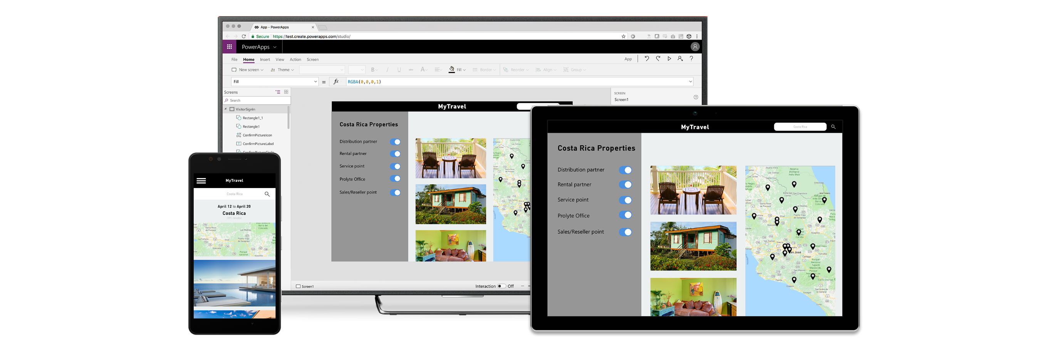
Innovate faster with a low-code/no-code platform
Reduce time & cost building business applications
Drive system-of-record to a single view to simplify your business processes and remove silos in your company
Enrich your apps connecting to your most critical business data
and automating
© Microsoft Corporation PowerApps
Notes:
With a low-code, no-code platform, you can reduce the time and cost associated with developing custom business applications, drive systems-of-record to a single view in order to simplify your business processes and remove data silos in your organization and enrich your apps by connecting them to your most critical business data and automate your business processes.
Now, let’s take a look at some real-world customer success stories…

Slide 10



Personalize the customer experience case study
Improving VIP customer experience
Company Size
9,800 Employees
Industry
Commercial Airlines
Headquarters
Europe
PowerApps Champion
Manuela Pichler, Development Manager
“The admin experience tied it all together – I was able to demonstrate governance for PowerApps, get buy-in from out IT operations management team, discover other PowerApps developers in the organization, and start a community.”
- Manuela Pichler, Development Manager, Virgin Atlantic
© Microsoft Corporation PowerApps
Notes:
Manuela leads a development team that achieves quick wins at Virgin Atlantic. Her team has used the PowerApps platform to reduce development time. Simple apps are built within 2 hours while complex apps, which previously took weeks or months, can be built in weeks or days. They have several solutions in production and under development such as apps for cargo queries, clubhouse spa health questionnaires, and safety and compliance audits.
Manuela and her team work closely with internal stakeholders and other departments to help them on their journey to digital transformation. She has started reaching out to business users who have discovered PowerApps through their Office 365 license and she is building a super-user community at her company. Additionally, she is working with IT Operations teams (such as InfoSec, Change Management) to define a support and governance model for PowerApps. Now Manuela is creating a customized admin experience that fits her team's needs.

Slide 11

Challenges
VIP passenger tracking was done through a daily manual (PDF) report, that used “day-behind” data
Approach was error prone (lots of duplication) and inefficient, taking up to 24 person-hours (6 people x 4 hour) every day
© Microsoft Corporation PowerApps

Slide 12

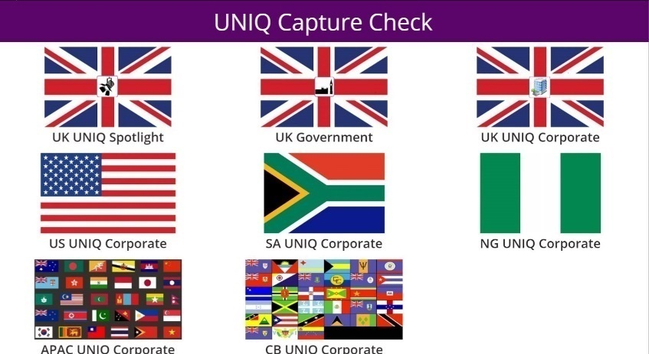
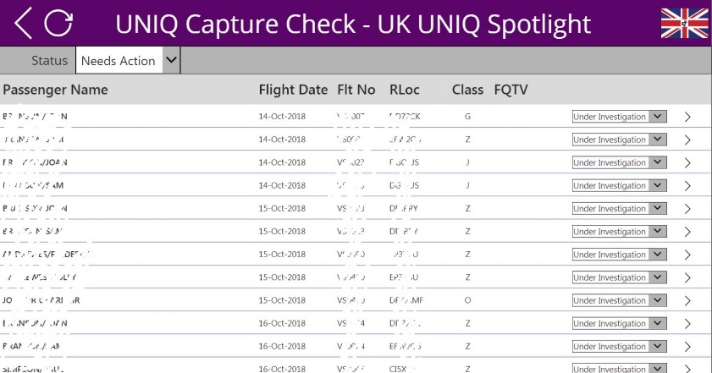
Results
Takes 1/4th the time compared to earlier – 1 hour per person per day
Agents can disambiguate names and prepare for VIPs on upcoming flights ​
Used daily by 6 team members of the VIP customer service team
Allows the team to focus on providing excellent customer service to high value customers
Some content blurred for confidentiality
© Microsoft Corporation PowerApps

Slide 13

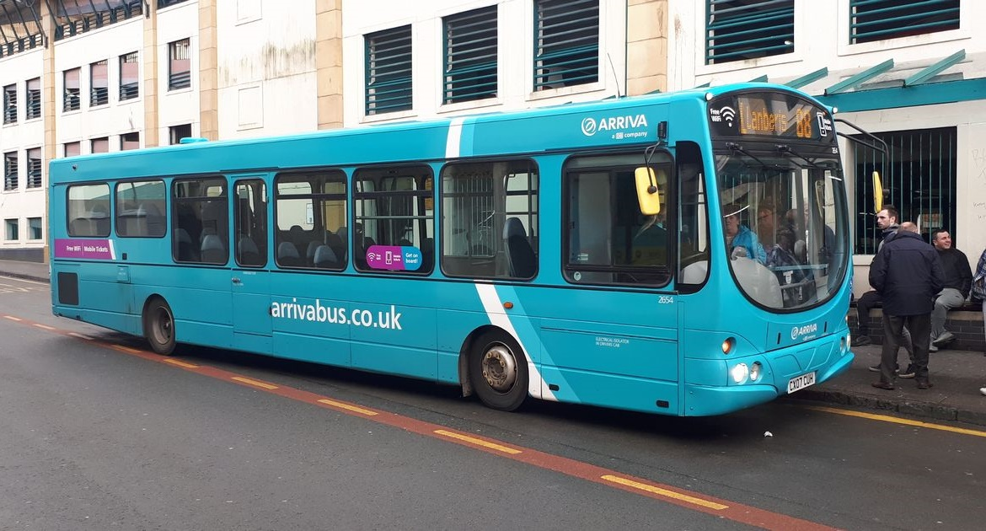

Streamline Execution case study
Improving bus route performance management
Company Size
61,000+ Employees
Industry
Travel and Transportation
Headquarters
United Kingdom
PowerApps Champion
Keith Whatling, Senior Analyst
“PowerApps is where I go to build apps now because the flexibility is just unbelievable.”
© Microsoft Corporation PowerApps
Notes:
Under pressure to meet high performance standards for its vehicles, bus routes, and drivers, Arriva London has unleashed the potential of Microsoft PowerApps and Microsoft Flow to quickly and easily develop apps for a wide range of business processes. The company has already realized efficiencies with two successful apps, and it plans to support the development of new apps across the organization.
Arriva London is charged with the timely and efficient service of the iconic red single and double-decker buses and New Routemasters that serve passengers in the city of London. The operation, which comprises more than 100 routes, 1,600 buses, 4,000 drivers, and 400 million annual passenger journeys, provides about 18 percent of the city’s bus services. “Every day, the mileage that our London buses cover is equivalent to going around the world six times,” says Keith Whatling, Senior Analyst at Arriva London.
Transport for London (TfL) is the local government organization responsible for most of London’s transportation system, and it sets high standards for winning and maintaining bus routes in the city. “Arriva has a number of indicators that we need to meet—including safety, cleanliness, and customer service,” says Philip Gerhardt, General Manager at Arriva London. After Arriva is awarded a contract for a bus route, Philip’s staff monitor performance. “We work to make sure that we’re performing to maximum capability,” he says. “If we perform beyond a certain standard, we receive a performance incentive based on contract revenue, which can add up.”
Full case study available here https://customers.microsoft.com/en-us/story/arriva-london-travel-transportation-powerapps

Slide 14


Challenges
Needed a solution to improve route management, monitor staff performance, stay compliant, and control costs
Route performance was managed through a combination of paper-based and Excel forms
Data stored in legacy AS400 systems
© Microsoft Corporation PowerApps
Notes:
Over the years, measuring live bus performance against TfL standards has been a challenge. TfL ranks routes against an average and the performance of other operators. “We’re one of a number of operators in London and we compete against those operators to win bus routes. We needed a solution that would help us improve route management, monitor staff performance, stay compliant, and control costs,” says Philip.
Unlike many other businesses, the Arriva London workforce does not experience a high level of turnover. “Many of our staff have long service,” says Keith. “That’s great, because it means we’ve got experts, but many of our staff have not grown up with technology.” Realizing that those employees use their phones to access social media, Keith decided to build user-friendly apps to help Arriva staff work efficiently and meet TfL standards.
Keith and his team decided to put Microsoft PowerApps (part of the Microsoft Office 365 cloud-based solution employed at Arriva) to the test. With PowerApps, Arriva can build its own custom apps or extend the capabilities already included in Office 365. “When I came to use PowerApps and was able to put something on the screen, press a button, and get it on a phone, it was absolutely revolutionary,” says Keith.
Senior Controllers at Arriva London need to be able to monitor live Controller performance. The process was paper based so it was a great candidate for an app. Keith began sketching out scenarios on bits of paper, then transferring them to the PowerApps platform. “I just started building things,” he says. “It was completely organic.”
Keith used PowerApps and Microsoft Flow to build a custom workflow. Now, for example, when an employee is late or absent, Microsoft Flow triggers an email notification. It also provides robust support for General Data Protection Regulation (GDPR) compliance.
Arriva is building another app, which will help repair teams respond more quickly. Currently, when a bus has a mechanical issue, an engineer notes the location and other details about the incident on carbon copy paper and a Clerk enters the data into the system. “With the app we’re developing, engineers will be able to input data directly into the system, use GPS to identify the location of the incident, provide photos, and even scan barcodes to identify parts,” says Keith.
Philip’s team is responsible for recommending improvements and adjustments to schedules. Keith and his team developed an app to help the wider teams manage dozens of proposals at any one time. “We wanted everything in one place so we could edit on the go,” says Philip. “The apps we’ve developed with PowerApps make it easier to complete our daily tasks, while having everything in one place so everybody has complete visibility.”
“It’s also helped us allocate responsibilities by using SharePoint to share action lists,” Philip says.

Slide 15

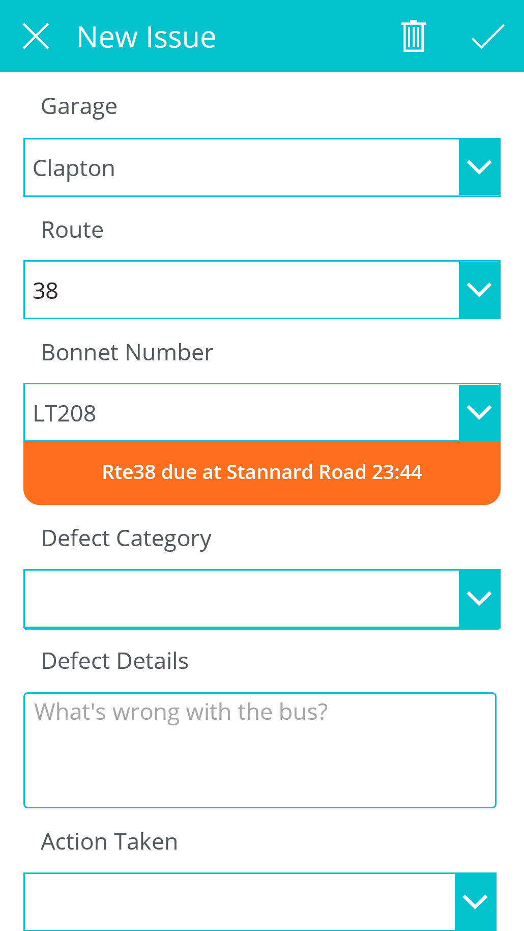
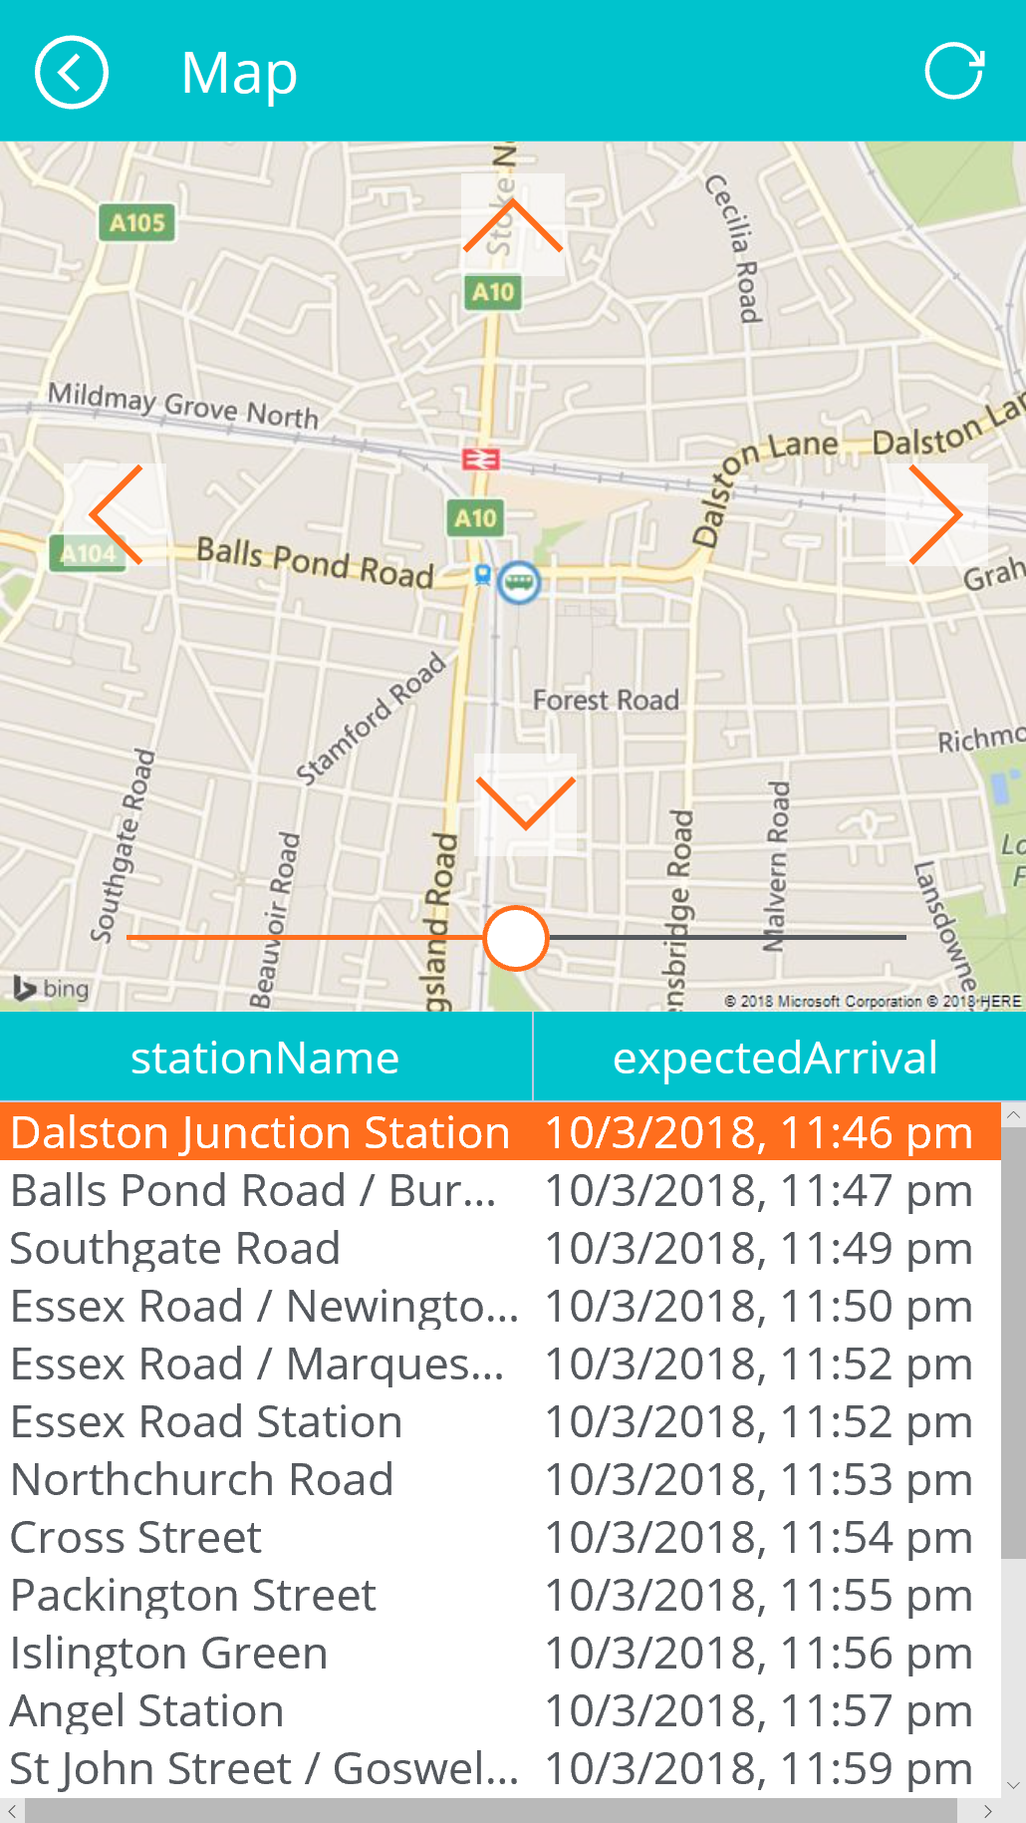
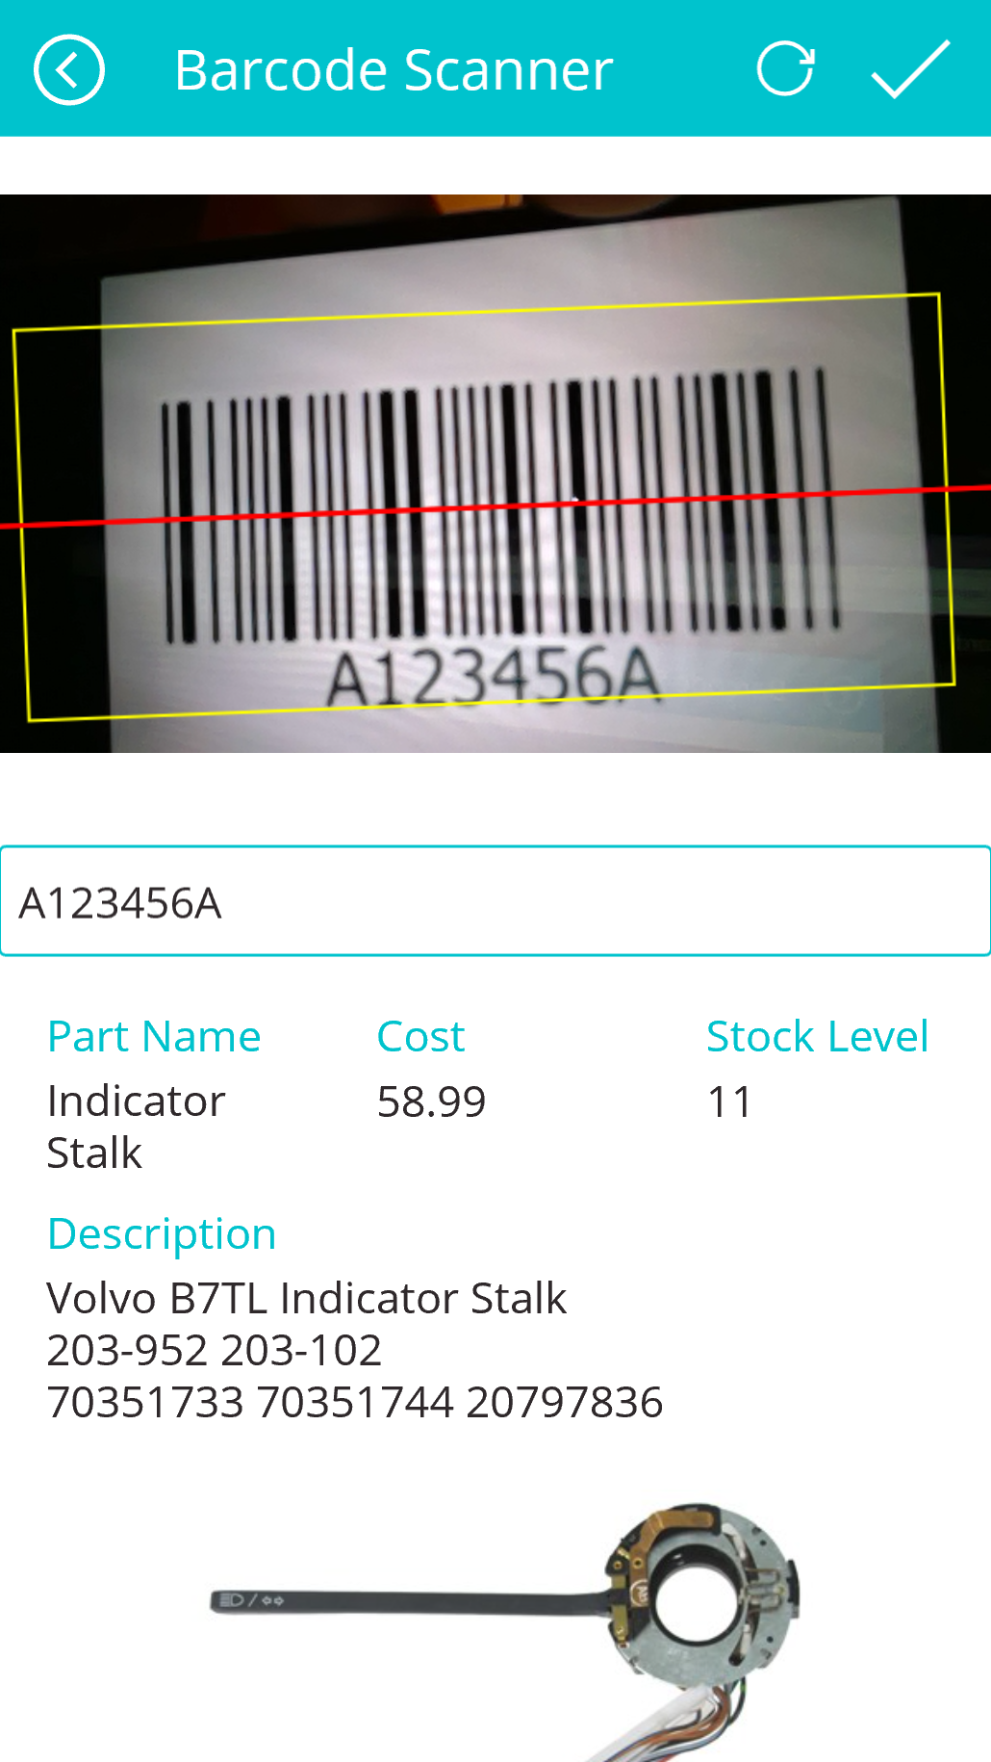
Results
Increased quality control productivity checks “an hour's job reduced to 20 mins” – Lee Ashton – Sr. Controller
Increased efficiencies and issue resolution turnaround, thanks to apps available anywhere
Empowers the team to maintain peak performance and meet Transport for London KPIs
© Microsoft Corporation PowerApps
Notes:
Keith has quickly championed PowerApps at all levels across Arriva. “We’re just at the beginning of our PowerApps journey,” Keith says.
The apps Arriva London has developed with PowerApps make it easier for teams to maintain peak performance and meet the high expectations of TfL. “We have a lot more transparency about what needs to be done and it makes things go a lot smoother,” says Keith. “PowerApps is where I go to build apps now because the flexibility is just unbelievable.”

Slide 16


Maximize IT investments and reduce risk case study
Increasing safety in train maintenance operations
Company Size
150,000 Employees
Industry
Transportation
Headquarters
Saint-Denis, Seine-Saint-Denis, France
PowerApps Champion
Rémi Delarboulas, Digital Adviser
Given the success of this app, Remi and team went on to build more apps, including supply chain management, client feedback management, and train inspection. He has started working with counterparts across France to share his experience with PowerApps.
© Microsoft Corporation PowerApps
Notes:
France's national state-owned railway company, SNCF, manages rail traffic in France and the Principality of Monaco. SNCF operates the country's national rail services, including the TGV, France's high-speed rail network. Its functions include operation of railway services for passengers and freight, and maintenance and signaling of rail infrastructure. Trains undergo rigorous maintenance and repair processes in one of many technical centers, known as ‘technicenters’.

Slide 17

Maximize IT Investments and Reduce Risk – Challenges
Manual pen and paper tracking of various factory floor operations
Rebuilding bogies and replacing springs requires precise calculations that took 2 days to complete
Serious safety implications if margin of error is greater that one millimeter – error rate was 50%
© Microsoft Corporation PowerApps
Notes:
SNCF Technicenters mostly rely on pen and paper to perform and track various operations on the factory floor. These operations can range from a small paint job to a complex deconstruction and re-construction of an entire train engine.
One of the challenges SNCF had in this technicenter was around rebuilding bogies and replacing the corresponding springs, a delicate operation that relies on very precise calculations and takes two days to complete. SNCF operates large machinery to refurbish springs that might have been in circulation for millions of miles. Once the springs have been refurbished, they need to be placed on different types of bogie chassis. However, their height must fit with the bogie spring holders within an error margin of less than a millimeter. Failure to respect this threshold can have serious safety implications. Because of the complexity of the operation and the manual nature of how those calculations were performed by the factory workers, the error rate was around 50 %. In other words, 1 in 2 bogies needed to be completely rebuilt.

Slide 18
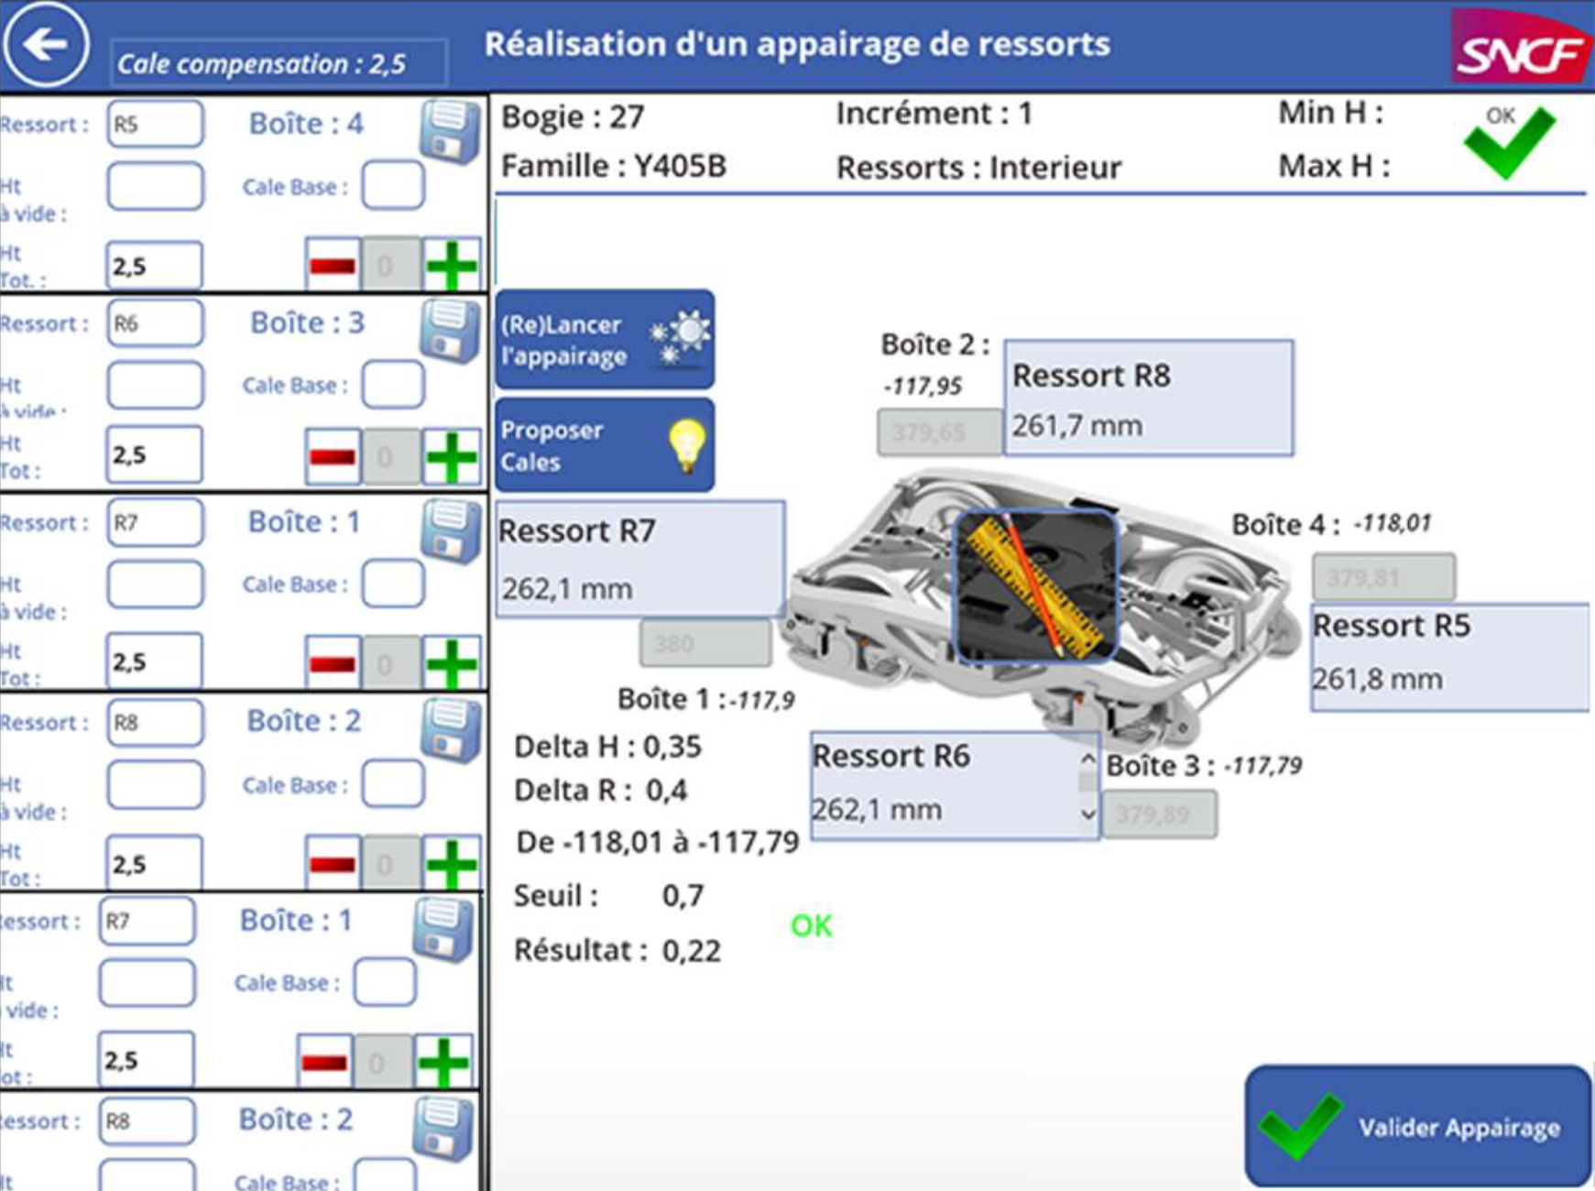
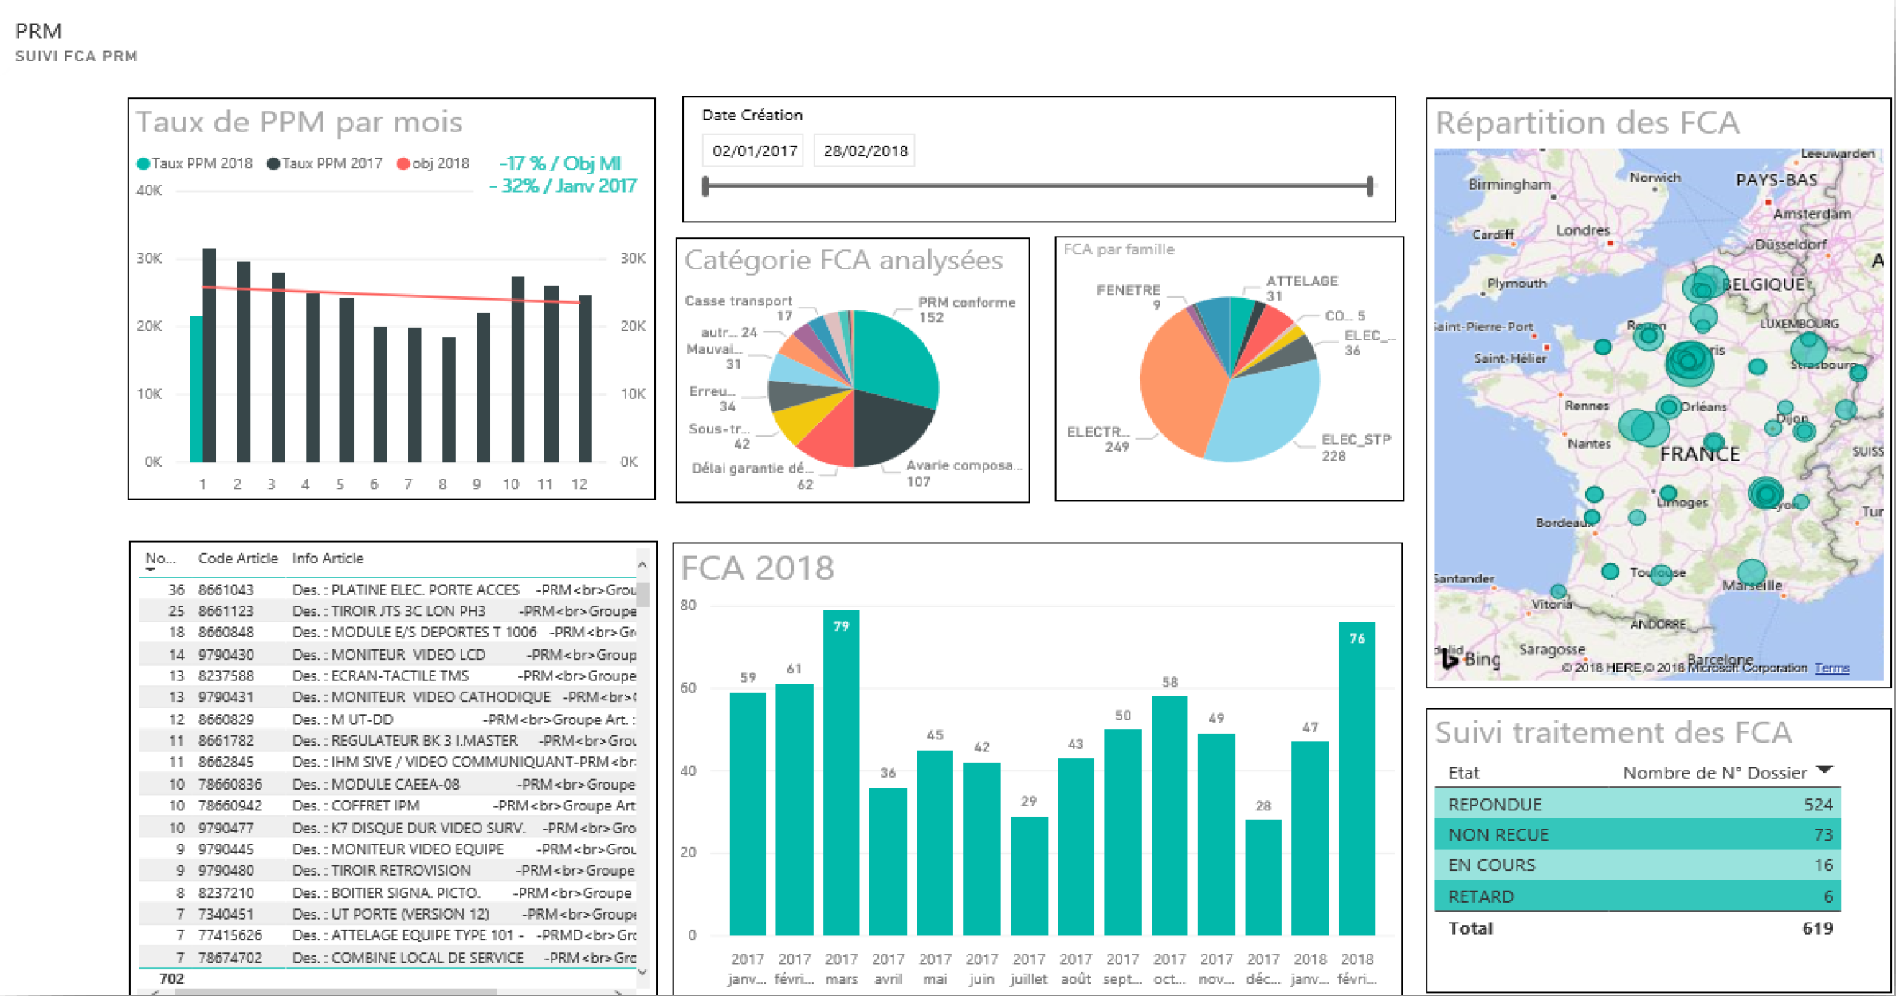
Maximize IT Investments and Reduce Risk – Results
Spring bogie pairing error rates reduced by 40–50%
Saved time and streamlined the repair process
Created data intelligence to get meaningful insights
Increased accountability and transparency
© Microsoft Corporation PowerApps
Notes:
Rémi Delarboulas, a digital adviser in the digital transformation team took the initiative to build a PowerApps application called Digi Bogies. The aim was to reduce the error rate and streamline the work required to perform this operation. The result is a very intuitive user experience that culminates in the app providing a list of recommendations and guidance around optimal spring placements.
The solutions were built using PowerApps, Microsoft Flow, Power BI and SharePoint. The app is currently used by 20+ workers within Remi’s factory with the possibility of deploying the app at the national level.
Factory workers use Digi Bogies to create a new project or search a list of existing active projects. Each project lists the type of chassis needing refurbishment and the current status of the project. Once a bogie chassis is selected, the app provides a list of recommended springs and allows the workers to select the one they see fit. Finally, the app allows the users to validate their selection according to well established technical specifications. All of the app data is stored in SharePoint and Power BI reports provide a real-time view of the progress in refurbishment of the bogie spring pairing process.
As a result of Remi’s efforts, SNCF has reduced spring bogie pairing error rates by 40 to 50 percent and they’ve saved time and streamlined the repair process. They now have data intelligence with Power BI dashboards which helps SNCF gain meaningful insights and helps increase accountability and transparency.
Given the success of the Digi Bogie app, Remi and his team went on to build many more apps used in various scenarios including supply chain management, client feedback management, and train inspection. Today, there are over 8 apps running in this particular technicenter with more coming online. Meanwhile Remi is working with his counterparts across France to share his experience with PowerApps and to deploy some of the key apps at the national level.

Slide 19
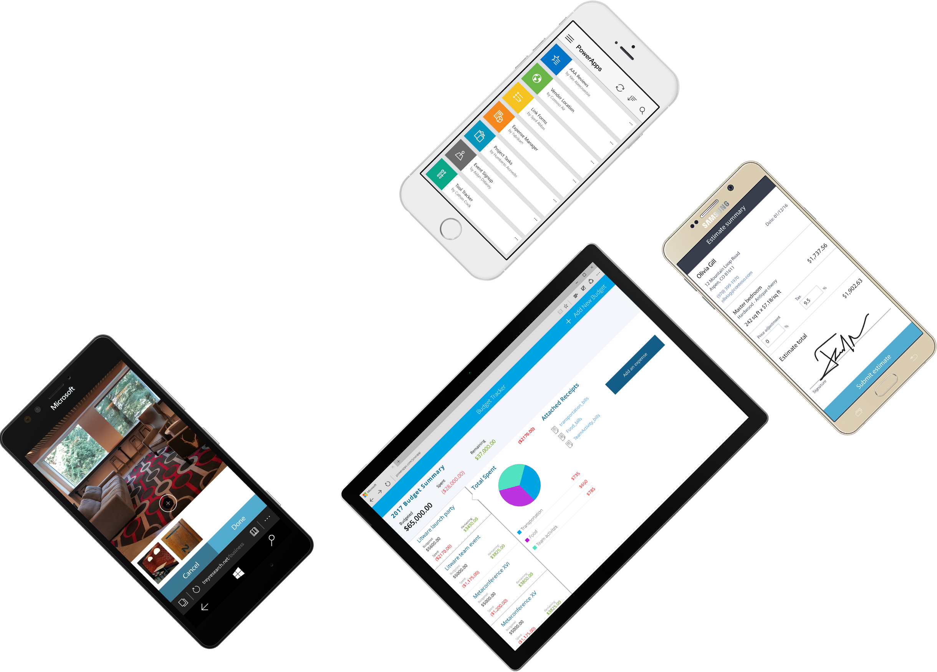

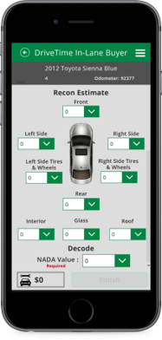
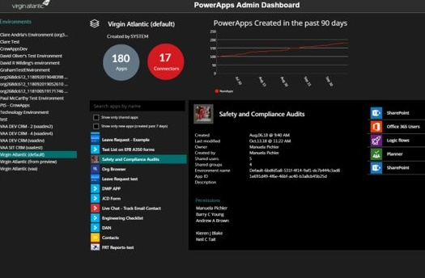
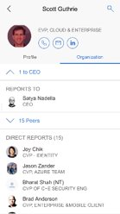
Introducing PowerApps
Rapidly build apps with point-and-click ease to automate business workflows and processes
web.powerapps.com
© Microsoft Corporation PowerApps
Notes:
With Microsoft PowerApps, you can empower your Firstline Workers – the ones who know your day-to-day workflow and process challenges best – with a software tool they can use to quickly build powerful apps to solve everyday challenges themselves – with absolutely no coding knowledge or development experience needed.
PowerApps is a low-code/no-code platform with a canvas-based point-and-click design approach that allows your business users to quickly connect to your data and automate your business workflows and processes with the ease of creating a PowerPoint presentation.
Best of all, you can get started with PowerApps today because it’s included in your Office 365 subscription.

Slide 20
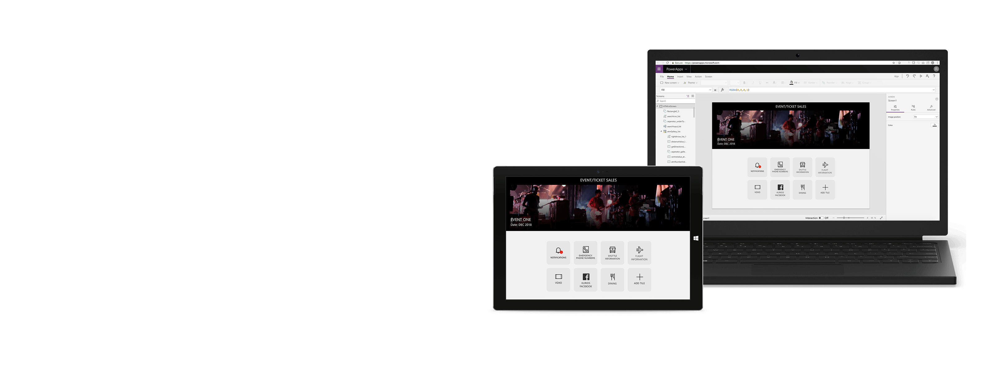

A unique approach to building business apps
Easily build apps with a full-featured low-code/no-code platform
Connect to all your data with pre-built connectors, custom connectors
Put your data to work with the Common Data Service for Apps
Office 365, Azure, Dynamics 365, Power BI, Microsoft Flow Integration
Strong enterprise governance & security
Pro-dev extensibility
© Microsoft Corporation PowerApps
Notes:
Easily build apps
Rich canvas-based authoring. Full creative freedom to place controls and craft user experiences with a PowerPoint-like canvas
“True WYSIWYG”: use the app while building it. Creators work with live data and can directly use the app as they work, getting instant feedback that helps build great user experiences faster and more intuitively for business developers.
Template apps for phone, tablet, and web. Get started quickly with pre-built apps covering common business development scenarios across devices and form factors, ranging from customer service to site inspections. PowerApps automatically connects to data source and imports the schema. The end result is a fully functional app connected to the user’s data.
Connect to any data
Connect your data with Common Data Service for Apps
Built-in connectors to more than 200 systems and services
Create custom entities to extend
Access data stored on-premises with the data gateway
Enterprise governance & security
Unified admin center provides comprehensive management across 1st party, 3rd party and custom apps in an AAD tenant or environment, including DLP, backup, and audit logs
Compliance with 13+ standards including HIPAA, EU Model Clauses, SOC and GDPR
Mobile Application Management/Model Device Management via Intune
Pro-dev extensibility
Visual Studio plugin, robust Azure integrations, and in-line serverless code amplify pro developer productivity at every step.
Robust APIs and SDK support. Hook into business processes and actions and pre- and post-processing and interface with client events.
Custom controls and connectors. Pro devs provide building blocks by bringing their any REST interface or custom UI control
Integration with Office 365, Azure, Dynamics 365, Power BI, Microsoft Flow
Tight integrations with SharePoint, Excel, Infopath, Access, Microsoft Teams that enables embedding PowerApps in the context of your productivity apps
Integration with Microsoft Flow for simple integration SaaS (iSaaS) integrations
Connection to Azure Functions for more complex external business logic and event based
Integration with Power BI that enables to embed Power BI dashboards in PowerApps and PowerApps apps in Power BI enabling insight to action scenarios

Slide 21
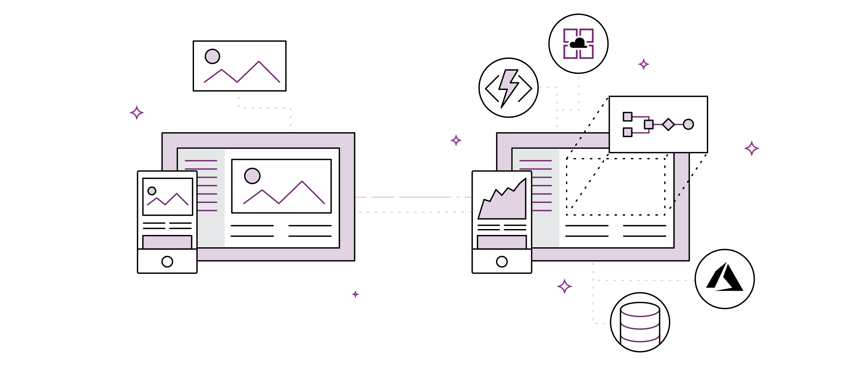
PowerApps Demo
© Microsoft Corporation PowerApps

Slide 22
Streamline Execution –
Opportunities
The journey from paper to digital
Demo Available in Live Drive
© Microsoft Corporation PowerApps

Slide 23


Total Economic Impact (TEI)
We used to have three full-time people writing reports. That’s now down to only one person
—CLIENT
In the first year we saved $500,000 in external developer costs. We expect to see similar savings in future years
—CLIENT
We reduced our time to quote from twelve days down to four
—CLIENT
70%
Less app dev cost
and effort
362%
ROI over 3-year term
<3 Months
Payback
Source: The Total Economic Impact™ Of PowerApps And Microsoft Flow, a commissioned study conducted by Forrester Consulting on behalf of Microsoft, June 2018
Source: The Total Economic Impact™ Of PowerApps And Microsoft Flow, a commissioned study conducted by Forrester Consulting on behalf of Microsoft, June 2018
© Microsoft Corporation PowerApps
Notes:
To better understand the benefits, costs, and risks associated with this investment, Forrester interviewed four customers using PowerApps and/or Flow. Interviewees said that by reducing application development time and empowering non-developers to create custom applications and workflows they were able to greatly reduce development costs and streamline business processes. These process improvements delivered business benefits such as reduced time-to-market, better customer service, and increased revenues.

Slide 24
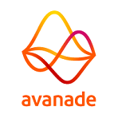





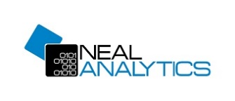



230+
Partners covering 70+ countries delivering solutions and consulting offerings
© Microsoft Corporation PowerApps
Notes:
Slide Objective:

Slide 25
Getting started with PowerApps
PowerApps plans for all your needs
PowerApps for Office 365
PowerApps Plan 1
PowerApps Plan 2
Customize and extend Office 365
PowerApps for Office 365 is included as part of your Office 365 subscription so you can start customizing and extending your Office 365 experience
Bridge digital gaps
If you want to connect to data in your technology stack (on-premises or cloud), to third-party cloud services, or to the Common Data Service for applications
Advanced management & control
If you want to digitize more complex business processes and workflows with increased governance and administration of your apps and full access to the Common Data Service for applications
© Microsoft Corporation PowerApps
Notes:
PowerApps is designed to be a no cliffs application development platform that supports a wide range of apps and use cases, from power users customizing and extending their Office 365 experience and data to developers creating apps that map complex business processes and work with large volumes of data in the Common Data Service for Applications.
The PowerApps portfolio of offerings supports this vision with plans that cover all the business needs of an organization:
• PowerApps for Office 365 extends Office 365 productivity scenarios with apps that connect to Office 365, other Microsoft cloud services, and standard data sources—these additional apps operate in the context of Microsoft 365.
• PowerApps Plan 1 enables users to create and run more advanced business apps that can connect to all your enterprise data (whether from custom applications, additional 3rd party cloud services, or on-premises) and take advantage of the Common Data Service for Apps to manage and operate business data and add more sophisticated logic to the apps. Plan 1 enables organizations to create rich business apps that operate beyond Microsoft Office 365 and Microsoft clouds.
• Power Apps Plan 2 allows organizations to develop apps that address scenarios with more complex business rules, workflows and code plug-ins. Plan 2 apps also provides access to more capabilities and capacity from the Common Data Service for Applications, including the ability to read and write restricted entities.

Slide 26
Microsoft Power platform
PowerApps
Power BI
Microsoft Flow
Dynamics 365
Common Data Service for Apps
Data Connectors
Azure
Office 365
Standalone Apps
© Microsoft Corporation PowerApps

Slide 27

It’s easy to
get started…
Learning resources at aka.ms/powerapps-resources
If you are an Office 365 customer, try PowerApps with Office 365
Start a free trial
© Microsoft Corporation PowerApps

