Slide 1
Partner instructions:
You can use this deck to help guide the Security Workshop in which you help the customer decide what Microsoft 365 Business deployment options to recommended for them.
At this point, the customer has already seen the Microsoft 365 Business Technical Deep dive workshop and should therefore know all details needed to make an educated decision with your help.
To avoid repetition, information about the product features is kept to a minimum (including references to prerequisites considered irrelevant for this discussion); instead, focus is on which options there are relevant, and what decisions have to be made.
Only the Microsoft 365 Business overview is repeated in this session for reference.

Slide 2
Version History & Updates
hidden slide
V | Date | Who | What
.03 | 07-12-2018 | David Bjurman-Birr | First public preview delivered.
NOTE: This is an early release preview. Please check http://aka.ms/bsecure for the updated release.
Please keep this page up to date!
Notes:
This deck is frequently updated with new insights and feedback from the field. Please keep version history up to date.

Slide 3
Security Workshop Microsoft 365 Business Secure Deployment Toolkit
Speaker name
<Partner Name>
Notes:
Welcome to the Microsoft 365 Business Security Worksho

Slide 4
Security Workshop Agenda
This session is intended to share, and capture, information that will help deploy and configure Microsoft 365 Business.
Microsoft 365 Business Overview
Microsoft 365 Tenant Security
Office 365 ATP
Windows Defender Exploit Guard

Slide 5
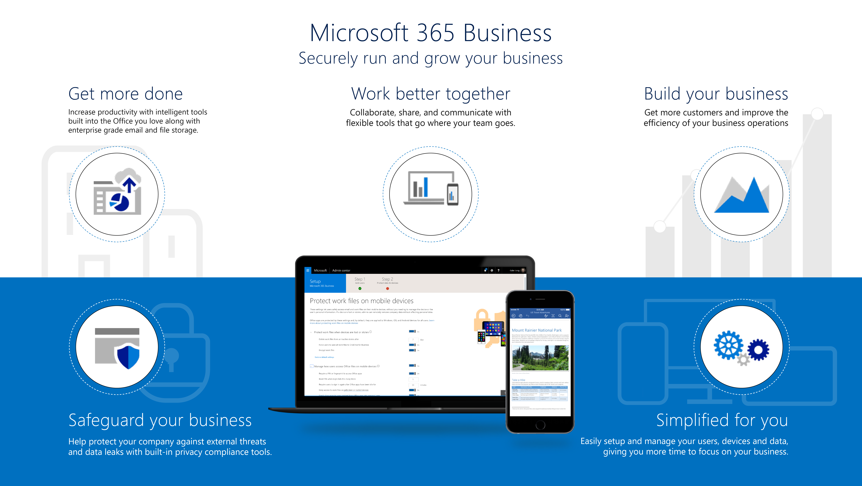
Notes:
Now before we dig into how to deploy Microsoft 365 Business, let us take a minute to review what Microsoft 365 Business delivers to your customers
With Microsoft 365 Business your customers can get more done with Intelligent tools built into the Office you love along with enterprise grade email and file storage
Your customer’s staff can work better together with the new Microsoft Teams and can collaborate as a group with their co-workers, customers and suppliers.
Microsoft 365 Business also includes specific business apps designed to help build the business- like Bookings and Outlook customer Manager for example. These help in acquiring customers and improving the efficiency of business operations​
Microsoft 365 Business safeguards your customer’s data by helping protect against external threats like phishing and malicious emails. It also includes features to help protect sensitive information like Social security numbers, credit card information etc from leaving the organization
Finally, you can easily enable all of these features along with simplifying device setup so you can unlock the value of your Microsoft 365 Business subscription faster
let’s take a deeper dive in to what you get with your Microsoft 365 Business Subscription

Slide 6
What’s new?
We’ve recently added advanced security features to Microsoft 365 Business to help businesses protect against cyberthreats and safeguard sensitive information (e.g. credit card nos., SSNs, etc.)
Cyber Threats
Safeguard Sensitive Information
Office 365 Advanced Threat Protection
Attachment scanning & ML detection to catch suspicious attachments
Link Scanning/Checking to prevent users from clicking suspicious links
Windows Exploit Guard Enforcement
Preventing devices from ransomware and malicious websites at device end points
Data Loss Prevention* Does Deep Content Analysis to easily identify, monitor, and protect sensitive information from leaving org
Azure Information Protection* Controls & Manages how sensitive content is accessed
Intune Availability Protecting data across devices with E2E Device and app management
Exchange Online archiving 100GB Archiving & preservation policies to recover data or remain compliant
BitLocker Enforcement Encrypt Data on devices to protect data if device lost or stolen
*While these are security features, they will be covered in detail in module 5.

Slide 7
Secure Score - Account
How will we secure the tenant?
Recommendations:
Decision | Description
DD-01 | Enable MFA for all admins
DD-02 | Enable MFA for all users
DD-03 | Enable mailbox owner auditing
DD-04 | Who will review reports?
DD-05 | Who will review privileged access?

Slide 8
Secure Score - Data
How will we secure the tenant?
Recommendations:
Decision | Description
DD-06 | Enable client rules forwarding block?
DD-07 | Enable audit data recording?
DD-08 | Enable additional mailbox auditing?
DD-09 | Disable external sharing?
DD-10 | Disable external SIP federation?

Slide 9
Secure Score - Device
How will we secure the tenant?
Recommendations:
Decision | Description
DD-11 | Enable mobile device management services?
DD-12 | Require mobile devices to use a password?

Slide 10
Security Workshop (O365 ATP) Agenda
This session is intended to share, and capture, information that will help configure the O365 ATP Solution for your deployment.
Architectural Overview
O365 Advanced Threat Protection
Anti-malware Policy
Anti-spam Policy
DKIM
ATP Safe Links
ATP Safe attachments
ATP anti-phishing

Slide 11
Protect – Mail Flow
Edge block | Authentication | Implicit intra-Org DMARC | AV Engines
Block before allowing in. | Standards SPF, DMARC, DKIM DKIM default signing. | Messages from one of your domains to one of your domains. Acts like DMARC, based on Intelligence. | Multiple engines scan mail for known malicious content.
Notes:
SPF (Sender Policy Framework):Sender Policy Framework (SPF) is a simple email-validation system designed to detect email spoofing by providing a mechanism to allow receiving mail exchangers to check that incoming mail from a domain comes from a host authorized by that domain's administrators. The list of authorized sending hosts for a domain is published in the Domain Name System (DNS) records for that domain in the form of a specially formatted TXT record. Email spam and phishing often use forged "from" addresses, so publishing and checking SPF records can be considered anti-spam techniques.
Domain-based Message Authentication, Reporting and Conformance (DMARC) is an email-validation system designed to detect and prevent email spoofing. It is intended to combat certain techniques often used in phishing and email spam, such as emails with forged sender addresses that appear to originate from legitimate organizations. Specified in RFC 7489, DMARC counters the illegitimate usage of the exact domain name in the From: field of email message headers. For more info: https://en.wikipedia.org/wiki/DMARC
DKIM: DomainKeys Identified Mail (DKIM) is an email authentication method designed to detect email spoofing. It allows the receiver to check that an email claimed to have come from a specific domain was indeed authorized by the owner of that domain.^{[1]} It is intended to prevent forged sender addresses in emails, a technique often used in phishing and email spam. For more info: https://en.wikipedia.org/wiki/DomainKeys_Identified_Mail

Slide 12
EOP - Anti-malware policy
Will you start with the default policy or custom policy?
Recommendations:
Start with default policy and monitor (keep it simple).
Avoid importing very complex rules from 3rd party systems.
Configure policy settings to your needs.
Decision | Description
DD-13 | Keep Default Policy or create custom policy.
DD-14 | Malware Detection Response? YES/NO and STANDARD/CUSTOM
DD-15 | Common Attachment Types Filter? ON/OFF
DD-16 | Sender Notification? INTERNAL/EXTERNAL/OFF
DD-17 | Administrator Notification? YES/NO
DD-18 | Custom Notification? YES/NO

Slide 13
EOP - Anti-spam policy
Will you start with using standard settings or custom settings?
Recommendations:
Start with standard settings.
Avoid importing very complex rules from 3rd party systems.
Closely monitor spam/bulk email.
Educate users on how to block/whitelist within Outlook.
For very sensitive customers, consider modifying the SCL (spam confidence level)—begin with an increment of “1”, and then monitor again.
Decision | Description
DD-19 | Enable Standard Settings? YES/NO (overrides Custom Settings)
DD-20 | Modify SCL level? – Value ?

Slide 14
EOP - DKIM
Enable DKIM for all your domains.
Decision | Description
DD-21 | Enable DKIM for all authoritative domains? YES/NO

Slide 15
ATP - Safe Links
Enable ATP Safe links for ALL users.
Decision | Description
DD-22 | Use Default ATP Policy? YES/NO
DD-23 | Is there need for a specific policy for dedicated recipients? YES/NO

Slide 16
ATP - Safe attachments
Enable ATP Safe attachments for ALL users.
Use redirect to capture samples of malicious files.
Scope by domain (use ctrl-A to select all) to enable entire org quickly.
Use Distribution Groups to ramp onboarding.
Turn on SharePoint Online, Teams and OneDrive for Business.
Recommendations:
Use Security and Compliance Center Real Time reports.
Use Quarantine for more detail on catch.
Decision | Description
DD-24 | Enable ATP Safe attachments for all users? YES/NO
DD-25 | Use redirect in Policy? YES/NO
DD-26 | Scope by domain? YES/NO
DD-27 | Ramp up using Distribution Groups? YES/NO
DD-28 | Turn on ATP for SharePoint, OneDrive, and Microsoft Teams? YES/NO

Slide 17
ATP - anti-phishing
Tune machine models tolerance for Phishing.
Recommendations:
Consider lowering the phish threshold for key users.
Decision | Description
DD-29 | Lowering Phishing threshold for key users? YES/NO

Slide 18
ATP - Additional Design Decisions
Review Exchange Transport Rules (ETRs)—Make sure IP/Domain allow rules include checks for authentication.
Recommendations:
Utilize the new reporting Add-in to gain insights.
For optimal protection against phishing and spoofing, implement all three authentication methods: SPF, DKIM, and DMARC.
Implement DMARC with p=reject.
Decision | Description
DD-30 | Enable check for authentication in ETRs? YES/NO
DD-31 | Make use of updated reporting add-in? YES/NO
DD-32 | Implement SPF, DKIM and DMARC? YES/NO
DD-33 | Implement DMARC with p=reject.
DD-34 | Use ETRs to Skip Safe Attachments/Safe Links
DD-35 | Create ETRs to skip ATP internally? YES/NO
Notes:
https://technet.microsoft.com/library/mt734386(v=exchg.150).aspx#DMARCbestpractices
https://www.microsoft.com/en-us/microsoft-365/blog/2015/01/20/enhanced-email-protection-dkim-dmarc-office-365/

Slide 19
Questions & Answers

Slide 20
Thank you!

Slide 21
© 2018 Microsoft Corporation. All rights reserved. Microsoft, Windows, and other product names are or may be registered trademarks and/or trademarks in the U.S. and/or other countries. The information herein is for informational purposes only and represents the current view of Microsoft Corporation as of the date of this presentation. Because Microsoft must respond to changing market conditions, it should not be interpreted to be a commitment on the part of Microsoft, and Microsoft cannot guarantee the accuracy of any information provided after the date of this presentation. MICROSOFT MAKES NO WARRANTIES, EXPRESS, IMPLIED OR STATUTORY, AS TO THE INFORMATION IN THIS PRESENTATION. Microsoft, Windows, Windows Server, Windows Server 2008 R2, Windows Server 2012 R2 are either registered trademarks or trademarks of Microsoft Corporation in the United States and/or other countries. Other products mentioned that are not trademarks include: PowerShell.

