Slide 1
Resiliency in Azure Business continuity and data protection
Author name
Date

Slide 2
Table of contents
Introduction
Technical overview
Reference architecture/design patterns
Components/capabilities
Performance/limitations
Deployment best practices
Maintenance/support
Partner solution offerings

Slide 3
What is Resiliency?
Not about avoiding failures, but responding to failures
Primary site
Primary site
Secondary site
Original
Backup
High availability
Disaster recovery
Backup
When your applications have a catastrophic failure, run a second instance
When your applications have a catastrophic failure, run them in Azure or a secondary datacenter
When your data is corrupted, deleted or lost, you can restore it
Notes:
Resiliency is the ability of a system to recover from failures and continue to function. It's not about avoiding failures, but responding to failures in a way that avoids downtime or data loss. The goal of resiliency is to return the application to a fully functioning state following a failure.
Three important aspects of resiliency are high availability, disaster recovery and backup.
High availability (HA) is the ability of the application to continue running in a healthy state, without significant downtime. By "healthy state," we mean the application is responsive, and users can connect to the application and interact with it.
Disaster recovery (DR) is the ability to recover from rare but major incidents: non-transient, wide-scale failures, such as service disruption that affects an entire region.
One way to think about HA versus DR is that DR starts when the impact of a fault exceeds the ability of the HA design to handle it.
When you design resiliency, you must understand your availability requirements. How much downtime is acceptable? This is partly a function of cost. How much will potential downtime cost your business? How much should you invest in making the application highly available? You also have to define what it means for the application to be available. For example, is the application "down" if a customer can submit an order but the system cannot process it within the normal timeframe? Also consider the probability of a particular type of outage occurring, and whether a mitigation strategy is cost-effective.
Data backup is a critical part of resiliency. If the stateless components of an application fail, you can always redeploy them. But if data is lost, the system can't return to a stable state. Data must be backed up, ideally in a different region in case of a region-wide disaster.
Backup is distinct from data replication. Data replication involves copying data in near-real-time, so that the system can fail over quickly to a replica. Many databases systems support replication; for example, SQL Server supports SQL Server Always On Availability Groups. Data replication can reduce how long it takes to recover from an outage, by ensuring that a replica of the data is always standing by. However, data replication won't protect against human error. If data gets corrupted because of human error, the corrupted data just gets copied to the replicas. Therefore, you still need to include long-term backup in your resiliency strategy.

Slide 4
Resiliency in the public cloud
Resiliency is a joint effort between customers and service providers
Customer’s responsibility
IaaS
PaaS
SaaS
Resiliency considerations
Database / data
High availability, DR, backup
Workload / application
High availability, DR, backup
Virtual Machine / OS
High availability, DR, backup
Storage
High availability, DR, backup
Networking
High availability, DR
Power / facility
High availability, DR
Service provider’s responsibility
Notes:
Building a reliable application in the cloud is different than building a reliable application in an enterprise setting. While historically you may have purchased higher-end hardware to scale up, in a cloud environment you must scale out instead of scaling up. Costs for cloud environments are kept low through the use of commodity hardware. Instead of focusing on preventing failures and optimizing "mean time between failures," in this new environment the focus shifts to "mean time to restore." The goal is to minimize the effect of a failure.
It’s also a joint responsibility between the service provider and the customer. It’s a joint responsibility to build a resilient application especially in an IaaS model. Customers have the responsibility to keep their virtual machines, applications and workloads, and data resilient.

Slide 5
Resiliency in Azure
Azure provides resiliency as a platform and solutions through globe’s largest datacenter footprint
Resiliency solutions customers can use
IaaS
PaaS
SaaS
Resiliency services in Azure
Database / data
Azure Backup, Azure SQL/MySQL Database
Workload / application
Azure Backup, Azure Site Recovery
Virtual Machine / OS
Availability Set. Azure Site Recovery, Azure Backup
Storage
Local/Zone/Geo redundant storage, Managed Disk
Networking
Region Pairs, Availability Zones, IP/Load Balancers
Power / facility
Region Pairs, Availability Zones, Availability Set
Azure resiliency as a platform
Notes:
Azure provides resiliency, as a platform and solutions through globe’s largest datacenter footprint.
Our (Microsoft’s) commitment is to create world’s most resilient environment for customers to build and host their applications.
Microsoft is committed in building resilient physical assets:
Multiple layers of physical protection from the perimeter to buildings to computer rooms
State-of-the-art security controls such as video coverage, biometrical authentication, verified single-person entry
Provisioning and maintenance of all the hardware.
Datacenter operations security and management:
Security operations center, with 24x7x365 security operations.
Comprehensive and quick incident assessments.
Continuous monitoring by security experts.
Cloud infrastructure security and management:
Secure multi-tenancy
DDos defense system
Data segregation and encryption
Customers have the responsibility to keep their virtual machines, applications and workloads, and data resilient.

Slide 6
Azure resiliency as a platform
Resilient from hardware, datacenter, and regional outages
Power / facility
Region Pairs, Availability Zones, Availability Set
Datacenter
Region
Data Residency boundary
Availability
Region
Region
Region 1
Region 2
Datacenter
Zone 1
Availability
Availability
Zone 1
Zone 2
Zone 3
Zone 1
Zone 2
Zone 3
Zone 2
Zone 3
Availability Sets
High Availability protection from hardware failures in a datacenter.
Availability Zones
High Availability protection against loss of datacenters. Multiple datacenters per physically separated zone. Each zone features independent network, cooling, and power.
Region Pairs
Protection for your data and applications from the loss of an entire region with Geo-redundant storage (GRS) and Azure Site Recovery.
Notes:
Availability Sets
High Availability protection from hardware failures in a datacenter.
Availability Zones
High Availability protection against loss of datacenters. Multiple datacenters per physically separated zone. Each zone features independent network, cooling, and power.
Region Pairs
Protection for your data and applications from the loss of an entire region with Geo-redundant storage (GRS) and Azure Site Recovery.

Slide 7
Azure resiliency as a platform
Availability Zones, protecting against datacenter outages
Power / facility
Region Pairs, Availability Zones, Availability Set
Datacenter
Region
Data Residency boundary
Availability
Region
Region
Region 1
Region 2
Datacenter
Zone 1
Availability
Availability
Zone 1
Zone 2
Zone 3
Zone 1
Zone 2
Zone 3
Zone 2
Zone 3
Resiliency with Data Residency
Availability Zones and a paired region within the same data residency boundary provides high availability, disaster recovery, and backup.
Protection against entire datacenter loss
Each zone is physically separated and consists of one or more datacenters with independent power, network, and cooling.
99.99% SLA for mission critical apps
High Availability supported with industry best SLA when two or more VMs are running in separate Availability Zones within a region.
Notes:
Resiliency with Data Residency
Availability Zones and a paired region within the same data residency boundary provides high availability, disaster recovery, and backup.
Protection against entire datacenter loss
Each zone is physically separated and consists of one or more datacenters with independent power, network, and cooling. Applications and data are replicated through zone-redundant services.
99.99% SLA for mission critical apps
High Availability supported with industry best SLA when two or more VMs are running in separate Availability Zones within a region.

Slide 8
Azure resiliency as a platform
Industry-leading high availability SLA
Power / facility
Region Pairs, Availability Zones, Availability Set
Industry-leading broadest choice of data residency
Industry-only
Industry-leading high availability SLA
VM SLA
VM SLA
VM SLA
Regions
99.9%
99.95%
99.99%
52
Data residency
Single VM
Availability sets
Availability zones
Region pairs
Protection with Premium Storage
Protection against failures within datacenters
Protection from entire datacenter failures
Protection from disaster with Data Residency compliance

Slide 9
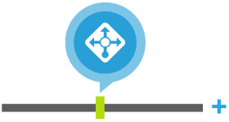
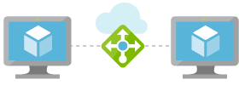
Azure networking resiliency solutions
Azure networking resiliency solutions
Networking
Region Pairs, Availability Zones, IP/Load Balancers
TCP Port 80
Simplify load balancing for applications Create highly-available and scalable applications in minutes supporting TCP/UDP-based protocols
High availability and robust performance for your applications Load Balancer automatically scales with increasing application traffic
Internal load balancer Use the internal load balancer for traffic between virtual machines inside your private virtual networks
Build highly reliable applications Automatically takes unhealthy instances out of rotation, and reinstates them when they become healthy again
Public load balancer
80
80
80
Web tier subnet
VM
VM
VM
Internal load balancer
1443
1443
1442
Database tier subnet
SQL
SQL
SQL
Notes:
Azure Load Balancer you can scale your applications and create high availability for your services. Load Balancer supports inbound and outbound scenarios, provides low latency and high throughput, and scales up to millions of flows for all TCP and UDP applications.
Load Balancer distributes new inbound flows that arrive on the load balancer's frontend to backend pool instances, according to rules and health probes.
Additionally, a public load balancer can provide outbound connections for virtual machines (VMs) inside your virtual network by translating their private IP addresses to public IP addresses.
https://docs.microsoft.com/en-us/azure/load-balancer/load-balancer-overview

Slide 10
Azure networking resiliency solutions
Zone-redundant virtual network gateways (preview)
Networking
Virtual network gateways
Your virtual network
Availability Zone 1
Zone-redundant virtual network gateways
Virtual gateways
99.99%
VM (zonal)
VM (regional)
Availability Zone 2
Cross-Premises Ingress traffic
VM (zonal)
Cross-Premises Egress traffic
Instance #1
Zone-redundant virtual network gateway
Availability Zone 3
VM (zonal)
Instance #2
Gateway Subnet
Notes:
https://docs.microsoft.com/en-us/azure/vpn-gateway/create-zone-redundant-vnet-gateway

Slide 11
Azure storage resiliency solutions
Azure storage provides replication options based on availability needs
Storage
Local/zone/geo redundant storage
LRS
ZRS
GRS
99.999999999% (11 9s)
99.9999999999% (12 9’s )
99.99999999999999% (16 9s)
Region
Availability
Region 1
Region 2
Zone 1
Availability
Availability
Zone 2
Zone 3
Locally redundant storage
The simplest, low-cost replication strategy that Azure Storage offers.
Zone-redundant storage
A simple option for high availability and durability.
Geo-redundant storage
Cross-regional replication to protect against region-wide unavailability.
Notes:
https://azure.microsoft.com/en-us/pricing/details/storage/
https://docs.microsoft.com/en-us/azure/storage/common/storage-redundancy

Slide 12
Azure compute resiliency solutions
Apply autoscaling to virtual machines for high availability
Virtual Machine / OS
VM Scale set (VMSS)
Load balancer standard
Reliably deploy and update at a large scale Deploy hundreds of identical virtual machines in minutes.
Scale automatically Use only the compute resources your application needs at any time.
Simplify networking Easily spread your workloads across the virtual machines in your Virtual Machine Scale Set.
Support hyperscale workloads Elastic to support your scale-out workloads—including stateless web front ends, container orchestration, and microservices clusters.
VNet
VM scale set
VM scale set
VM scale set
Zone 1
Zone 2
Zone 3
Load balancer standard
VNet
VM scale set (coming soon)
Zone 1
Zone 2
Zone 3
Notes:
Reliably deploy and update at large scale
You can confidently deploy hundreds of identical virtual machines in minutes. With easy updates at scale, focus more on what matters—your application—and less on the infrastructure.
Scale automatically
Integrated with Azure Insights Autoscale, Virtual Machine Scale Sets gives you true autoscaling. There’s no need to pre-provision virtual machines, so you use only the compute resources your application needs at any time.
Simplify networking
Virtual Machine Scale Sets integrate with Azure networking resources such as Azure Load Balancer and Application Gateway. Easily spread your workloads across the virtual machines in your Virtual Machine Scale Set, and configure network address translation (NAT) rules to connect to specific virtual machine instances for troubleshooting.
Support hyperscale workloads
Virtual Machine Scale Sets are elastic and designed to support your scale-out workloads—including stateless web front ends, container orchestration, and microservices clusters. Azure Container Service and Azure Service Fabric run on Virtual Machine Scale Sets.

Slide 13
Azure compute resiliency solutions
Backup your virtual machine without any infrastructure needs
Virtual Machine / OS
Azure Backup
Azure virtual machine
Azure backup service
VM agent
Application-aware snapshots (VSS)
Native backups for Windows/Linux
No specific agent installation required
Fabric-level backup with no backup infrastructure needed
Backup extension
Temporary disk
Data disk 1
Data disk N
OS disk
Data transfer
Vault
Snapshot
Notes:
When the Azure Backup service initiates a backup job at the scheduled time, the service triggers the backup extension to take a point-in-time snapshot. The Azure Backup service uses the VMSnapshot extension in Windows, and the VMSnapshotLinux extension in Linux. The extension is installed during the first VM backup. To install the extension, the VM must be running. If the VM is not running, the Backup service takes a snapshot of the underlying storage (since no application writes occur while the VM is stopped).
When taking a snapshot of Windows VMs, the Backup service coordinates with the Volume Shadow Copy Service (VSS) to get a consistent snapshot of the virtual machine's disks. If you're backing up Linux VMs, you can write your own custom scripts to ensure consistency when taking a VM snapshot. Details on invoking these scripts are provided later in this article.
Once the Azure Backup service takes the snapshot, the data is transferred to the vault. To maximize efficiency, the service identifies and transfers only the blocks of data that have changed since the previous backup.
https://docs.microsoft.com/en-us/azure/backup/backup-azure-vms-introduction

Slide 14
Azure application resiliency solutions
Ensure application availability with cloud-based disaster recovery
Workload / application
Source environment (East US)
Target environment (Central US)
storageaccount
storageaccountcacheasr
storageaccountasr
Site Recovery Replicates workloads running on Azure virtual machines (VMs) from a primary site to a secondary location.
When an outage occurs at your primary site, you fail over to the secondary location and access apps from there. After the primary location is running again, you can fail back to it.
Data flow
Disks
Disks
Cache data
Disks
Disks
Data flow
Azure Virtual Machine
Azure Virtual Machine
Failover ready
Site recovery extension mobility service
Site recovery extension mobility service
Availability set
Availability set
Subnet1
Subnet1
VNet
VNet
Notes:
https://docs.microsoft.com/en-us/azure/site-recovery/azure-to-azure-architecture

Slide 15
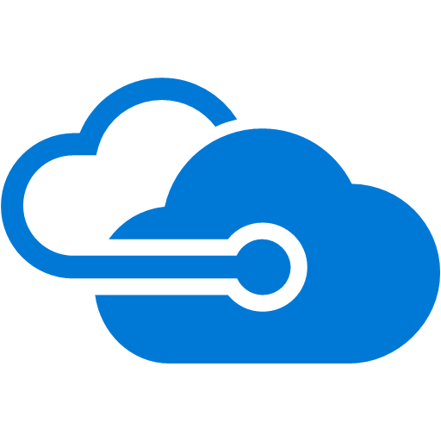
Azure database resiliency solutions
Backup your SQL database natively in Azure
Database / data
Azure Backup
Backup extension
Azure Backup Automatically discovers if a selected virtual machine is running SQL
Supports 15 minutes Recovery time objective (or RPO)
True point in time restore
Support for AG
Microsoft SQL Server
Microsoft SQL Server
SQL Native backups
Backup extension
Azure backup
Microsoft SQL Server
Backup extension

Slide 16
HERO products
Protect your data with Azure Backup
Azure Backup landing page: https://aka.ms/azure-backup
Azure Backup’s Cloud-First approach: https://aka.ms/azure-backup-cloud-first
Azure Backup blogs: https://aka.ms/azure-backup-blogs
Azure Backup videos: https://aka.ms/azurebackupvideos
Azure Backup documentation: https://aka.ms/azure-backup-documentation
Azure Backup support forum: https://aka.ms/azure-backup-support-forum
Feedback (user voice): https://aka.ms/azure-backup-user-voice
Ensure application availability with Azure Site Recovery
Support matrix for replicating one Azure region to another
Site Recovery documentation: https://aka.ms/siterecovery_documentation
Site Recovery blogs: https://aka.ms/siterecovery_blogs
Site Recovery Academy Course: https://aka.ms/siterecovery_mva
Support forum: https://aka.ms/asrforum
Feedback (user voice): https://aka.ms/ASRuservoice
Build high availability applications with Availability Zones
Visit the Azure regions page for availability: http://aka.ms/AzureRegions
Learn more about Availability Zones: http://aka.ms/AzureAZs
Build a comprehensive resiliency strategy: http://aka.ms/resiliency, http://aka.ms/AZoverview

Slide 17
Azure Site Recovery
Workload support in Azure Site Recovery
Workload / application
Azure Site Recovery
Workload | Replicate Azure VMs to Azure | Replicate Hyper-V VMs to a secondary site | Replicate Hyper-V VMs to Azure | Replicate VMware VMs to a secondary site | Replicate VMware VMs to Azure
Active Directory, DNS | Y | Y | Y | Y | Y
Web apps (IIS, SQL) | Y | Y | Y | Y | Y
System Center Operations Manager | Y | Y | Y | Y | Y
Sharepoint | Y | Y | Y | Y | Y
SAP Replicate SAP site to Azure for non-cluster | Y (tested by Microsoft) | Y (tested by Microsoft) | Y (tested by Microsoft) | Y (tested by Microsoft) | Y (tested by Microsoft)
Exchange (non-DAG) | Y | Y | Y | Y | Y
Remote Desktop/VDI | Y | Y | Y | Y | Y
Linux (operating system and apps) | Y (tested by Microsoft) | Y (tested by Microsoft) | Y (tested by Microsoft) | Y (tested by Microsoft) | Y (tested by Microsoft)
Dynamics AX | Y | Y | Y | Y | Y
Oracle | Y (tested by Microsoft) | Y (tested by Microsoft) | Y (tested by Microsoft) | Y (tested by Microsoft) | Y (tested by Microsoft)
Windows File Server | Y | Y | Y | Y | Y
Citrix XenApp and XenDesktop | Y | N/A | Y | N/A | Y
Notes:
https://docs.microsoft.com/en-us/azure/site-recovery/site-recovery-workload

Slide 18
Azure Backup
Comparing full, differential and incremental backup
Data
Azure Backup
Full backup, each backup copy contains the entire data source.
Differential backup stores only the blocks that changed since the initial full backup, resulting in a smaller amount of network and storage consumption.
Incremental backup achieves high storage and network efficiency by storing only the blocks of data that changed since the previous backup. With incremental backup, there is no need to take regular full backups.
A5
A9
A2, A3, A4, A5, A9
A2, A3, A4, A9
A2, A3, A4, A9
A5
Total space occupied
A4
A (A1, A2….,A10)
A3
A (A1, A2….,A10)
A (A1, A2….,A10)
A2
First backup
Second backup
Third backup
First backup
Second backup
Third backup
First backup
Second backup
Third backup
Full backup
Differential backup
Incremental backup
Notes:
https://docs.microsoft.com/en-us/azure/backup/backup-introduction-to-azure-backup

Slide 19
Designing resilient applications in Azure
Best practices in designing resilient Azure applications
Method of designing a resilient application https://docs.microsoft.com/en-us/azure/architecture/resiliency
Constructing a high available application in Azure https://docs.microsoft.com/en-us/azure/architecture/resiliency/high-availability-azure-applications
Backup and archive your application https://azure.microsoft.com/en-us/solutions/architecture/backup-archive-cloud-application/
Architecture of designing disaster recovery https://azure.microsoft.com/en-us/solutions/architecture/disaster-recovery-smb-azure-site-recovery/
Best practices in creating SAP/HANA with high availability and disaster recovery in place https://azure.microsoft.com/en-us/solutions/architecture/sap-s4-hana-on-hli-with-ha-and-dr/
Notes:
https://docs.microsoft.com/en-us/azure/architecture/resiliency
https://docs.microsoft.com/en-us/azure/architecture/resiliency/high-availability-azure-applications

Slide 20
Azure Backup
Partner opportunities
Deployment scenarios
Managed services
Packaged IP
Assessment and design
Compliance assessment
Design of Backup Infra for Private/Hybrid/Azure workloads
Long term retention to Cloud
Azure Backup Proof Of Concepts
Managing backup for LoB Apps
Manage LoB Hybrid & Azure environments
Configure and monitor backups
Recover on demand
Management IP
Pre-configured custom dashboards (PowerBI)
Automated backups, monitoring, alerting and logging
Workload backup and restore
Application-consistent backups for custom workloads
Pre and post scripts for Linux workloads
Backup-as-a-service
Azure Backup Consumption & Monitoring
SLA based backup and recovery experience
Migration
3rd Party to Azure Backup Migration

Slide 21
Azure Site Recovery
Partner opportunities
CSP support
API support
Azure Stack support
All ASR scenarios now support ARM and CSP model
Partner owns customer relationship and billing
Partner offers value added services
Model each customer to a subscription and a vault
Automation through PowerShell and Rest APIs
Restore configuration and service data using the Infrastructure Backup Service

Slide 22
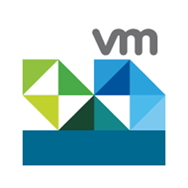
Partners solutions
Resiliency partner solutions in Azure

Slide 23
ISVs allow you to offer Azure for Offsite Backup to EVERYONE
Offsite Backup is REQUIRED – Why not do it better?
Data growth is explosive
63% of enterprises manage 50PB or more with 40-50% annual growth¹
Growth, cost, meeting protection needs, and migrations most painful²
51% of businesses admit their backup infrastructure cannot keep up³
Customers are not confident they can recover
36% are certain they would lose more than 24 hours of data⁴
Remote offices add further complexity
Azure offers test restores without impacting production
“Cold” data isn’t really cold anymore
Analytics and legal discovery mandate online data⁵
Tape is too expensive to meet these demands⁶
For your customer:
Long-term Retention
Granular recovery
Offsite requirement met
Gain restore in Azure
Yields for you:
Storage
Compute
ExpressRoute
Azure Services
(leveraging backups)
Notes:
Offsite backup and DR are an absolute requirement for every business – but it is one of their most painful and miserable tasks. Enter Azure which offers a better way. We can solve real problems and do so by co-existing with the customers existing backup, recovery, and DR platforms. Reduce data center footprint, allow selective migration to Azure, enable on-demand access to backup data, and end the cycle of equipment refresh and data migration.
1 http://www.enterprisestorageforum.com/storage-management/unstructured-data-growth-fueling-massive-migration-to-object-storage.html
2 https://www.networkworld.com/article/3200691/storage/most-acute-storage-pain-points-letdowns.html
3 http://www.enterprisestorageforum.com/backup-recovery/half-of-u.s.-businesses-are-bungling-their-backups.html
4 http://www.enterprisestorageforum.com/storage-management/storage-workloads-the-top-cloud-migration-targets.html
5 http://www.enterprisestorageforum.com/storage-services/the-cold-cloud-long-term-backup-storage-in-the-public-cloud-1.html
6 https://blog.hubstor.net/cloud-or-tape-for-long-term-data-storage

Slide 24
Why is Azure better for Backup and DR with ISVs?
Fiscal benefits
Pay-per-use
Never over purchase!
No large capital expenditures
Operational benefits
The last data migration
Goodbye capacity planning & procurement
Compute and Azure Services on-demand for recovery and legal discovery
Support cost effective recovery with compute, network, monitoring standing by
300% Growth with Backup ISVs in FY18!
Notes:
Backup and Recovery to Azure is one area where customers REALLY benefit from the traditional cloud value props like pay-per-use. On-demand resources mean they can recover machines and applications from backups or DR replicas whenever they need to without worrying about reserved or rented infrastructure. It gives them an affordable insurance policy and a platform to use for legal discovery and compliance assurance.

Slide 25
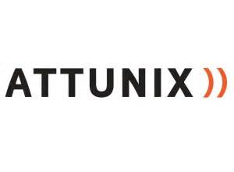
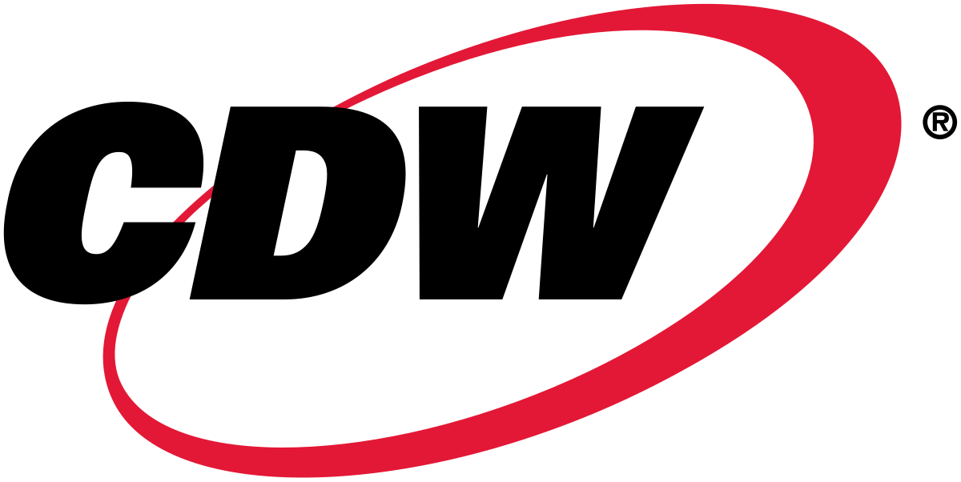
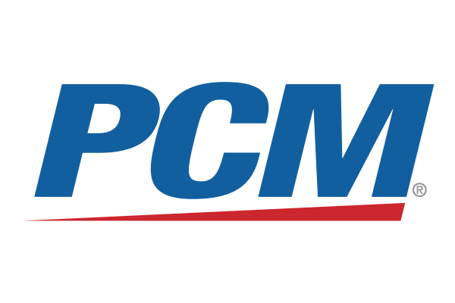
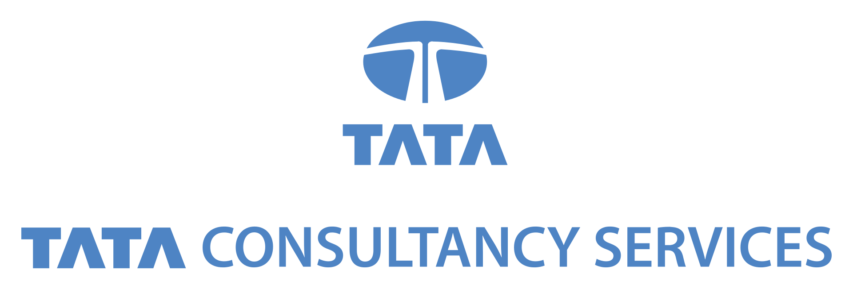
A Simple Process – Ask and attach
Attach to the incumbent
and
Land critical data in Azure
Step 1
Ask the customer what they use today
Step 2
Articulate why their solution is better “+ Azure”
Step 3
Engage the channel to drive and close
The customer is looking for a new solution?
- Position Azure Backup or Use the ISV Matrix -
Notes:
Our LSP and NSI partners have the existing reseller relationships and implementation practices to get your customer up, running, and consuming quickly. Use them to do the heavy lifting and drive ACA and ACR!

Slide 26
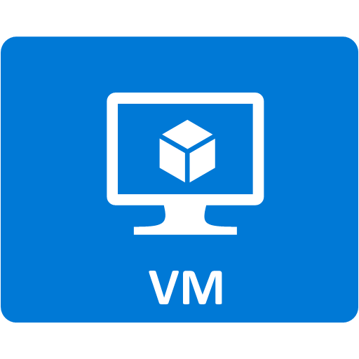
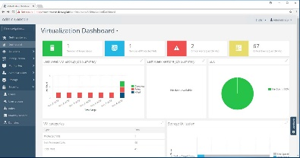
ISV Architecture
ISVs easily leverage Azure as a Backup Target
Customer managed backup storage and infrastructure
Customer subscription
Create and manage
On Prem
In Azure
Restore
Tiered Backup Storage
MediaAgent/Proxy
Backup data
Restore action
Target storage and resources
Add Storage Account(s) as Targets
*Indexing provides granular restores *Billing varies per monthly churn and restore patterns
*Deduplication reduces storage footprint *Some operational overhead to manage storage/MediaAgent/proxy in cloud
*Heterogenous application consistent protection *Restoration may require on prem connectivity or replica infrastructure in cloud
*Leverage Azure Storage Tiers through ISV policies
Notes:
Starting the process is easy and takes a few minutes. It leads to more than just storage consumption as ISVs require IaaS-based components to verify data and execute restore operations. Your customer has very little to learn and will find this to be very non-disruptive to their day-to-day routine. They can benefit from a best practices overview and the assistance of a skilled SI to help them get up and running smoothly and quickly, but the end-to-end process will not look very different from how they have always done things!

Slide 27
Backup to Azure Best Practices
Choose the right tier of storage
Cool Storage and Archive Storage impose penalties for early deletion (30/180 Days) – use for long term retention
Blob Storage offers lower transaction fees and should be used over GPv2 for active data sets like test restores
Reduce unnecessary transaction (TX) and egress fees
Turn off backup verification for copies sent to Azure (they were already verified on-premises)
If test restores are planned, execute them within Azure and from Hot Tier to reduce TX and Egress fees
Plan for restore operations
ISVs need running VMs and storage bandwidth to meet recovery windows
Do the math to determine the number of VMs and number of source storage accounts to meet their window

Slide 28
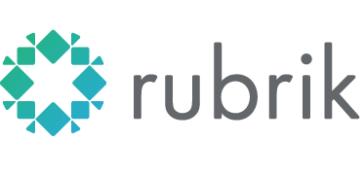
Top Backup and Disaster Recovery ISVs
See Appendix for full Backup, DR, and Archive ISV list
Gartner MQ Leader
Strategic alliance with Microsoft
Backup, Archive, DR
Protect On-premises & Azure machines & Azure optimized*
Global Deduplication
Does not support Archive tier**
Carla.ewing@veritas.com
Gartner MQ Leader
Highest level of Azure integration
Backup, Archive, DR
On-premises, Azure VMs, Azure SQL, BLOBs, Hdinsight
Deduplication
Does not offer low RPO DR
mblythe@commvault.com
Gartner Visionary
Fastest growing ISV #1 in Customer Sat^
Backup, Archive, DR
On-premises machines
Global Deduplication & content indexing
Near instant access
Cannot yet backup Azure VMs
jeff.garrett@rubrik.com
Not in 2017 MQ***
Industry buzz #2 in Customer Sat^
Backup & NAS
On-premises VMs & Files & Azure VMs
Global Deduplication & Production Storage
General purpose storage platform not specific to backup
pworsnop@cohesity.com
Gartner MQ Leader
Offers fast recovery of VMs to Azure
DR now Backup v8
Customers love agentless solution
Can migrate from AWS to Azure
Only supports VMs
Lacks search and index for item-level restores
jeff.shuey@zerto.com
Gartner MQ Leader
Leader in ISV co-sell & strong channel
Backup
VMs & Physical Servers
Require IaaS VMs 27/7/365
Do not support cost effective Blob storage
Jill.Wilkins@veeam.com
Notes:
* Cloud Catalyst optimizes transfers to Azure via dedupe, compression, and using Blob updates versus re-writes AND CloudPoint offers direct support for Azure VM Snapshots and is ACS-based
** As of July 2018
*** Expected to be in 2018 quadrant as visionary
^ Gartner customer reviews for Backup and Recovery Software - 2018

Slide 29
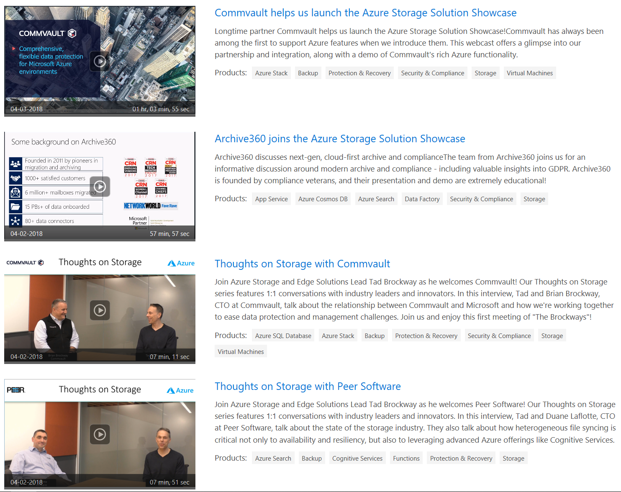
More resources at your disposal
OCP Catalog
ISV Videos on Azure Video Center
AzureStorageSales@Microsoft.com
Questions on opportunities and help with deals
AzureStorageDeals@Microsoft.com
Help with the largest multi-petabyte deals
AzureStorageFriends@ – Join Now
Technical questions
AzureBackupTechTalk
Azure Backup Technical and Sales Questions
Notes:
Speakers use this slide to identify content, related to their presentation, being offered in other sessions or labs at Microsoft Ready.
Your Track PM can provide a full listing of all of the sessions, Hands-on labs, Instructor-led Labs and Digital Ready Talks in your track, as well as the other tracks.
If you have questions, please contact your Track PM.

Slide 31
Azure and Backup Exec
Azure is the fastest growing cloud for Backup Exec
Backup, dedupe and DR to Azure cover the top customer use cases for cloud adoption
Azure Site Recovery extends Backup Exec Azure integration with tailored protection for each system per SLA-needs
Partner Opportunity: Serve top customer needs and drive Azure consumption with the combined solution

Slide 32
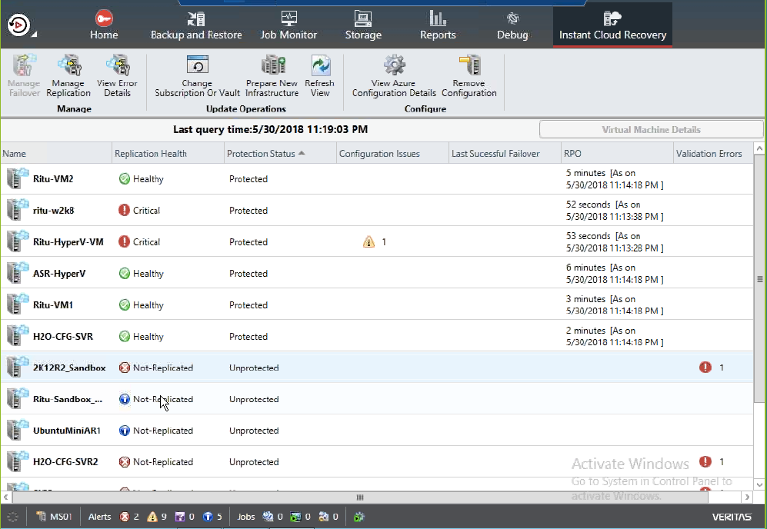
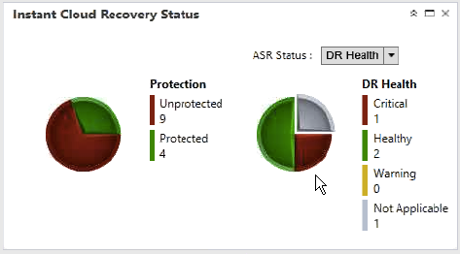
Protect all your data, not just some of it

Slide 33
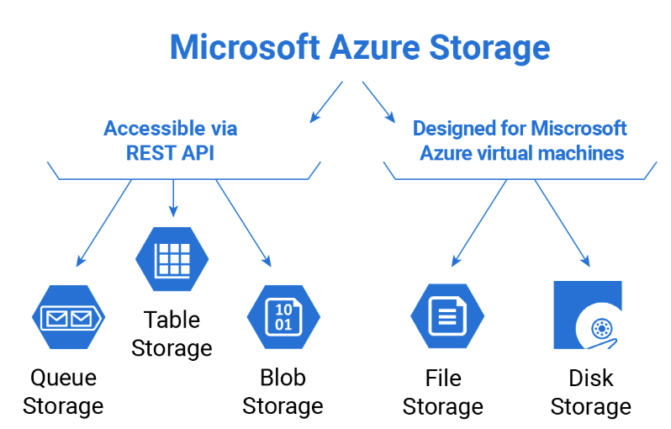
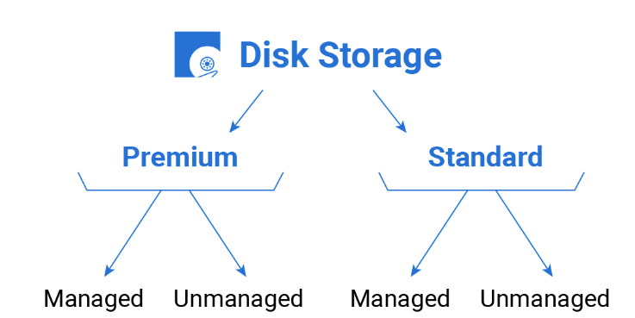
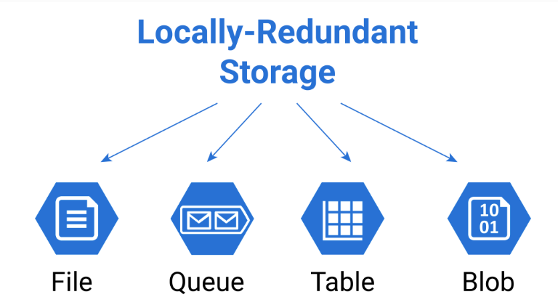
Azure storage options Azure provides options for your storage resiliency needs
Notes:
https://www.cloudberrylab.com/blog/microsoft-azure-storage-types-explained/

