Slide 1
Microsoft 365 Business
Sales Readiness Series
How to Pitch
Notes:
Hi and welcome back to the Microsoft 365 Business Sales Readiness series. Now that you have the broad vision for Microsoft 365 Business, it’s time for you to learn how to pitch it to your customers.
At the end of this session, I’m going to show you my 90-second elevator pitch that I personally developed so you can benchmark whether you’re better than me.
So let’s get started by meeting a real Microsoft 365 Business customer, Chad.

Slide 2
The reality of SMB today
50%
43%
50% more time in collaborative activities¹
37% of the global
workforce is mobile²
43% of cyber-attacks target small business³
¹ Harvard Business Review, January-February Issue 2016, ‘Collaborative Overload’
² Strategic Analytics, Global Mobile Workforce Forecast, 2015-2020, November 2015
³ Small Business Trends, CYBER SECURITY STATISTICS – Numbers Small Businesses Need to Know, Jan. 3, 2017
Notes:
Chad is facing a bunch of challenges. He’s about 30 years old, and he is not a techy type. He’s a creator. Those are his words, not mine. He’s on the road 4 months out of the year, he’s growing his company like mad crazy and isn’t quite sure how technology can help him and frankly he hadn’t thought about it until he and I managed to get in touch. I never once showed him this particular slide, but I know about these trends from research and it’s going to help me in my conversation with him.

Slide 3
Achieve more together
Create great work with Word, Excel, and PowerPoint
Meet Cortana, your new digital personal assistant
Connect with customers, coworkers, and suppliers
Bring together everything your team needs, in one place
Notes:
When Chad showed up in my office in Redmond, I started to talk to him about this solution that I thought might be able to help him grow his business. He didn’t know what that meant so he let me take him through it. I talked to him about achieving more together and he got that right away. It was about his productivity and being able to connect with his suppliers in China.

Slide 4
Anywhere it matters
Pillar 2
Work together with coworkers, from anywhere
Stay engaged with your teams, from your favorite device
No wifi, no problem. Edit offline and sync later
Take your work with you, with secure cloud storage
Notes:
I talked to Chad about productivity and collaboration anywhere it matters. Knowing that he was on the road for 4 months out of the year, it was critical that he have access to his files and can stay connected back to his business in Los Angeles without disruption.

Slide 5
Always-on security
Help protect against security threats
Safeguard company data across PCs, phones & tablets
Enable solid security, with simplified management
Get the latest Office 365 and Windows 10 updates
Notes:
Then I started talking to Chad about always-on security and this is pretty much where I lost him. It’s where we lose most SMB customers when talking about any product. Security is daunting and it seems that we have to engage an expert to be able to grasp it. Chad asked me what it meant to have always on security. I told him that it means that he able to protect his company data across devices both company owned and employee-owned. He immediately asked me what I meant by that so I gave him an example. I told Chad that it’s about introducing security that follows the user and protects the data on their device so that if someone loses their device, or leaves the organization, he can easily wipe all that data from it so it doesn’t fall into the wrong hands. Now this was not a scripted experience or interaction with Chad, but I could almost literally see the lightbulb go off in his head. He told me that he doesn’t trust his data with just anyone and as a result he only has given Office 365 to 4 people in his company. He said that he actually let go of one of those people who he just let into his inner circle and he was freaking out. He told me that went someone down to that person’s house to bang on the door and take their phone away from them to wipe his customer lists and email from their device.
I knew I had Chad right then, I told him that with Microsoft 365 Business he could wipe that former employee’s device so they couldn’t access his business’ information again.

Slide 6
Simplified for business
Quickly setup new employees to get them going
Manage users & devices with a single console
Simplify with a single login for all devices
Notes:
Now here’s where this experience could come crashing down. At the start of this, remember I said that Chad was not a techy type of person? Well he asked about how simple it was. Now back then I didn’t have a demo video like all of you have now, but I will tell you that the demo was super easy. We had a follow up call for about 25 minutes and Chad was fully setup. Now it doesn’t take 25 minutes to set up, it’s only about 10 minutes, but Chad had a bunch of questions and that extra time was spent teaching him about Microsoft Teams. Today he knows how to secure his data so the right people have access to it and he’s deployed Microsoft 365 Business out to all 25 employees. He’s better connected to what is going on in production, shipping, and is sleeping a bit better on his flights over to China to better grow his business.
Chad is the guy that didn’t know that he could do it, and now he can. You can as well… so here are my best practices in developing my pitch…

Slide 7
Know Your Customer
Need a pic
COLD:
How many employees do you have?
Are they all in one office?
Do you have sales people on the road or in multiple offices?
How do different departments interact?
WARM:
How often does your team collaborate on documents?
How often does your sales team work from the road?
What progress insights are you needing from your team and how often?
Notes:
Before you jump into a conversation, think about your customer. What do you know about their business and the way their business works?
This is all about ensuring you have enough background on your customer to identify which benefits of Microsoft 365 Business will resonate with them the most.
If you are preparing for a cold pitch – where you don’t have any background on the customer - plan on starting the conversation with questions like - How many employees do you have? Are they all in one office? Do you have sales people on the road or in multiple offices? How do different departments interact?
Now, if you are preparing for a warm pitch, reflect on similar questions based on the information you already know about your customer. You can use questions like: How often does your team collaborate on documents? How often does your sales team work from the road? What progress insights are you needing from your team and how often?
Answers to these questions will help you figure out which elements of Microsoft 365 to emphasize during your pitch.

Slide 8
One solution, designed for your business
Achieve more together
Anywhere it matters
Always-on security
Simplified for business
Notes:
Once you’ve gathered insights about your customer, it is time to introduce them to Microsoft 365. Use the customer pitch deck to learn how to talk to the four pillars of Microsoft 365:
Achieve More Together
Anywhere it Matters
Always-on Security
and Simplified for Business.

Slide 9
Find your customer story
Meet Chad
Chad needs simplicity
He needs to be able to work while travelling 4 months out of the year
He needs to get real-time insight from his production floor
He really wants to protect his customer lists
Notes:
The third thing is to use storytelling to resonate and reinforce the value with your customer.
This best practice will take your Microsoft 365 pitch to the next level. You can use my customer, Chad. He is on the Microsoft 365 Business web page and in the pitch deck so your customer can put a face to the name. But if you have your own that you want to use, think about the insights you know about your customer from my first best practice, and prepare to deep dive on a specific Microsoft 365 pillar (or pillars) that will resonate with them.
For example, if you know your customer has lots of sales people on the road, who need to work from tablets or mobiles, focus in on the Anywhere It Matters and Always-on Security pillars.
You could even communicate the Anywhere It Matters pillar to your customer by describing that their sales team can stay engaged with co-workers while on the move and never miss out on important documents and can keep such as files, calendars, email, and contacts up-to-date from anywhere. Tell your story around how employees on the road can create, edit, and share files anytime, from their PC, mobile phone, or tablet.
Because their sales team is constantly on the road, one thing’s certain—your customer will also need to be sure about security. So use the Always-on Security pillar to drive home the fact that with Microsoft 365 Business, your bustiness and customer data is stored in the same secured datacenters as Microsoft’s largest enterprise customers. Best of all, Microsoft 365 protects their company’s data across devices. So, if an employee leaves a laptop or cell phone on an airplane, you can immediately act so sensitive, or even any, business information won’t be at risk.

Slide 10
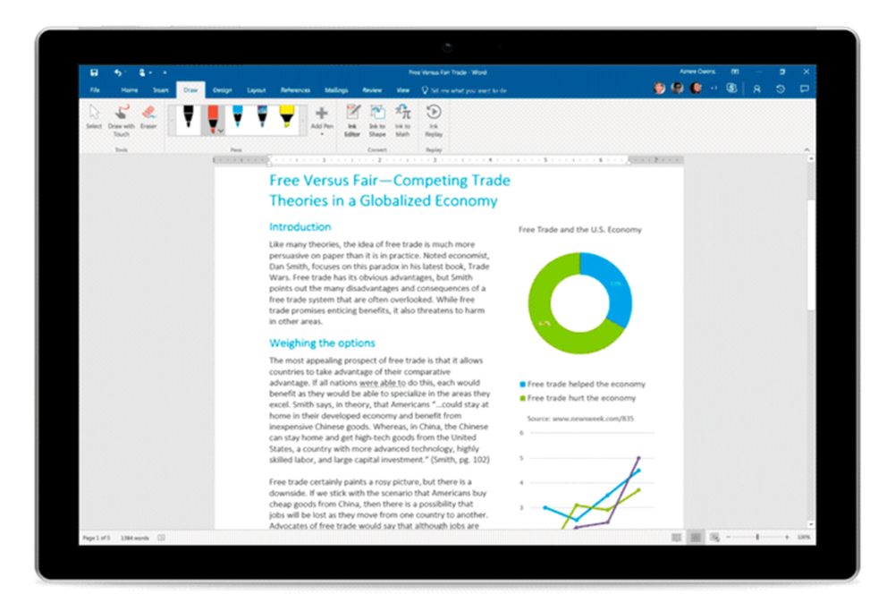
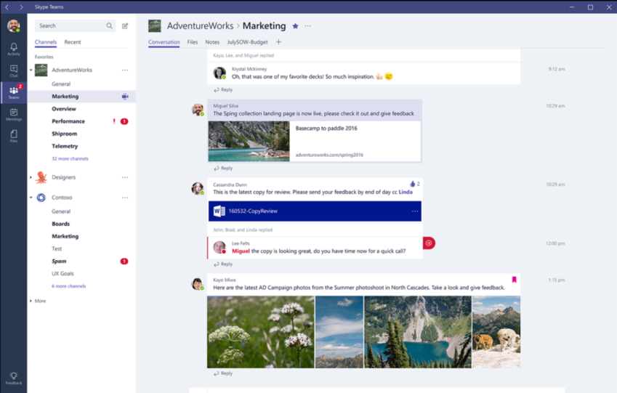
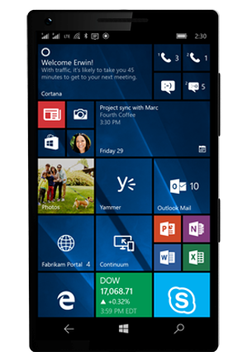
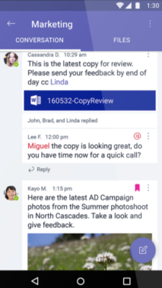
Demo
Incorporate a demo into your pitch
Get a demo tenant at http://demos.microsoft.com
Show the productivity and collaboration value
Notes:
Lastly, you should use a demo to show Microsoft 365 in action.
It’s so important to show it in action. You can end your pitch with a demo so your customer can see the features of Microsoft 365 working together.
Before giving the pitch to your customer, make sure you are set up with the Microsoft 365 demo tenant. That way, you can seamlessly access a demo environment.
Go to demos.microsoft.com to get set up. The set-up process is pretty quick and once your tenant is ready, you’ll be able to deliver effective demos that cover the full range of Microsoft 365 features on both desktop and mobile devices.
Alternatively, you can also use your own Microsoft 365 or Office 365 tenant to showcase many of the productivity apps. The real value is for the end user and showing them how Outlook or Teams can help them be more productive and work better together is so powerful.

Slide 11
Placeholder for Perfect Pitch
Notes:
And that’s it. Those are my Best Practices that will help you construct and deliver your own perfect pitch. Now I’m not saying I’ve perfected my own, but here’s my 90-second attempt at a perfect pitch. Since you never know when or where an opportunity to pitch Microsoft 365 Business to a potential customer could arise, practice doing this with your coworkers or friends. It took me awhile, but I managed to find someone who was willing to listen to my pitch over and over again. I really do love my mom… and she says that you’ll love my video too… Come back afterwards and I’ll have the list of resources for you to move on.

Slide 12
Next steps
→
Visit Microsoft365.com
→
Download the Pitch Deck
→
Prepare your elevator pitch
→
Practice, practice, practice!

Slide 13
Microsoft mission
Empower every person and every organization on the planet to achieve more

