Slide 1
Microsoft 365
Business Technical Series
Module 6: Ongoing Management
Presenter name
Date
Notes:
Welcome to module 6 of the Microsoft 365 Business technical series.

Slide 2
Microsoft 365 Business Deployment overview steps
Step 1
Step 2
Step 3
Step 4
Configure users
& policies
Deploy Office 365 Workloads & Clients
Deploy & manage Windows 10
Management & Troubleshooting
Notes:
<click>

Slide 3
Deployment Step 4 | Management & Troubleshooting
Step 1
Step 2
Step 3
Step 4
Configure users
& policies
Deploy Office 365 Workloads & Clients
Deploy & manage Windows 10
Management & Troubleshooting
Notes:
In this module we’ll be discussing management and troubleshooting.

Slide 4

Key takeaways
Understanding Microsoft 365 Business deployment step 4
  Device Actions
  User & Group Management
  How to Create an eDiscovery Case
  How to Search the Audit Log
  How to view DLP policy match reports
  How to view threat reports such as phish and malware
  Basic troubleshooting steps
  How to track an email
  How to manually sync Intune policies on a device
Notes:
These are the topics that we will be covering for deployment step 4.
(Need to clean up recording, notes were from a different module)

Slide 5

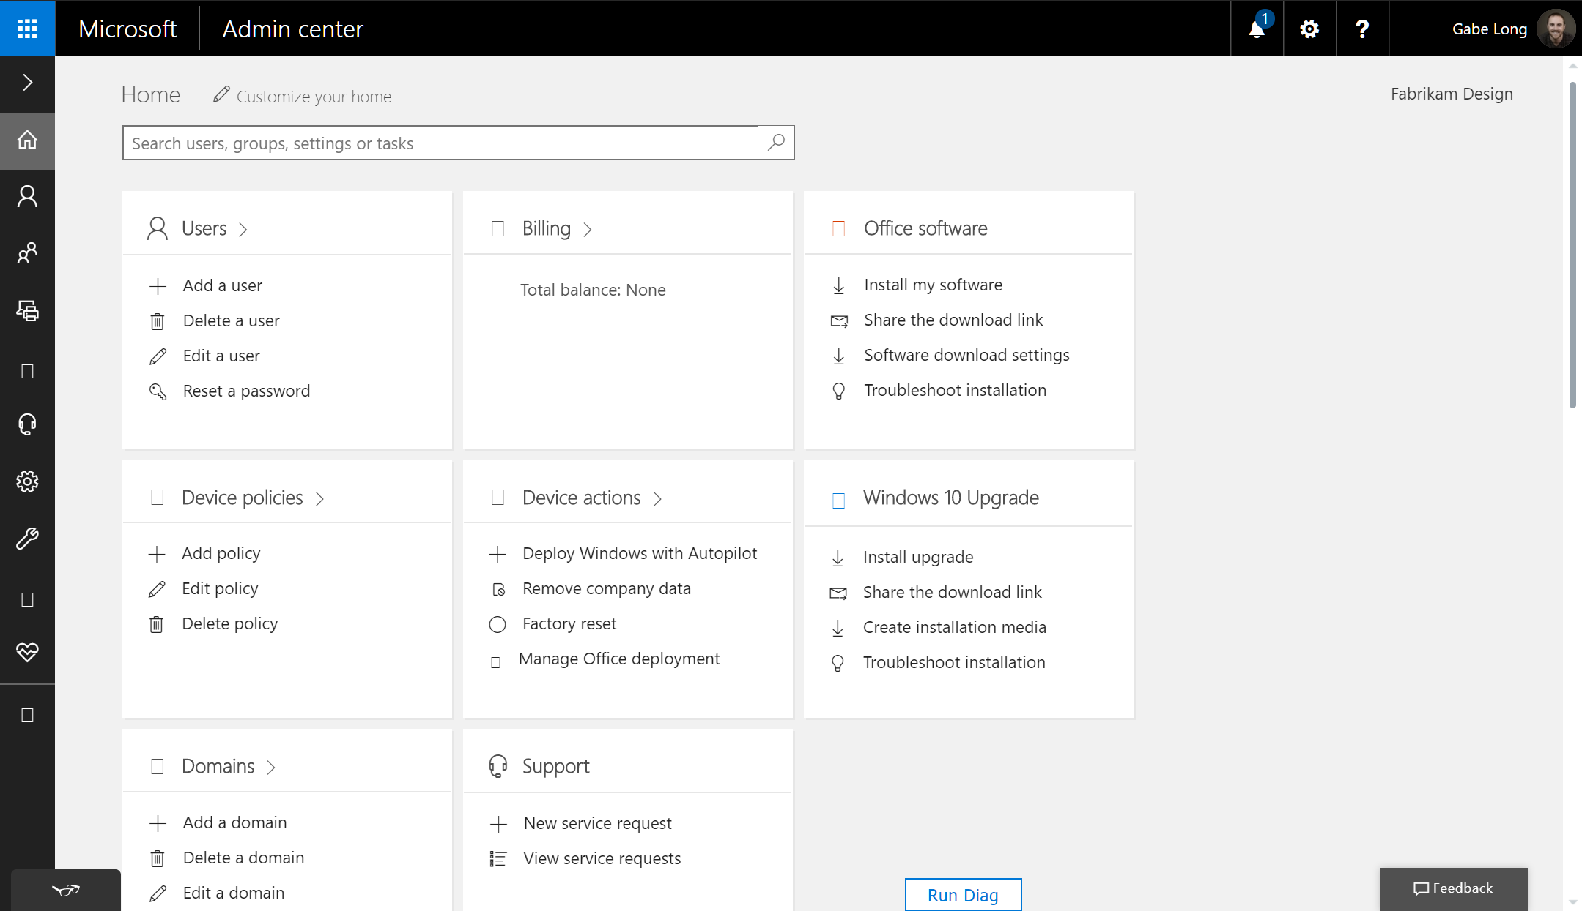
Management in Microsoft 365 Business
Notes:
Let’s begin by orienting ourselves in the Microsoft Admin Center. You’ll notice a direct mapping between three of four topic areas I just outlined and specific cards—one for users, and others for device policies and device actions. The fourth topic area maps to the Groups drop-down menu highlighted in the menu bar on the left. Together, they give you quick access to the full set of management capabilities in Microsoft 365 Business.
The policies that you create are specific to the device type and can be applied to specific groups of users. For example, this means that you could create one policy that applies to your executives and another that applies to everyone else.
For Android and iOS devices, you can add or edit application policies that protect Office apps and work files used by Office apps. You are able to control Windows 10 devices a bit more, so application policies can include additional settings, such as encryption and protection for network and cloud locations. You can also create device policies for Windows 10 devices that enforce settings like virus protection and automatic updates.
Let’s take a closer look now at each of these four areas. <click>

Slide 6
Demo:
Remote Wipe Business Data from a Lost Device
Notes:
NOTE TO PRESENTERS: Deliver the remainder of the content as a live demo. There are slide breaks for each of the four areas of management. These screenshot click-throughs are provided as your demo script but can also be used where access to the demo environment (demos.microsoft.com) is unavailable.

Slide 7
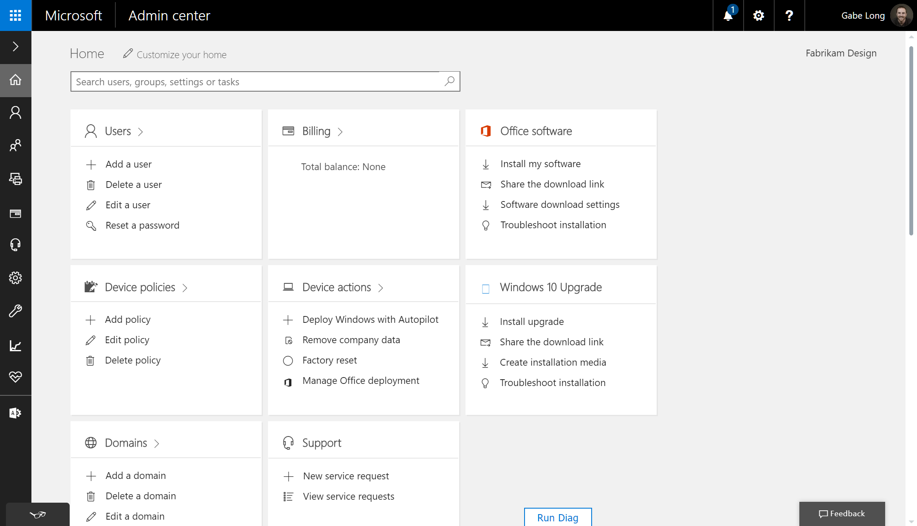
Device actions management
Notes:
We turn our attention to device actions management in Microsoft 365 Business.
Where Device policies is our go-to card for application management, Device actions is where we access important device management capabilities, including deployment using AutoPilot, the ability to remove company data from devices, resetting devices back to their factory settings, and managing the automatic installation of Office 365 applications on devices.
Since we covered the first and last of those in earlier modules, we’ll focus now on the middle two.
The ability to remove company data from a user’s device quickly is essential when a device is lost or stolen, but it’s also essential when a user chooses to leave the company and we need to delete company data from that user’s personal device.
Using Microsoft 365 Business enables you to safely remove your company data without impacting the user’s personal data.
The ability to quickly “factory reset” a device comes in handy when we want to repurpose a device to a new user.
A factory reset reverts a device to its original settings at the time of purchase.
All apps and data installed on the device after purchase are removed.
A device reset may be in order because someone left the company and his or her company-owned device is being passed on to to a new hire.
Or, as is often the case in SMBs, we might see an existing device get “handed down” as new devices are provisioned. <click>
<click>

Slide 8
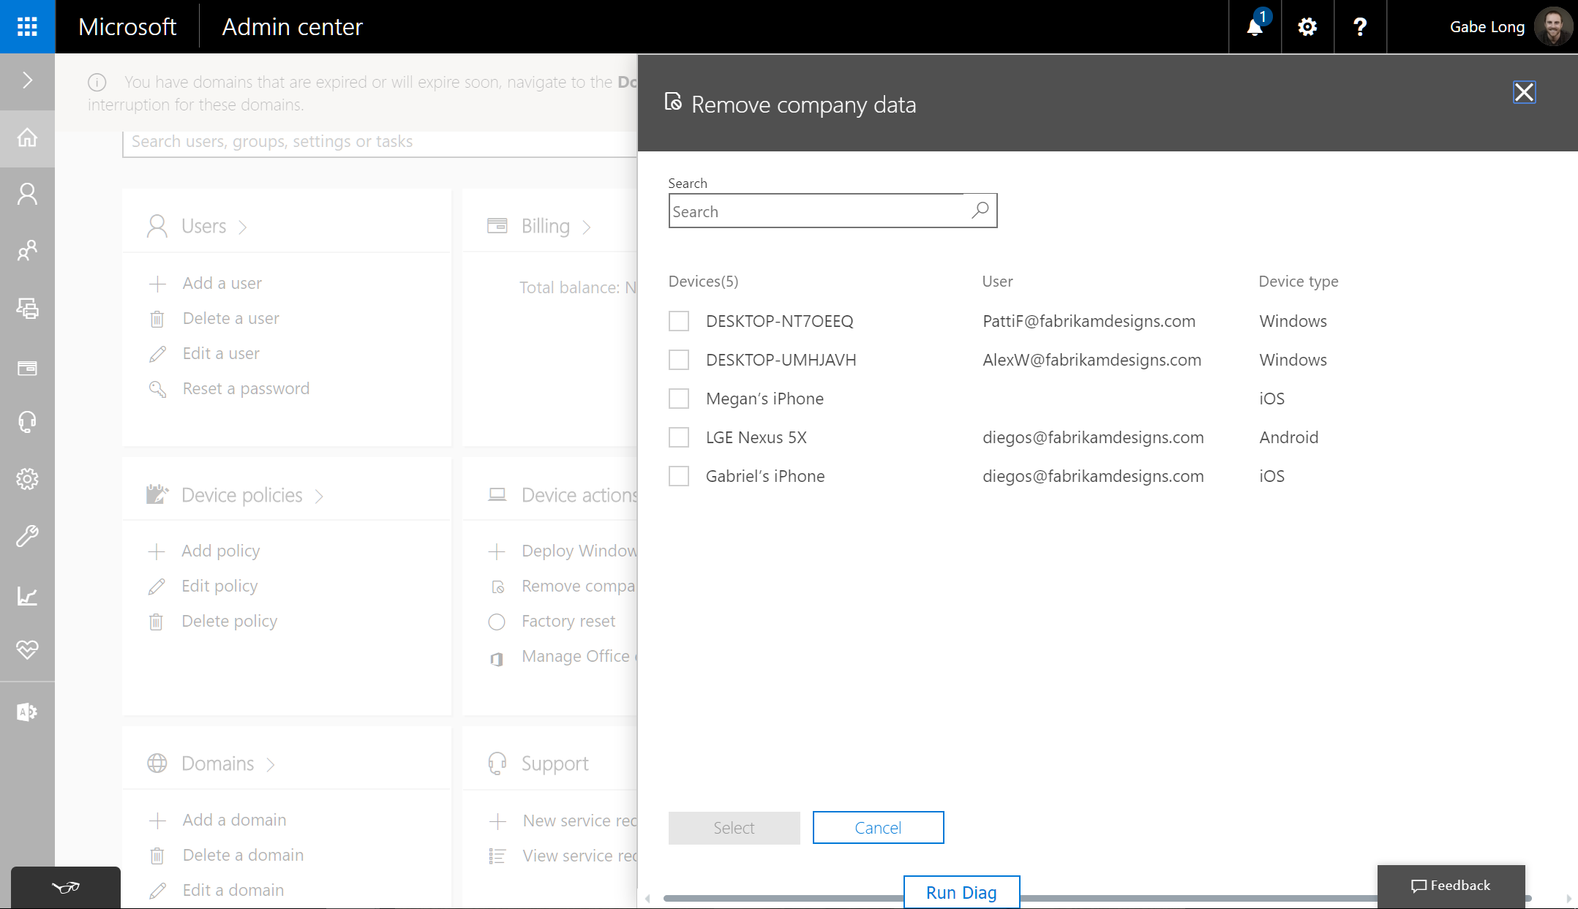
Device actions management
Notes:
Clicking Remove company data brings up our list of devices. Here, for example, we see two Windows 10 desktops that are under management, along with a few mobile devices. To remove company data, simply click the device and then click Select. Remember that if you remove company data from a device, you can’t restore it. Typically, a data wipe takes just three to five minutes. <click>

Slide 9
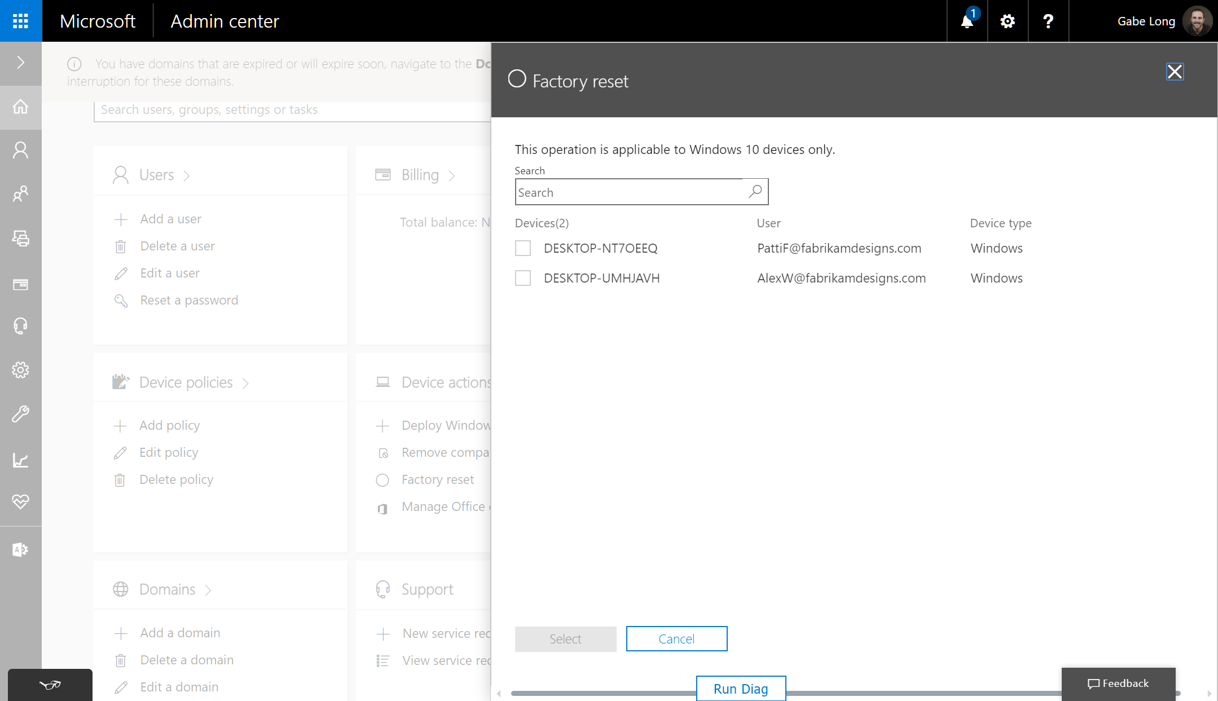
Device actions management
Notes:
Resetting a Windows device to factory setting—also known as wiping the Windows device—works pretty much the same way. Clicking Factory reset in the Device actions card, we see our two Windows 10 desktops. To wipe a device, simply check off that device and click Select. The next time that device comes online, the wipe will be completed.
As I mentioned a moment ago, a data or device reset typically takes three to five minutes from the time the action was initiated, assuming the device is online. Note that your managed devices are set to automatically check in every eight hours. If you make a change, however, from the Admin Center, as we just did, it typically takes up to 45 minutes for that change to be deployed on the device. It is possible, however, to manually sync a Windows device from the device itself. Under Settings > Accounts > Access school or work, click the AAD account icon, click Info, and then click Sync. <click>

Slide 10
Management in Microsoft 365 Business
Notes:
Let’s begin by orienting ourselves in the Microsoft Admin Center. You’ll notice a direct mapping between three of four topic areas I just outlined and specific cards—one for users, and others for device policies and device actions.
The fourth topic area maps to the Groups drop-down menu highlighted in the menu bar on the left. Together, they give you quick access to the full set of management capabilities in Microsoft 365 Business.
The policies that you create are specific to the device type and can be applied to specific groups of users. For example, this means that you could create one policy that applies to your executives and another that applies to everyone else.
For Android and iOS devices, you can add or edit application policies that protect Office apps and work files used by Office apps.
You are able to control Windows 10 devices with more settings, so application policies can include additional settings, such as encryption and protection for network and cloud locations.
You can also create device policies for Windows 10 devices that enforce settings like virus protection and automatic updates.
Let’s take a closer look now at each of these four areas. <click>

Slide 11
Demo:
Manage Users and Groups
Notes:
Let’s take a quick look at managing groups and users.
NOTE TO PRESENTERS: Deliver the remainder of the content as a live demo. There are slide breaks for each of the four areas of management. These screenshot click-throughs are provided as your demo script but can also be used where access to the demo environment (demos.microsoft.com) is unavailable.

Slide 12
Group management
Notes:
Group management is accessed via the menu list on the left side.
You create groups to apply different policy levels to different users.
For example, you may want managers to be able to save docs to their local device, but you want everyone else limited to only saving data to SharePoint and OneDrive for Business. <click>

Slide 13
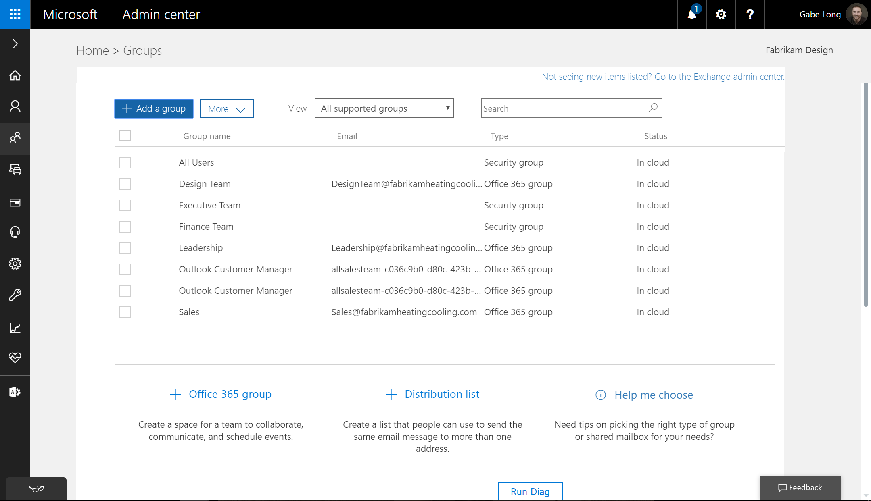
Group management
Notes:
Clicking Groups from the left menu brings us to this page, where you can see and manage existing groups and create new groups. Let’s begin by adding a group. In this example, we’ll use the Add a group button at the top. <click>

Slide 14
User management
Notes:
The user management capabilities available to you in Microsoft 365 Business provide options to add and delete users, edit user information, and reset user passwords. <click>

Slide 15
User management
Notes:
Adding a user is fast and easy. Just click Add a user. <click>

Slide 16
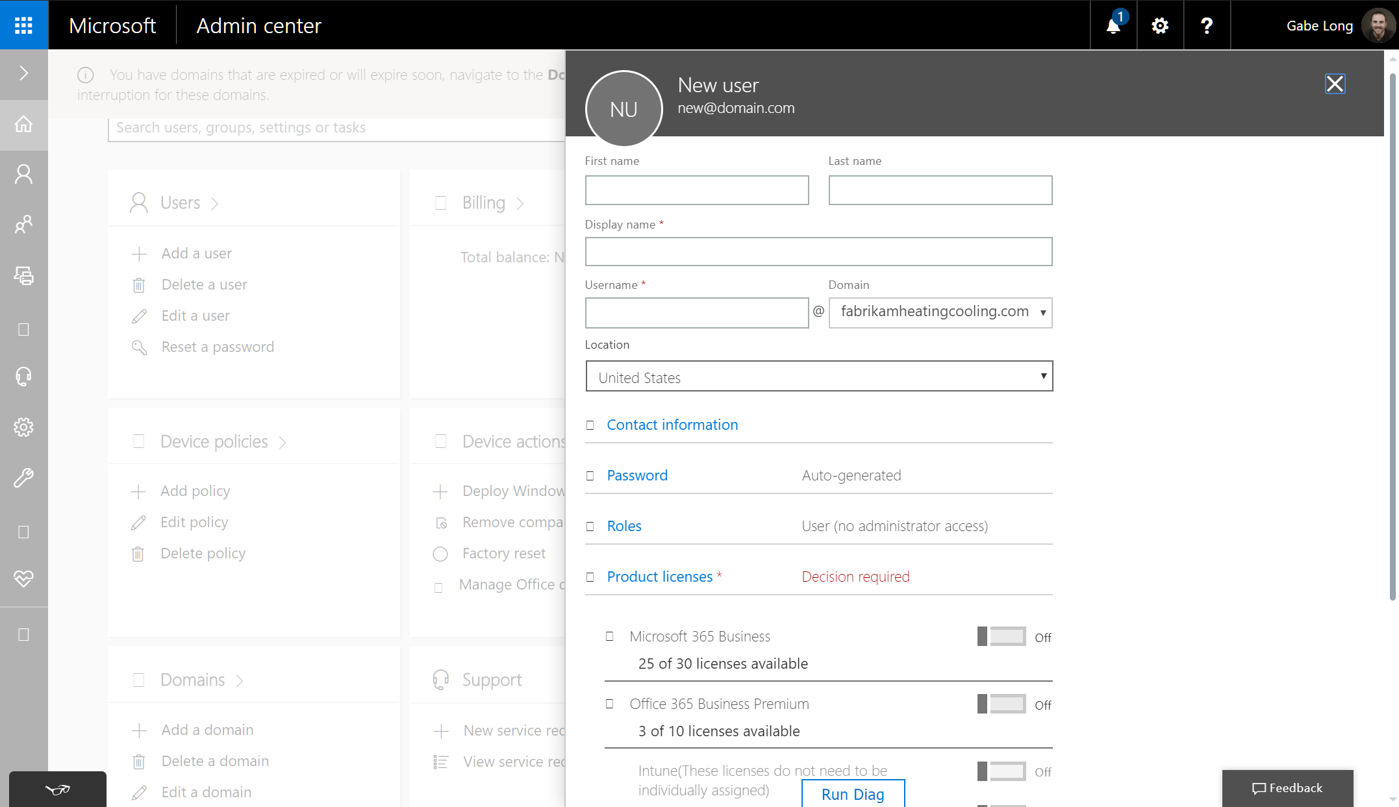
User management
Notes:
…. Enter the user’s name, company name, and contact information. <click>

Slide 17
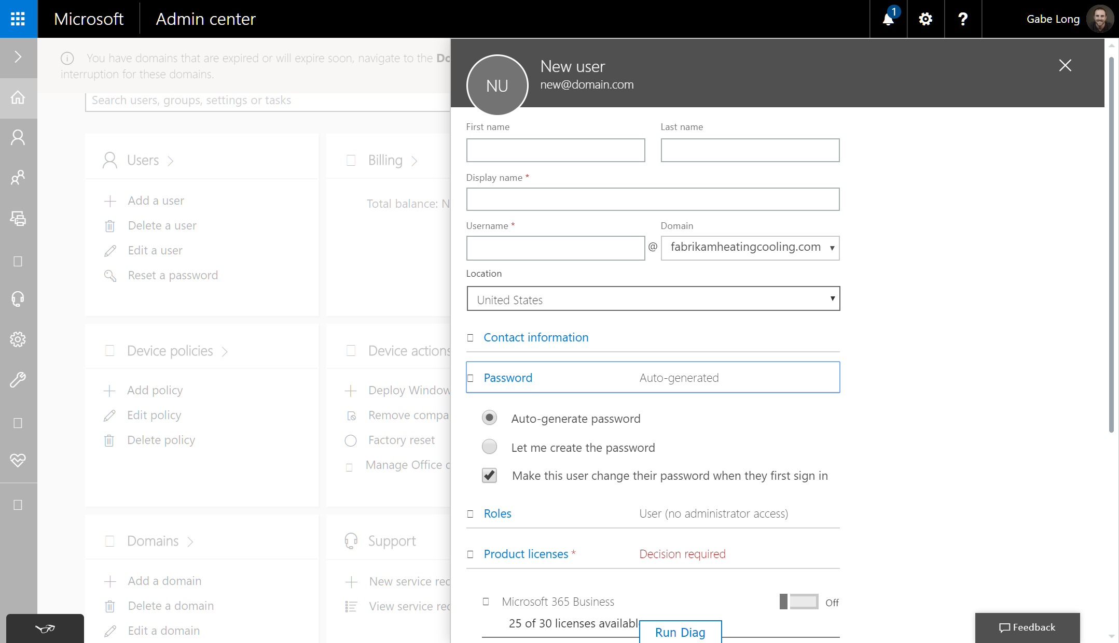
User management
Notes:
You also have two options for determining the user’s password—one can be auto-generated, and you can set one yourself. After you complete all your selections and click Add at the bottom, you’ll see a confirmation page which allows you to send the username and password to as many as five email addresses.
In addition, you can force the user to set a new password on first sign-in. <click>

Slide 18
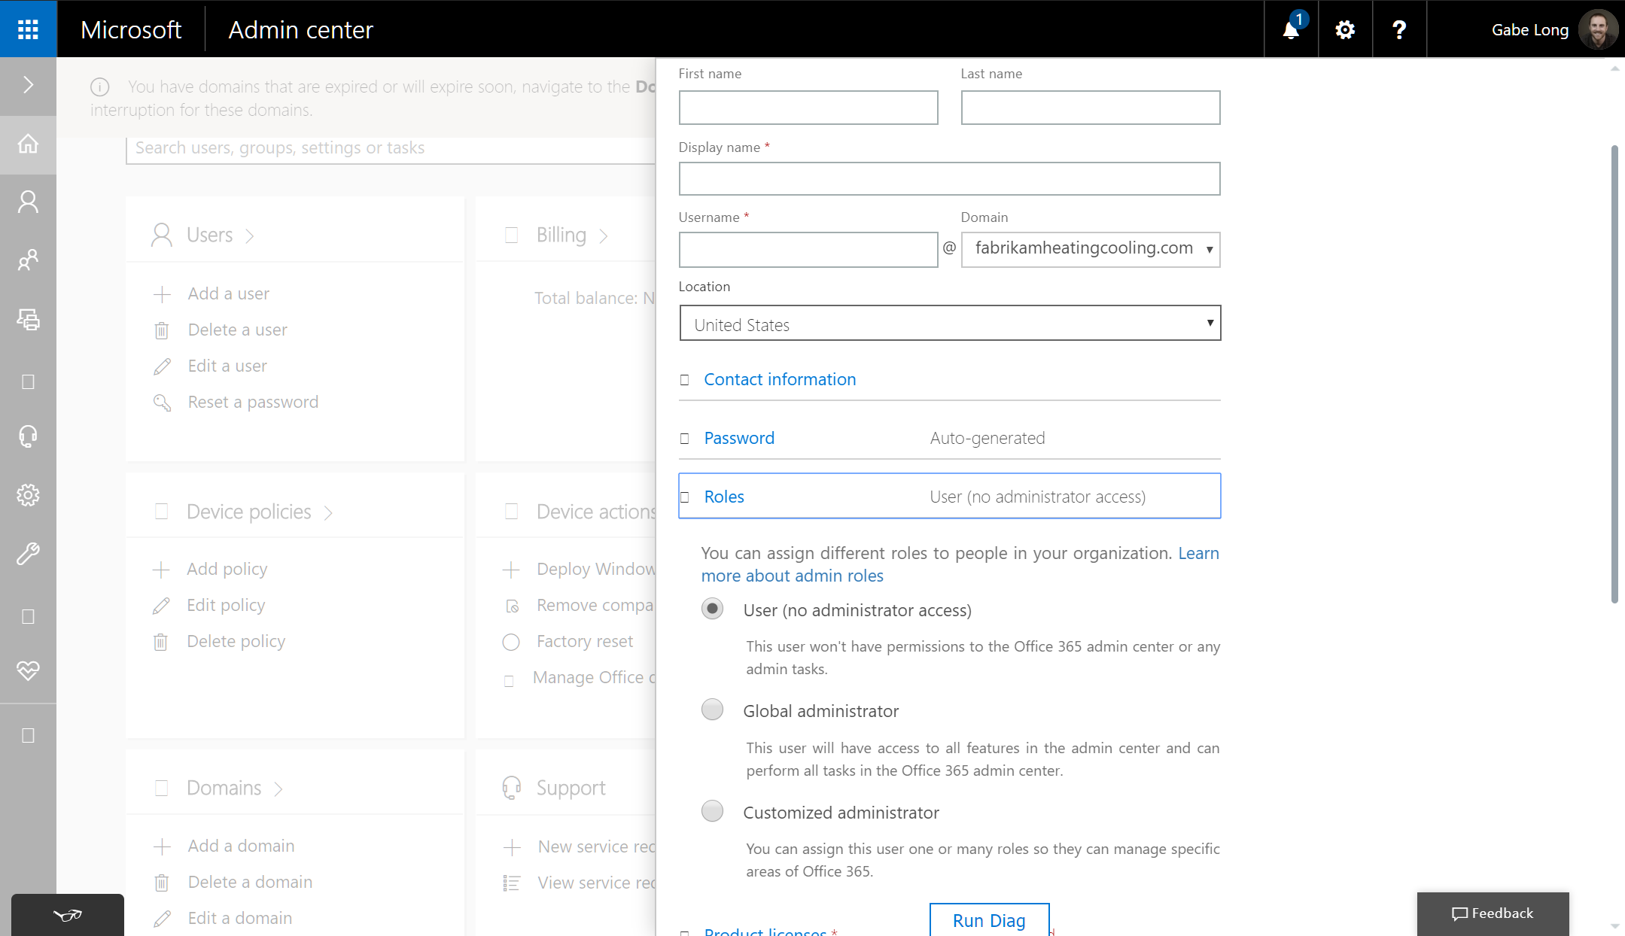
User management
Notes:
User setup also allows you to select one of three roles for each user. As a User, the end user has no admin privileges—that’s likely to be your most common choice. At the other end of the spectrum, choosing Global administrator will give the user full admin privileges. Finally, you can create a Customized administrator role. <click>

Slide 19
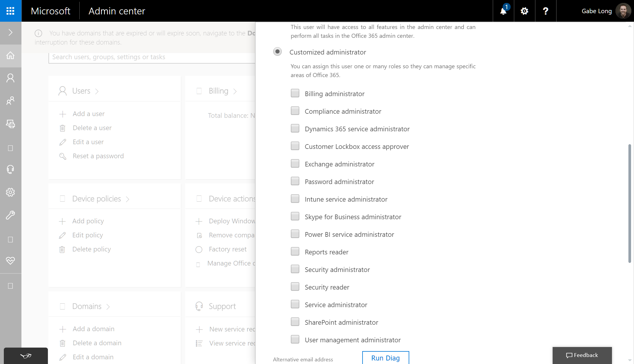
User management
Notes:
Choosing the Customized administrator role provides a further set of admin privilege options. For example, you can allow a user—let’s say the owner of the company—to manage billing, users, or passwords. <click>

Slide 20
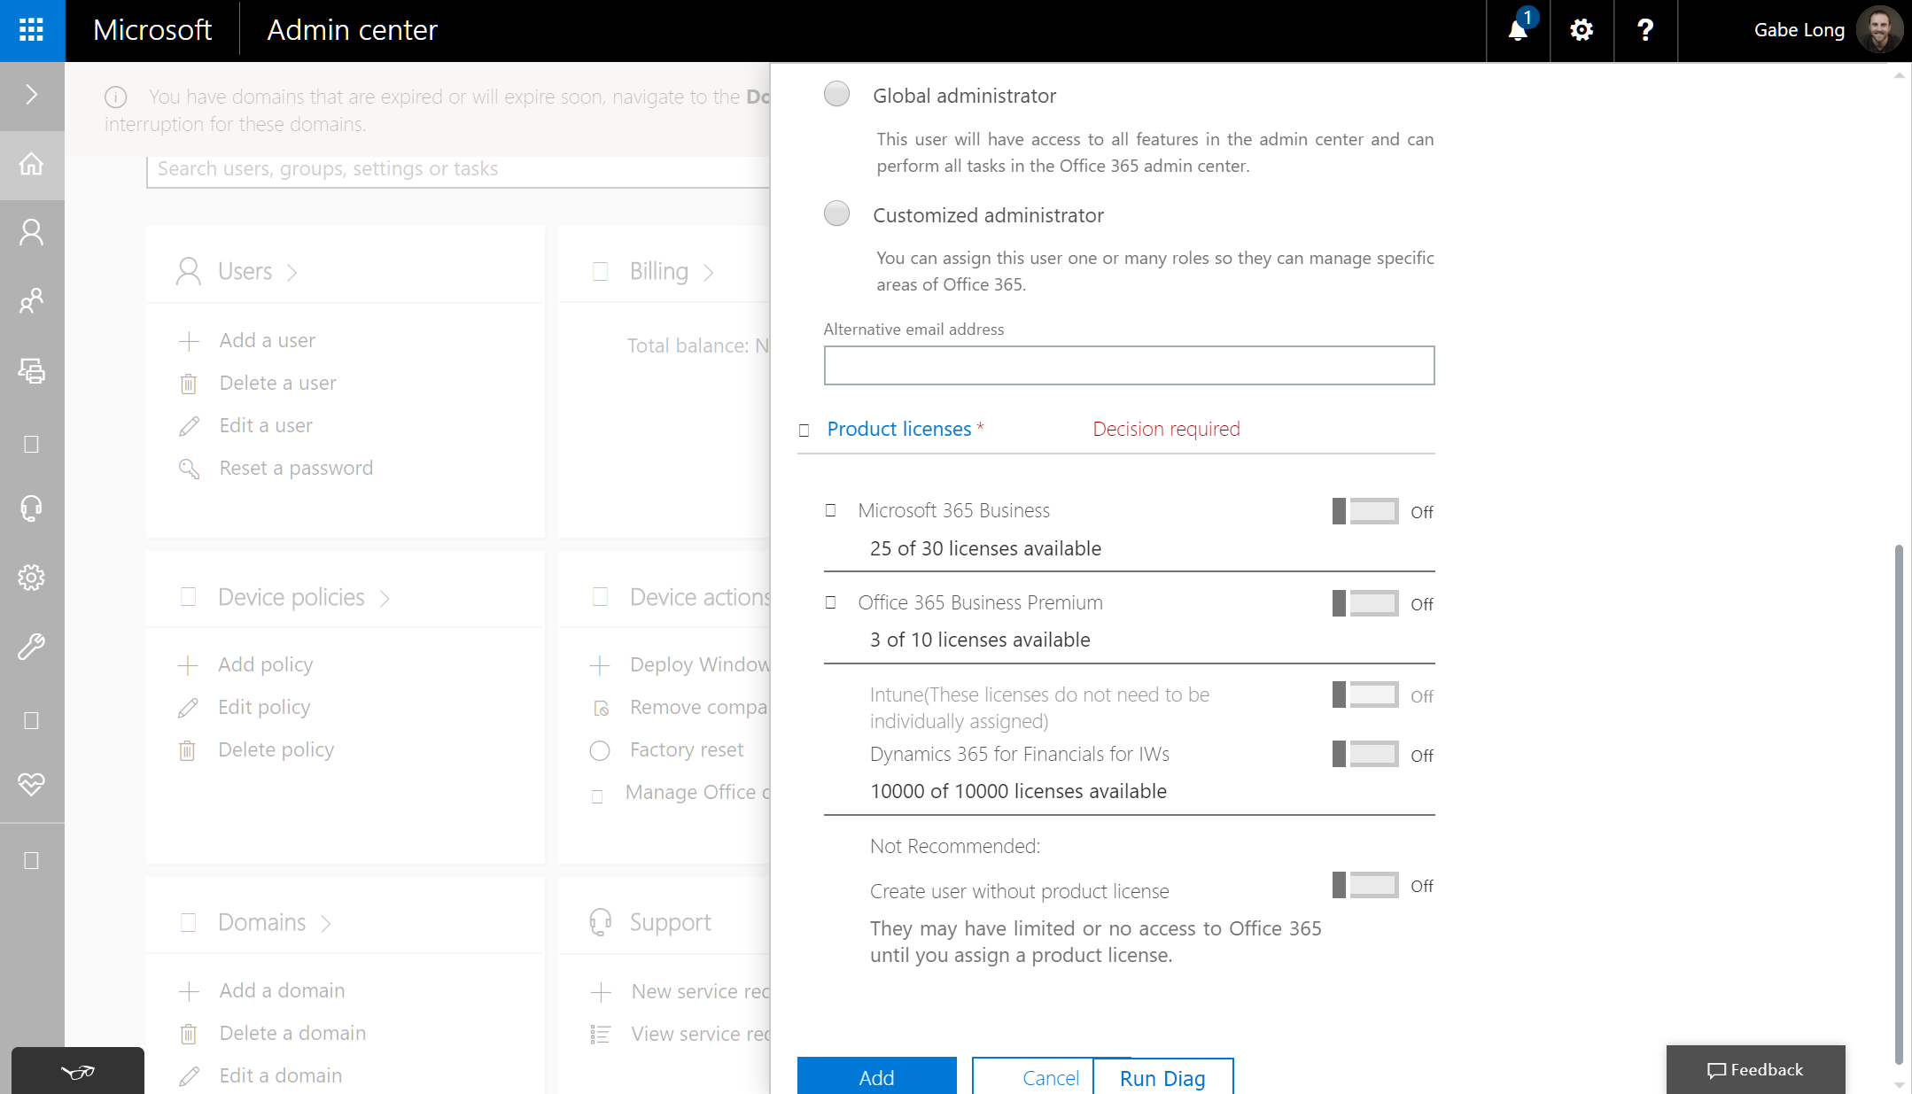
User management
Notes:
Lastly, you assign specific licenses to the user. In this case, Microsoft 365 Business is the logical choice, but any other licenses provisioned via Partner Center will be available for selection here.
When all your selections are complete, just click Add, which is located at the bottom of this New user card. <click>

Slide 21
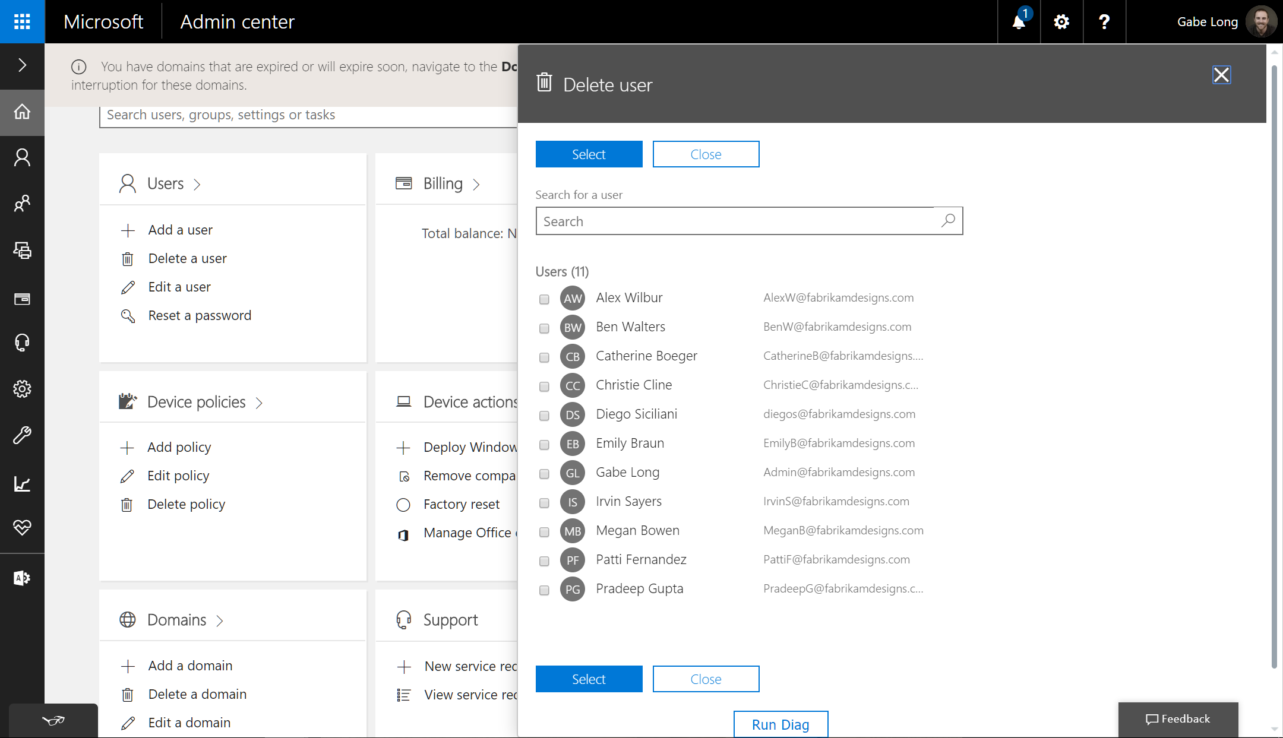
User management
Notes:
Deleting a user is straightforward. From the Users card on the home page, select Delete a user, which opens the list of current users. Simply check off the user or users you want to delete and click Select. <click>

Slide 22
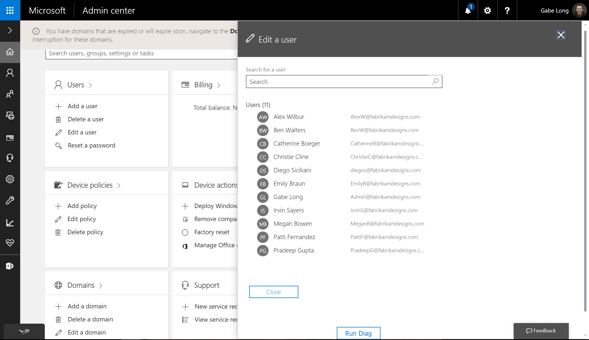
User management
Notes:
Editing a user’s info is also straightforward. From the Users card on the home page, just select Edit a user, which opens the list of current users. Check on the name of the user whose information you want to edit—in this case, let’s say that’s Patti. <click>

Slide 23
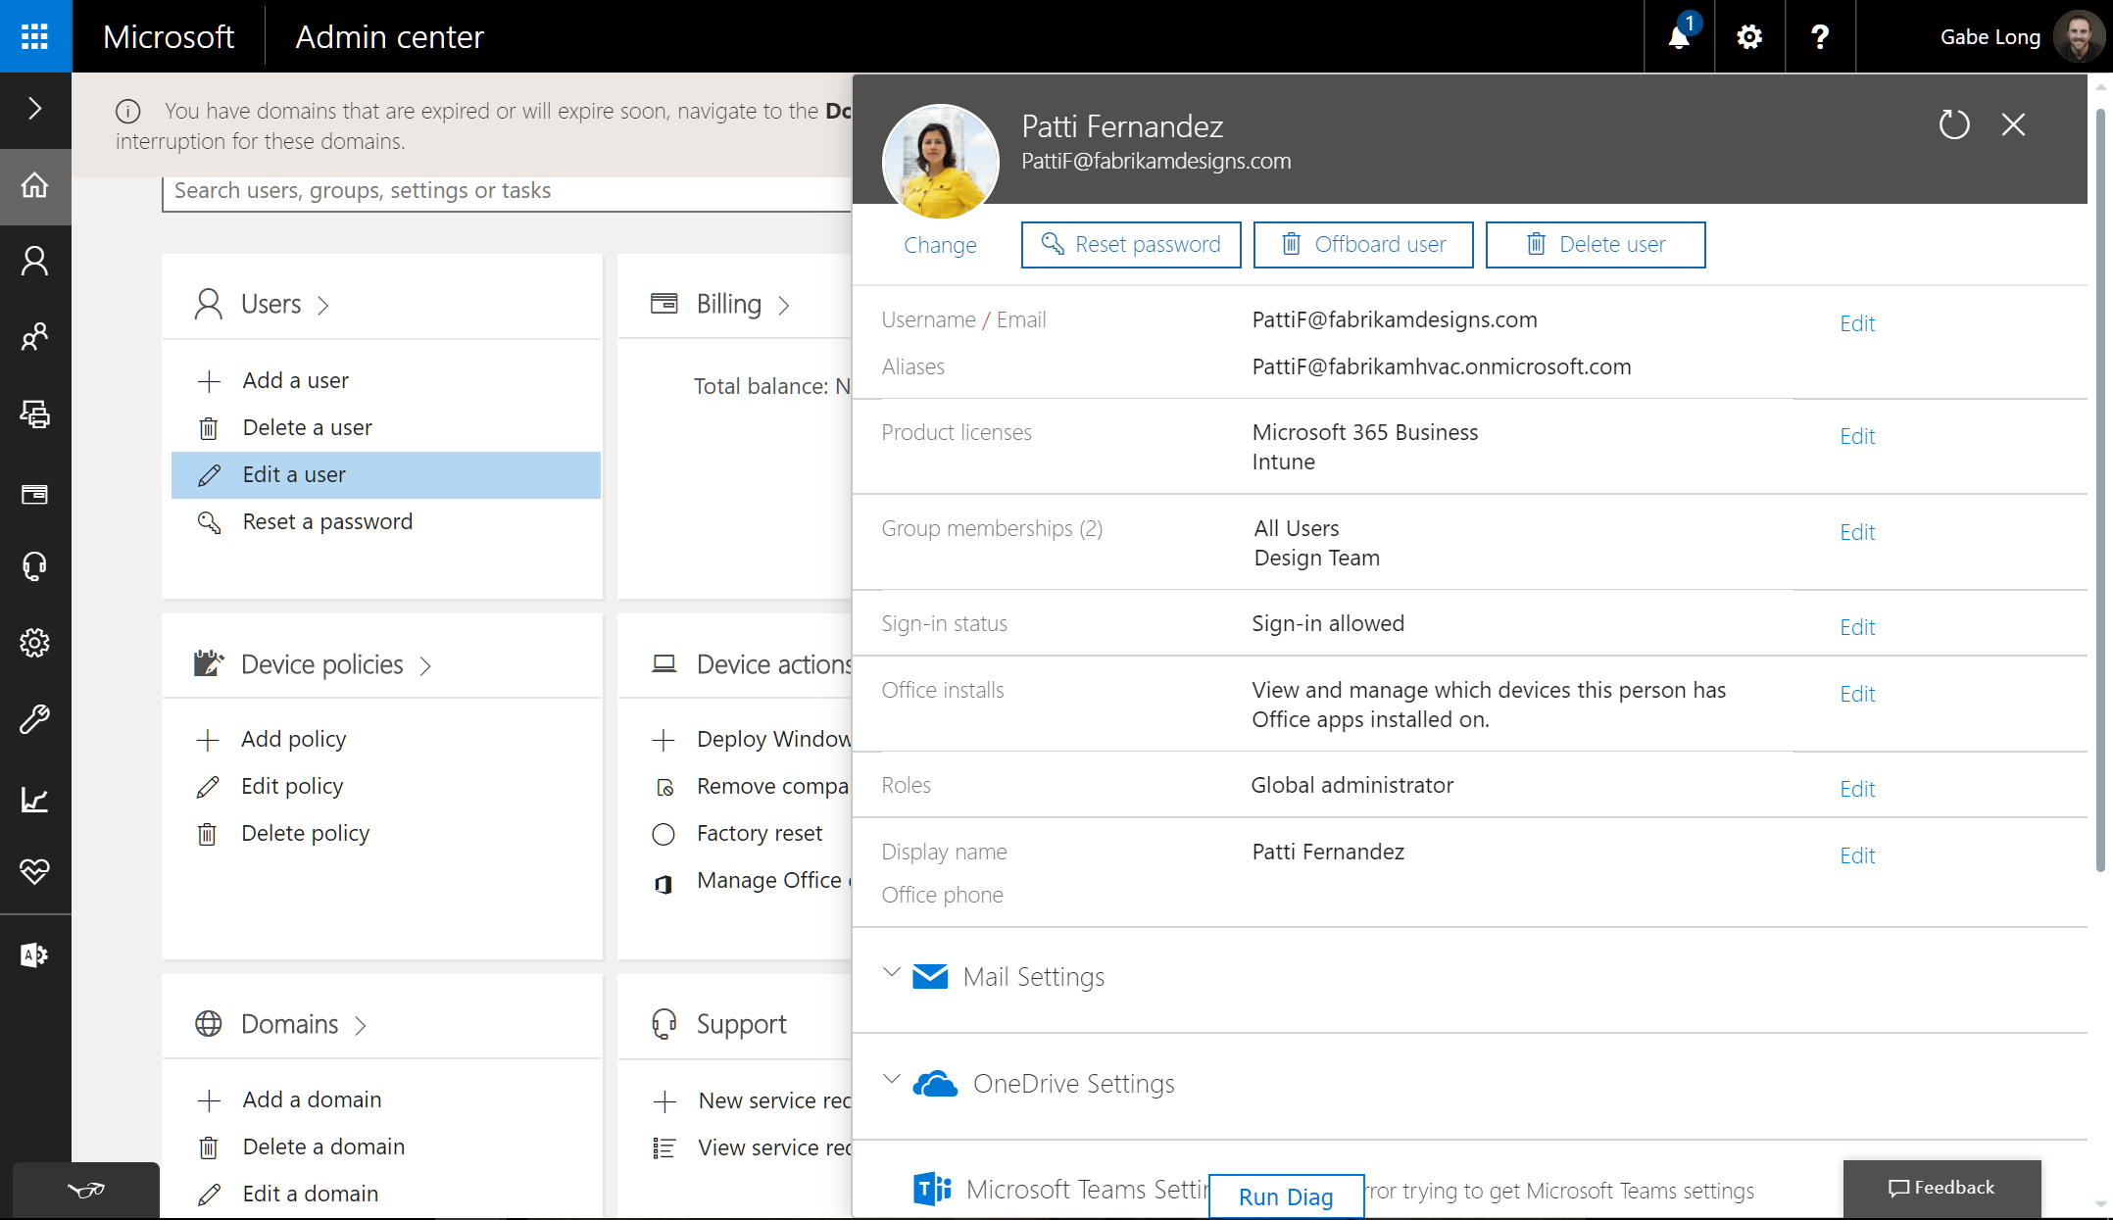
User management
Notes:
This brings up a card with all the user’s info. Here you can edit user information; reset the user’s password; update mail, OneDrive, and device policy settings; and see and manage all the devices the user has installed Office on. <click>

Slide 24

User management
Notes:
Looking back at the Users card option on the home page, we see there is an even faster way to reset a user’s password. Clicking Reset a password brings up a list of your users. Choose the user or users whose password you want to reset, and click Select. <click>

Slide 25
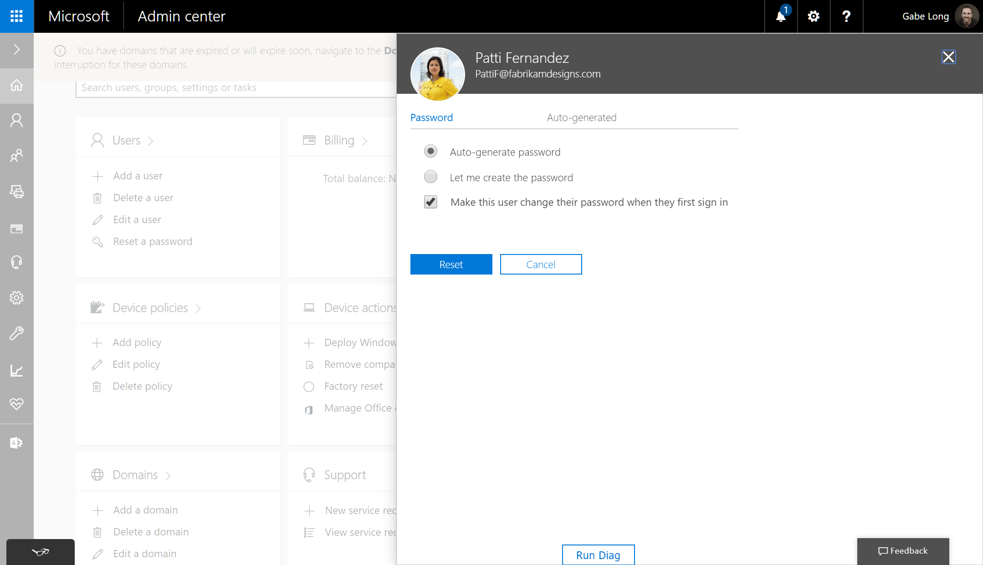
User management
Notes:
As we showed you during new user setup, you now have two options for creating the new password. You can also choose to force the user to create a new password on his or her next sign-in.
That covers the user management options available to you right from the Microsoft Admin Center home page.. <click>

Slide 26
Content Search & eDiscovery
What is it?
Content Search is an eDiscovery tool in that allows you to search for in-place items such as email, documents, and instant messaging conversations in your Microsoft 365 Business organization
What you need to know
Content search is the core capability. eDiscovery layers additional features such as case management, organization, and controls that determine who can manage and view content on a case by case basis
Searchable locations in Microsoft 365 Business:
  Exchange Online mailboxes and public folders
  SharePoint Online sites and OneDrive for Business accounts
  Skype for Business conversations
  Microsoft Teams
  Office 365 Groups
Typical search time for a Microsoft 365 Business customer is 30 seconds
  Content is indexed upon ingress
Notes:
You can use the Content Search eDiscovery tool in the Office 365 Security & Compliance Center to search for in-place items such as email, documents, and instant messaging conversations in your Office 365 organization.
Use this tool to search for items in these Office 365 services:
Exchange Online mailboxes and public folders
SharePoint Online sites and OneDrive for Business accounts
Skype for Business conversations
Microsoft Teams
And
Office 365 Groups
Reference: https://support.office.com/en-ie/article/content-search-in-office-365-53390468-eec6-45cb-b6cd-7511f9c909e4

Slide 27
Content Search & eDiscovery
Deployment task:
Customers and partners can assign eDiscovery permissions in the Security & Compliance Center
eDiscovery Managers
eDiscovery Administrators
  Can create and manage cases
  Preview and export search results
  Add and remove members to a case
  Create case holds to ensure content is not deleted by user(s) subject to the hold
  Can only access & manage the cases they create
  Can access all eDiscovery cases
  Can add themselves to a case
Notes:
The primary eDiscovery-related role group in Security & Compliance Center is called eDiscovery Manager.
There are two subgroups within this role group.
eDiscovery Managers - An eDiscovery Manager can use the Content Search tool in the Security & Compliance Center to search content locations in the organization, and perform various search-related actions such as preview and export search results.
Members can also create and manage eDiscovery cases, add and remove members to a case, create case holds, and run Content Searches associated with a case, and access case data in Office 365 Advanced eDiscovery.
An eDiscovery Managers can only access and manage the cases they create. They can't access or manage cases created by other eDiscovery Managers.
eDiscovery Administrators - An eDiscovery Administrator is a member of the eDiscovery Manager role group, and can perform the same Content Search and case management-related tasks that an eDiscovery Manager can perform. Additionally, an eDiscovery Administrator can:
Access all cases that are listed on the eDiscovery cases page in the Security & Compliance Center.
Access case data in Advanced eDiscovery for any case in the organization.
Manage any eDiscovery case after they add themself as a member of the case.
Reference: https://support.office.com/en-ie/article/assign-ediscovery-permissions-in-the-office-365-security-compliance-center-5b9a067b-9d2e-4aa5-bb33-99d8c0d0b5d7

Slide 28
Perform an eDiscovery Content Search
Basic Steps:
Create a new search
Preview search results
View information & statistics about a search
Export search results
Notes:
After you run a Content Search, the number of content locations and an estimated number of search results are displayed in the search profile.
You can also quickly view statistics, such as the content locations that have the most items that match the search query. After you run a search, you can preview the results or export them to a local computer.
Reference: https://support.office.com/en-ie/article/assign-ediscovery-permissions-in-the-office-365-security-compliance-center-5b9a067b-9d2e-4aa5-bb33-99d8c0d0b5d7

Slide 29
Demo: eDiscovery
Notes:
Let’s look at eDiscovery capabilities in Microsoft 365 Business.
NOTE TO PRESENTERS: Deliver the remainder of the content as a live demo. There are slide breaks for each of the four areas of management. These screenshot click-throughs are provided as your demo script but can also be used where access to the demo environment (demos.microsoft.com) is unavailable.

Slide 30
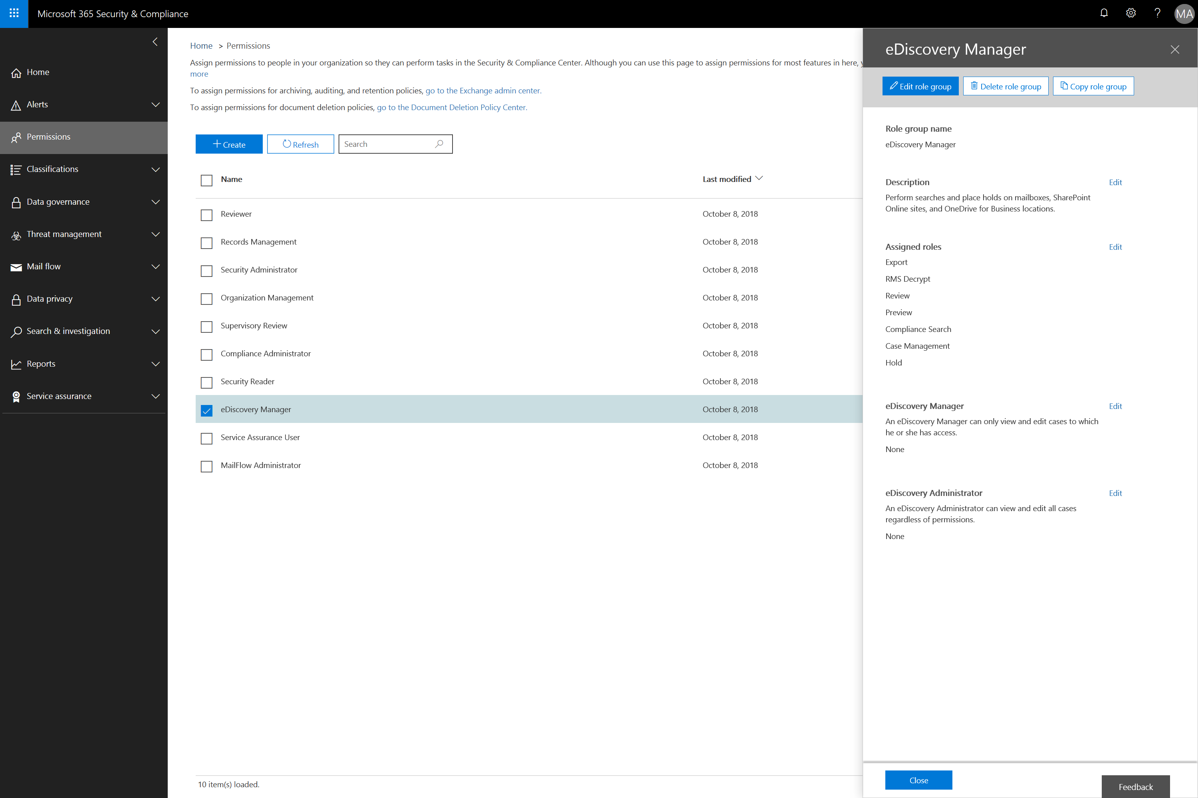
Notes:
In this scenario, one of the customer’s employees, Grady Archie, has requested that Megan start an eDiscovery case to find all documents and emails related to a disputed patent application.
Grady informs Megan that he would like all content in Microsoft 365 Business with the keyword “patent” protected from deletion and made available for him to review.
He also asked Megan to make sure the content can be exported and made available to opposing council if required.
An admin browses to protection.office.com to access the Security & Compliance Center to assign Megan the appropriate rights by selecting permissions on the left hand side and then eDiscovery Manager, and then assigning the eDiscovery Manager role since Megan has not performed an eDiscovery Content search previously.
The admin then clicks Edit next to the eDiscovery Manager role

Slide 31
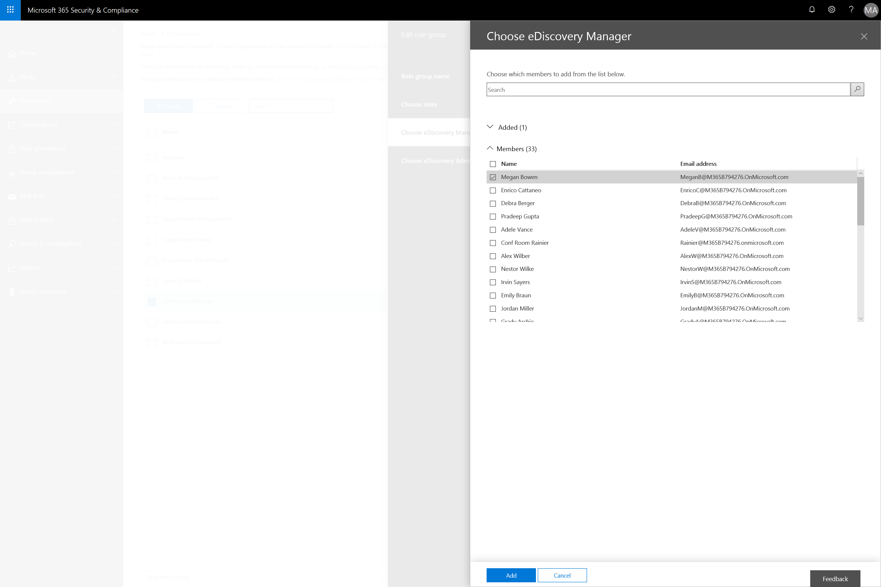
Notes:
Ensuring Megan’s account is selected we click add.

Slide 32
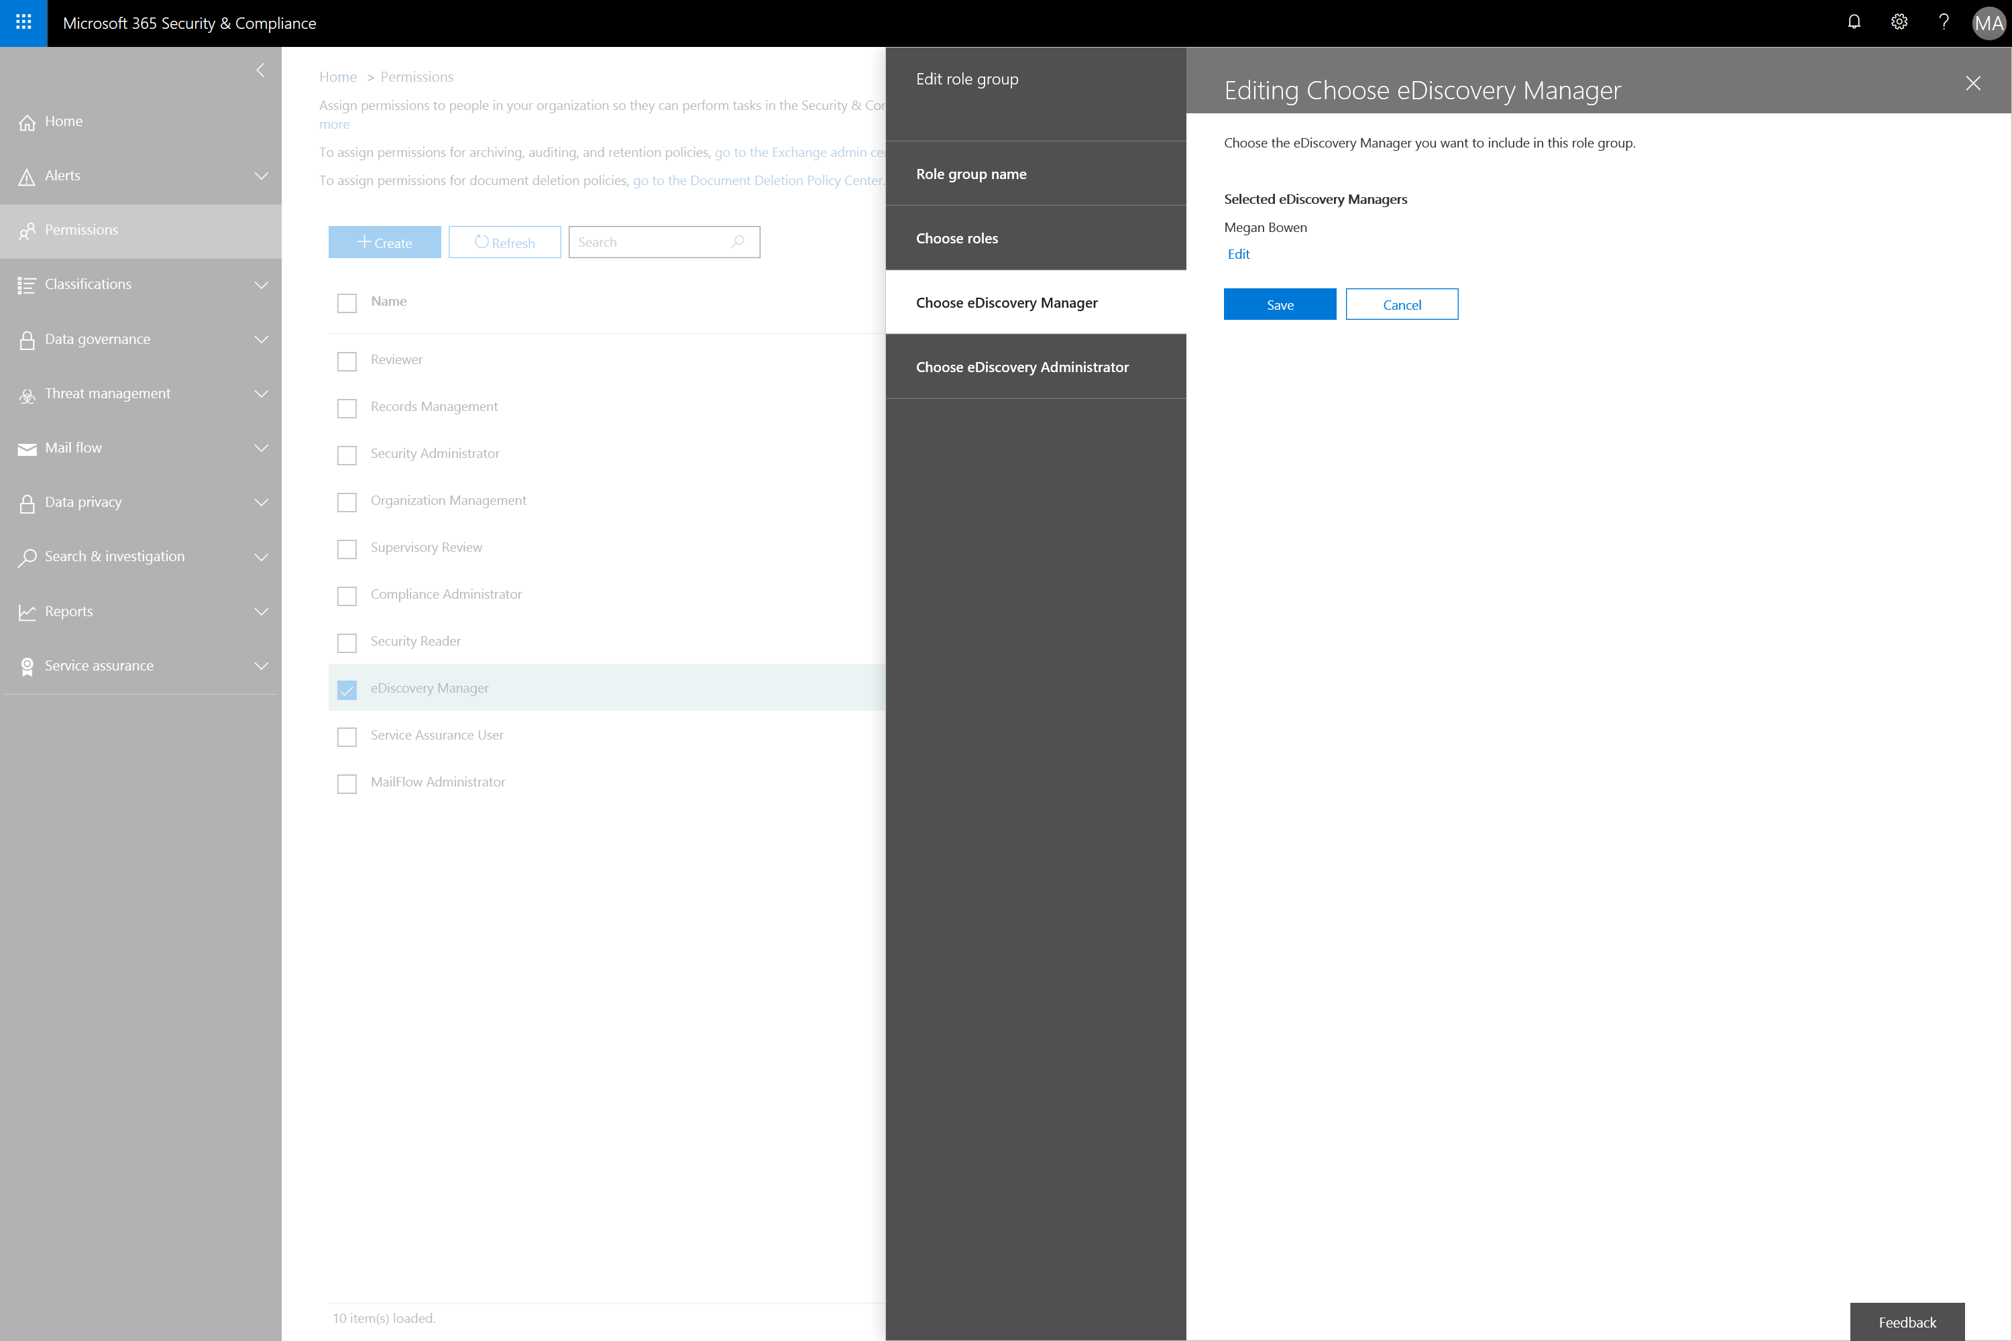
Notes:
The admin then saves the updated eDiscovery Managers role with Megan's account added and closes remaining dialog screens.

Slide 33
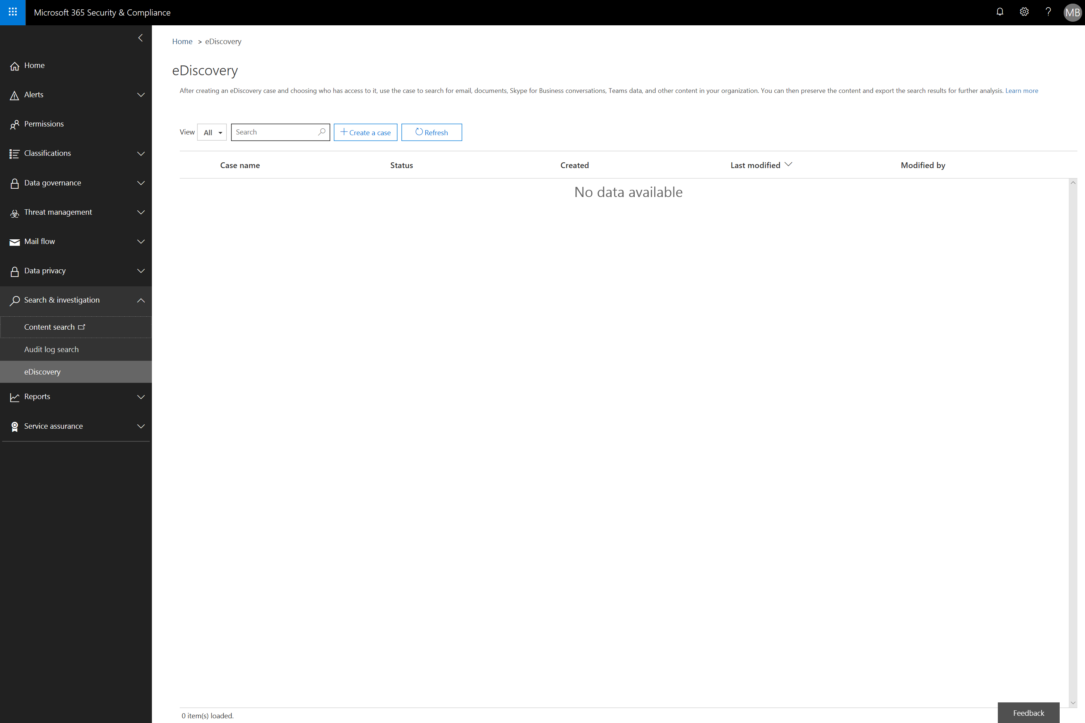
Notes:
Now that Megan has the eDiscovery Manager role assigned to her user account, she can log into the Security & Compliance center at protection.office.com
Megan clicks Search & investigation in the left hand navigation and then > eDiscovery and Create a case
Content search is a subset of eDiscovery functionality and can be used to perform a preliminary investigation without features such as Hold and Case Management. The underlying Content Search capability is the same for both.

Slide 34
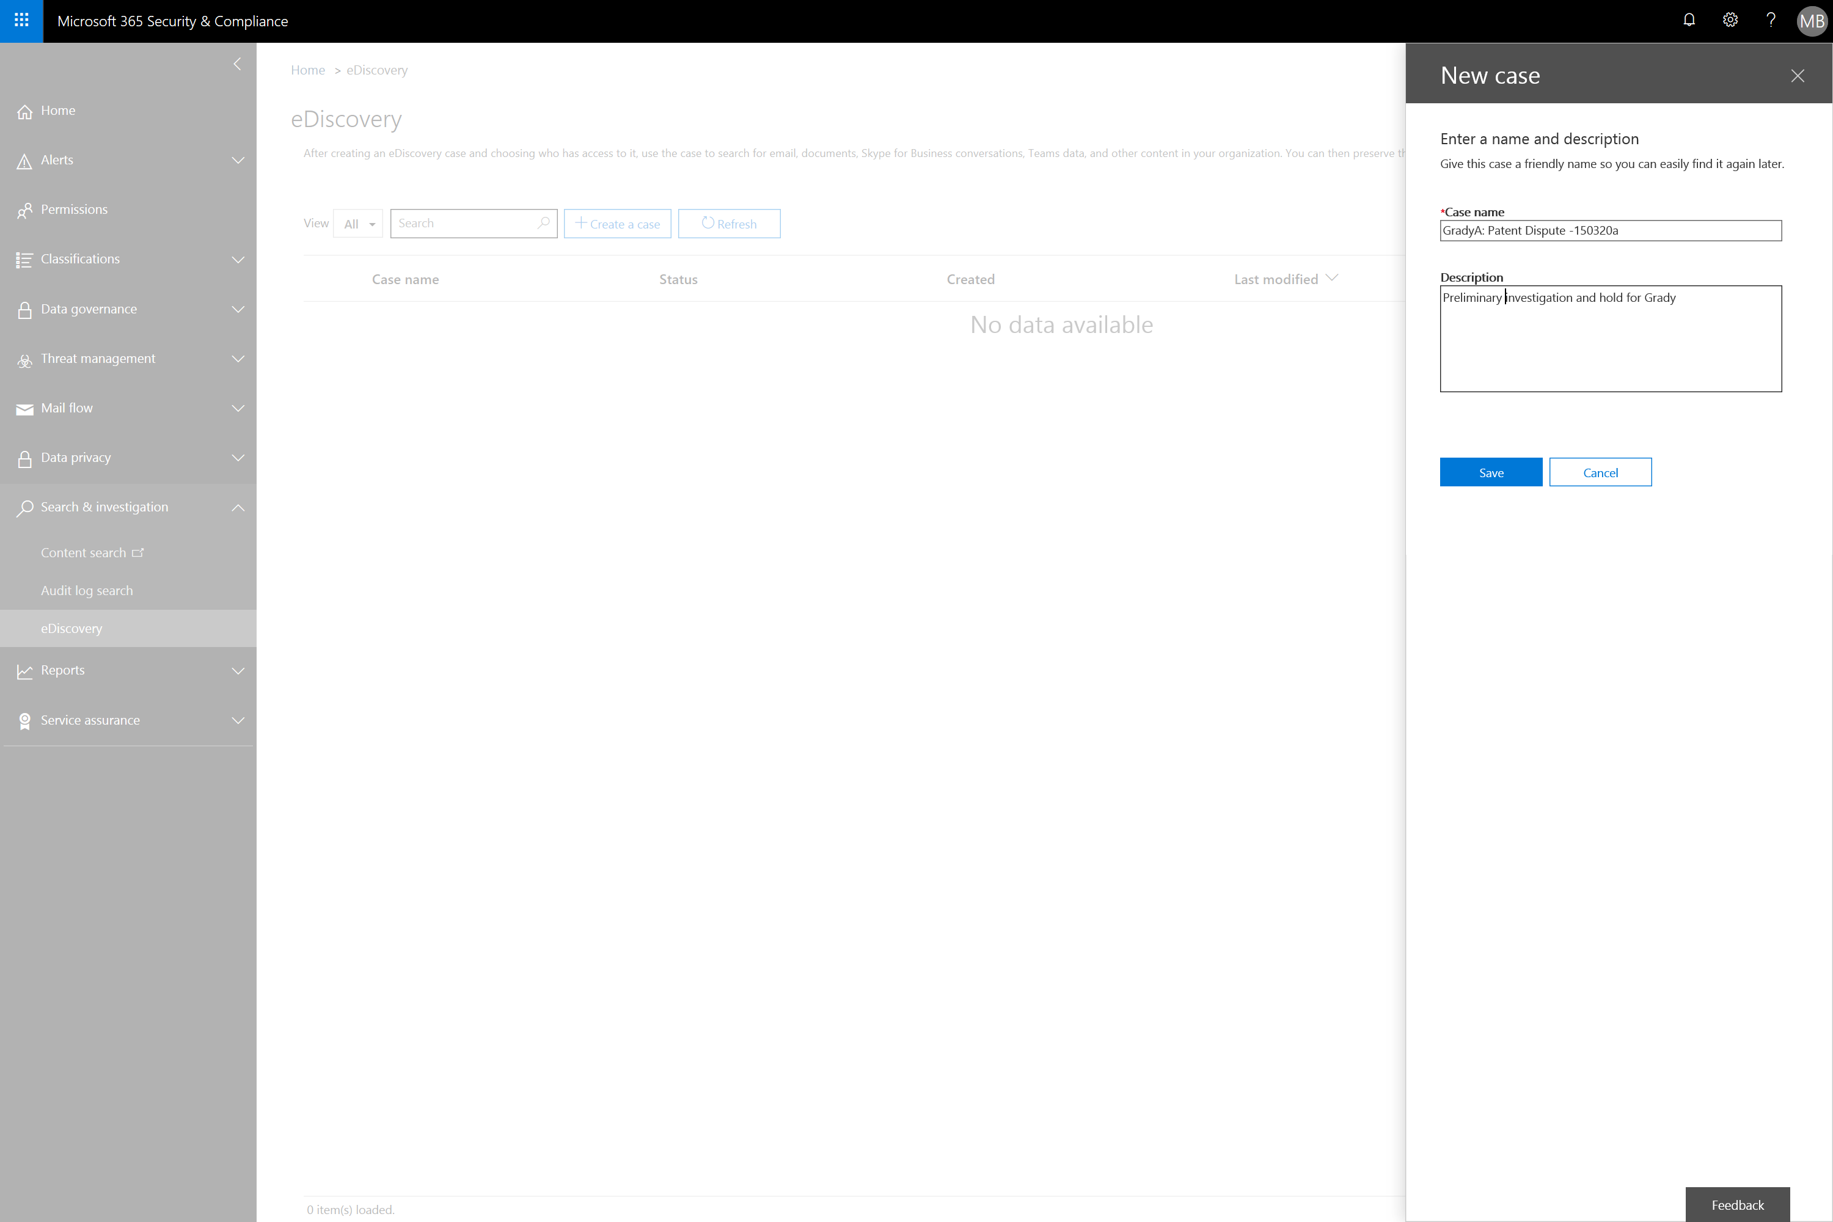
Notes:
Megan fills out Case details and presses Save

Slide 35
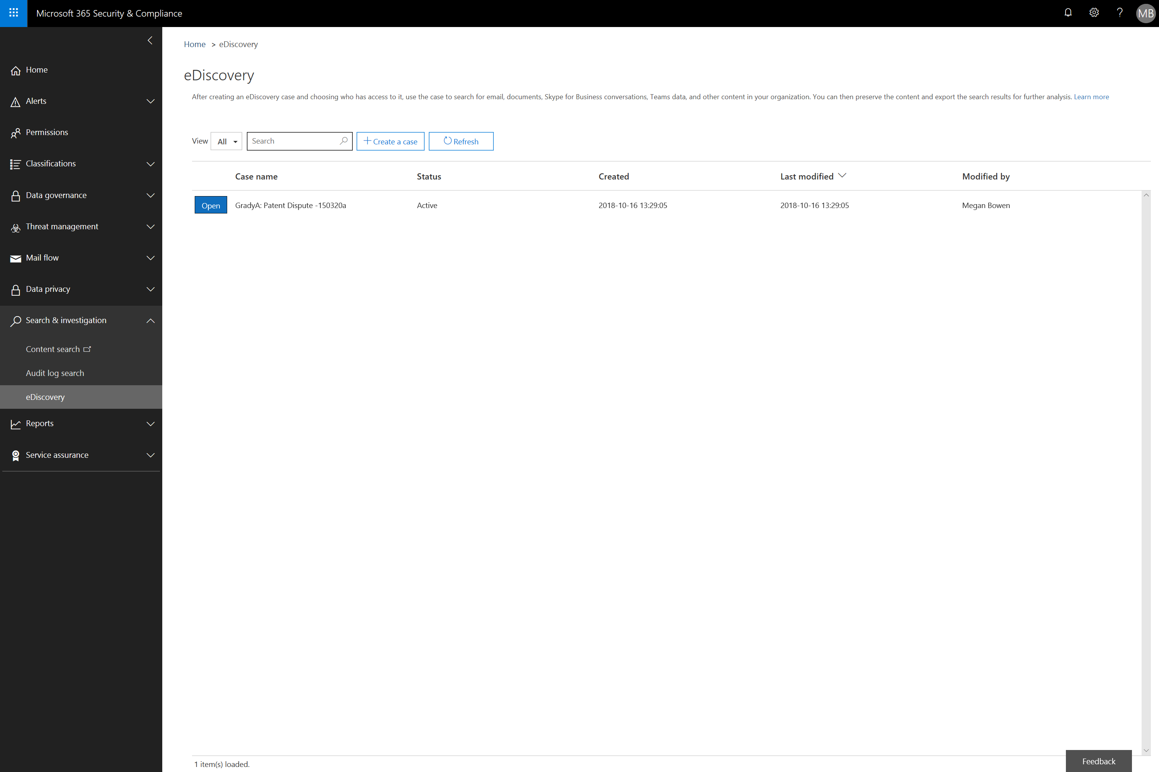
Notes:
Megan clicks Open to continue setting up the case

Slide 36
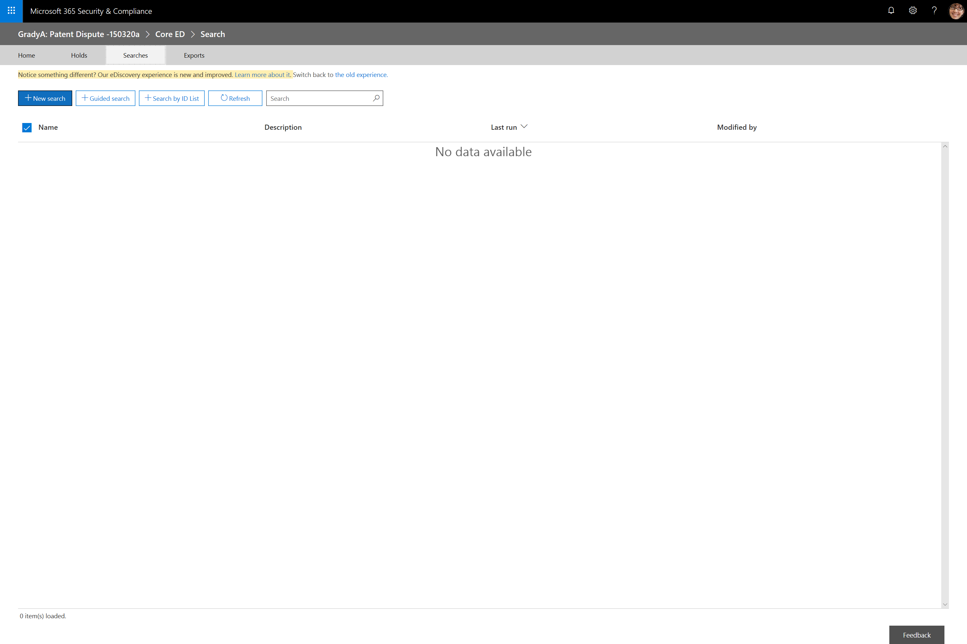
Notes:
Megan selects Searches and the New Search to prepare a content search for this case

Slide 37
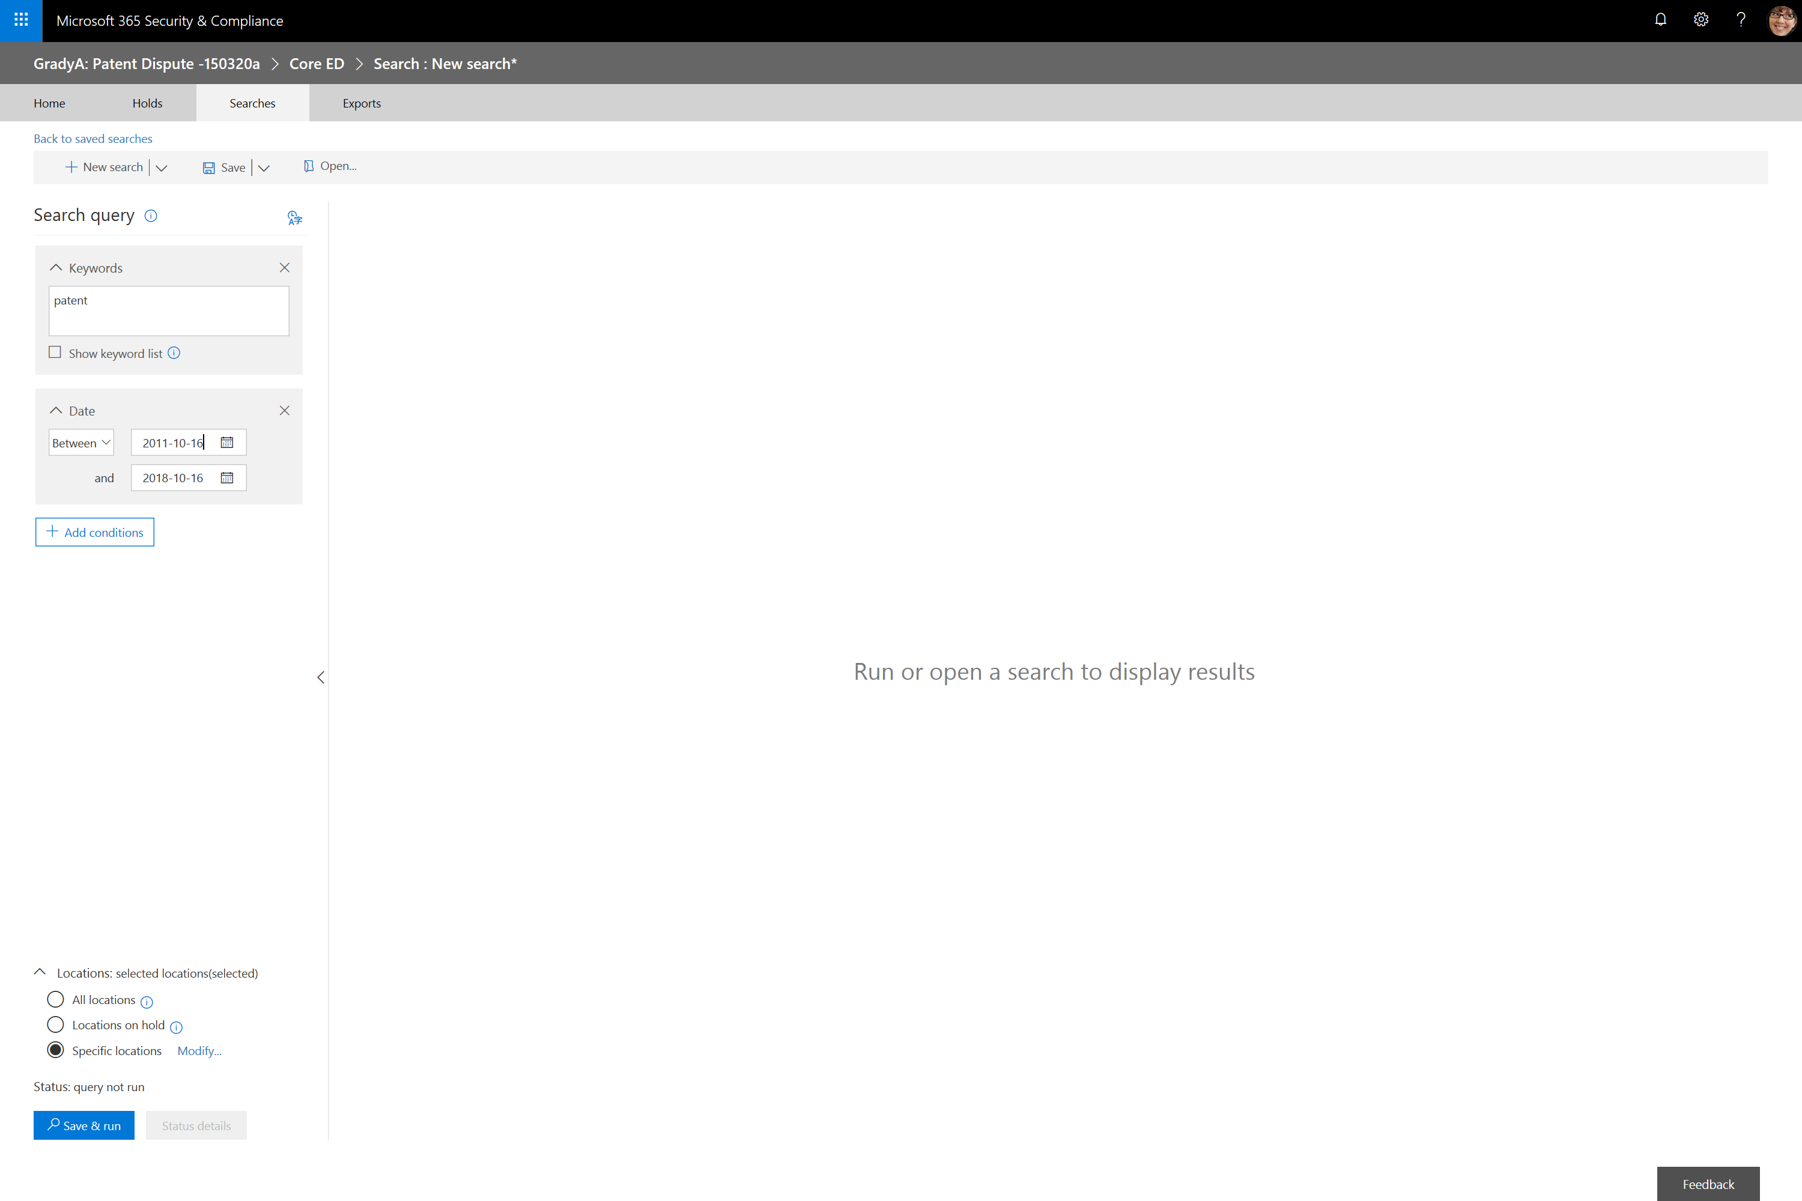
Notes:
Megan adds the Date condition and specifies the 7 year date range of 10/16/2011 to 10/16/2018 requested by Grady
Megan enters ‘patent’ for the keyword
Megan presses Modify to specify the locations Exchange Email and SharePoint Sites which include Teams and OneDrive locations
Megan presses Save & Run to execute the content search

Slide 38
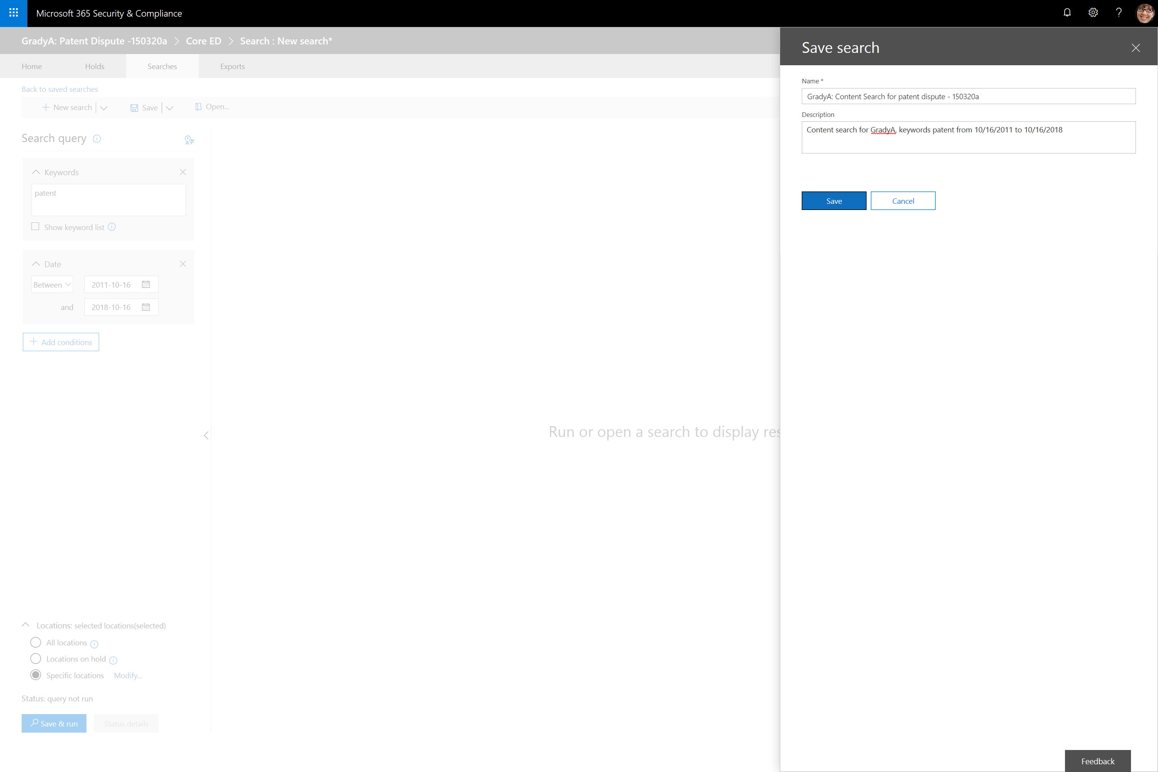
Notes:
Megan fills out details for the underlying content search and presses save.
NOTE: A case can have multiple associated content searches

Slide 39
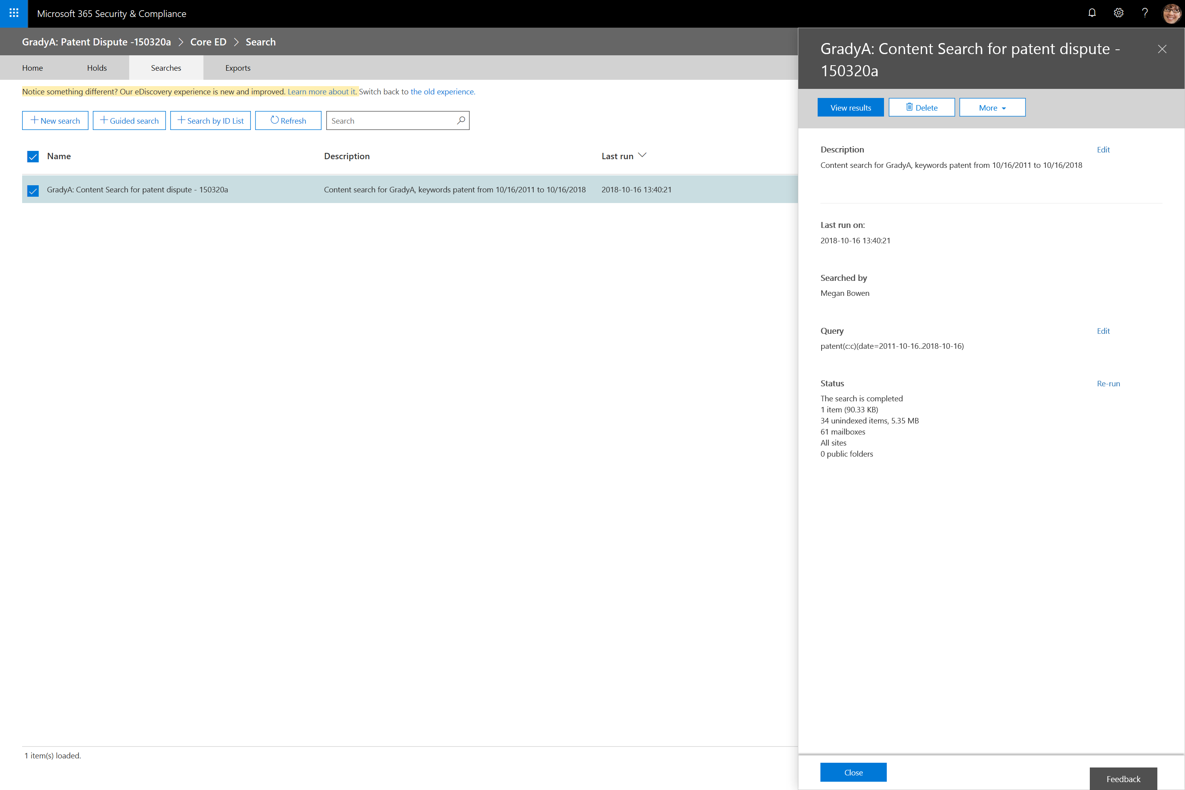
Notes:
After the content search runs, Megan selects it to review statistics such as the number of mailboxes searched, and the number items found. She can use this detail to help determine if her search parameters are correct.

Slide 40
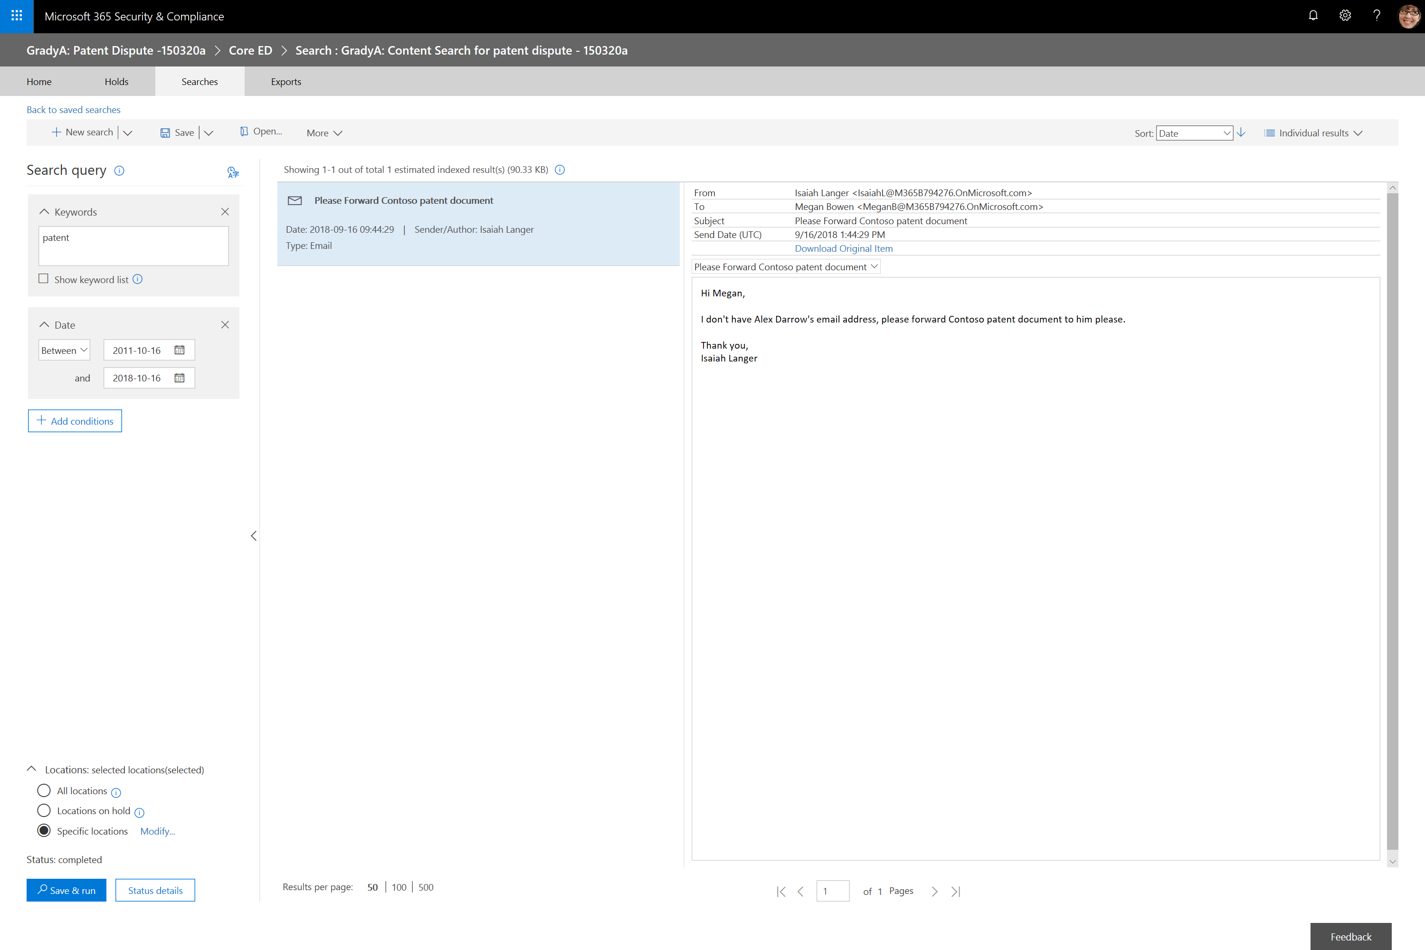
Notes:
Megan reviews the preview results and evaluates if additional work is needed.
When satisfied that she has met Grady’s requirements, she could then perform additional tasks such as:
Using the Export tab to produce required discovery reports for internal, external, and opposing council
Use the Holds tab to place a Hold so case content cannot be modified or deleted
Add additional members to the case, such as internal council, so they can review results
Close the case

Slide 41
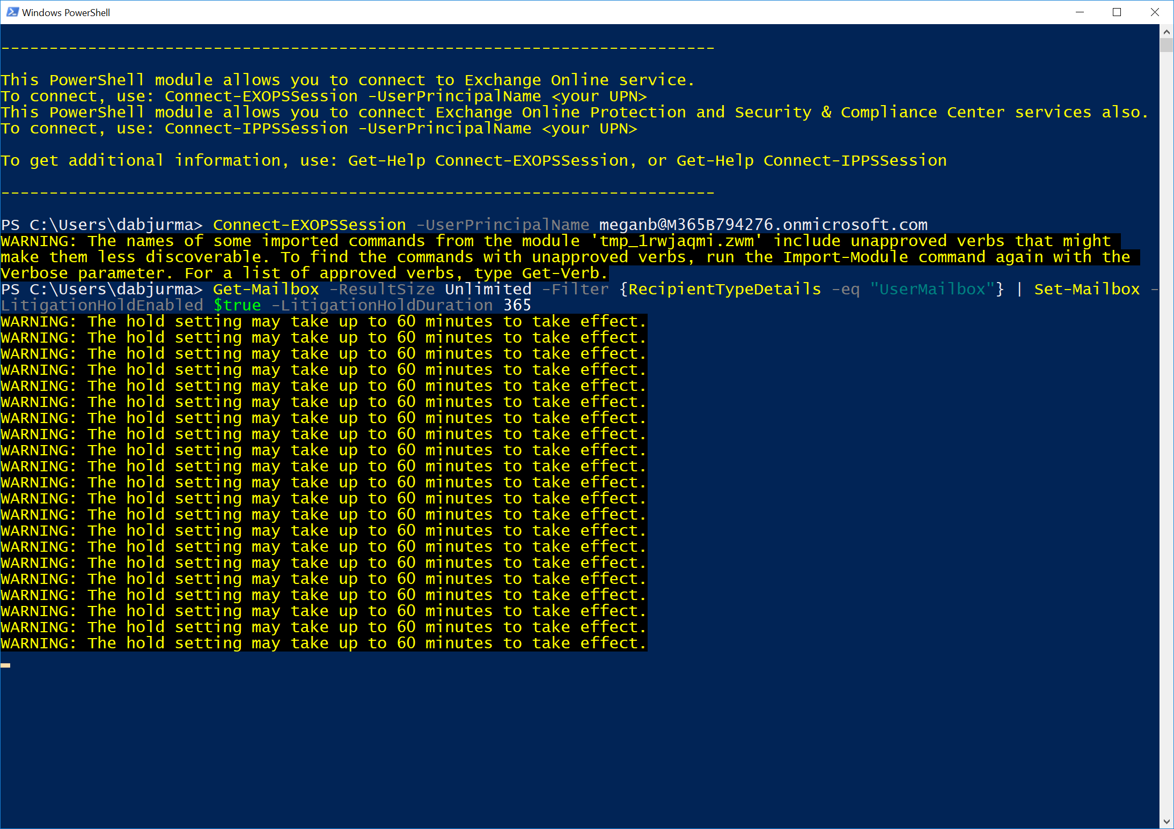
Litigation Hold for all
Notes:
Grady is concerned that important email related to the case might get deleted before he has a chance to review it. Grady asks Megan to put a hold on all user mailboxes for a period of one year to ensure he has full access to all Exchange Online mailbox content even if a users deletes an email or calendar appointment.
Megan knows she can do this via the Security & Compliance center; however, she also knows of a faster way. She will user PowerShell to put a Litigation Hold on all users mailboxes with one command.
Megan starts the Microsoft Exchange Online PowerShell module. Megan’s account is configured to require Multi-Factor authentication, so she uses this PowerShell module because it works with MFA.
Megan types Connect-EXOPSSession -UserPrincipalName meganb@M365B794276.onmicrosoft.com in the shell and logs in with MFA when prompted.
Next, Megan runs the command Get-Mailbox -ResultSize Unlimited -Filter {RecipientTypeDetails -eq "UserMailbox"} | Set-Mailbox -LitigationHoldEnabled $true -LitigationHoldDuration 365 to put all mailboxes on Litigation Hold for one year.

Slide 42
Microsoft 365 Business | Audit Log
What is it?
A unified audit log to view user and administrator activity in your Microsoft 365 Business organization.
What you need to know:
Audit logging may not be enabled by default
M365B customers should ensure it is turned on before they start using their tenant
Auditors will require the View-Only Audit Logs role
Compliance Management and Organization Management role groups have this role by default
Audit records are retained for 90 days
Audit records can be sent to a Security Information and Event Management (SIEM) solution for longer term storage
Notes:
you can use the Office 365 Security & Compliance Center to search the unified audit log to view user and administrator activity in your Office 365 organization. The unified audit log allows searches for user and admin activity across your tenant’s SharePoint, OneDrive, Exchange, Sway, eDiscovery, Teams, Yammer, Flow and Stream instances.
You (or another admin) must first turn on audit logging before you can start searching the Office 365 audit log.
To turn it on, just click Start recording user and admin activity on the Audit log search page in the Security & Compliance Center.
If you don't see this link, auditing has already been turned on for your organization.
After you turn it on, a message is displayed that says the audit log is being prepared and that you can run a search in a couple of hours after the preparation is complete.
You only have to do this once.
Reference: https://docs.microsoft.com/en-us/office365/securitycompliance/search-the-audit-log-in-security-and-compliance

Slide 43
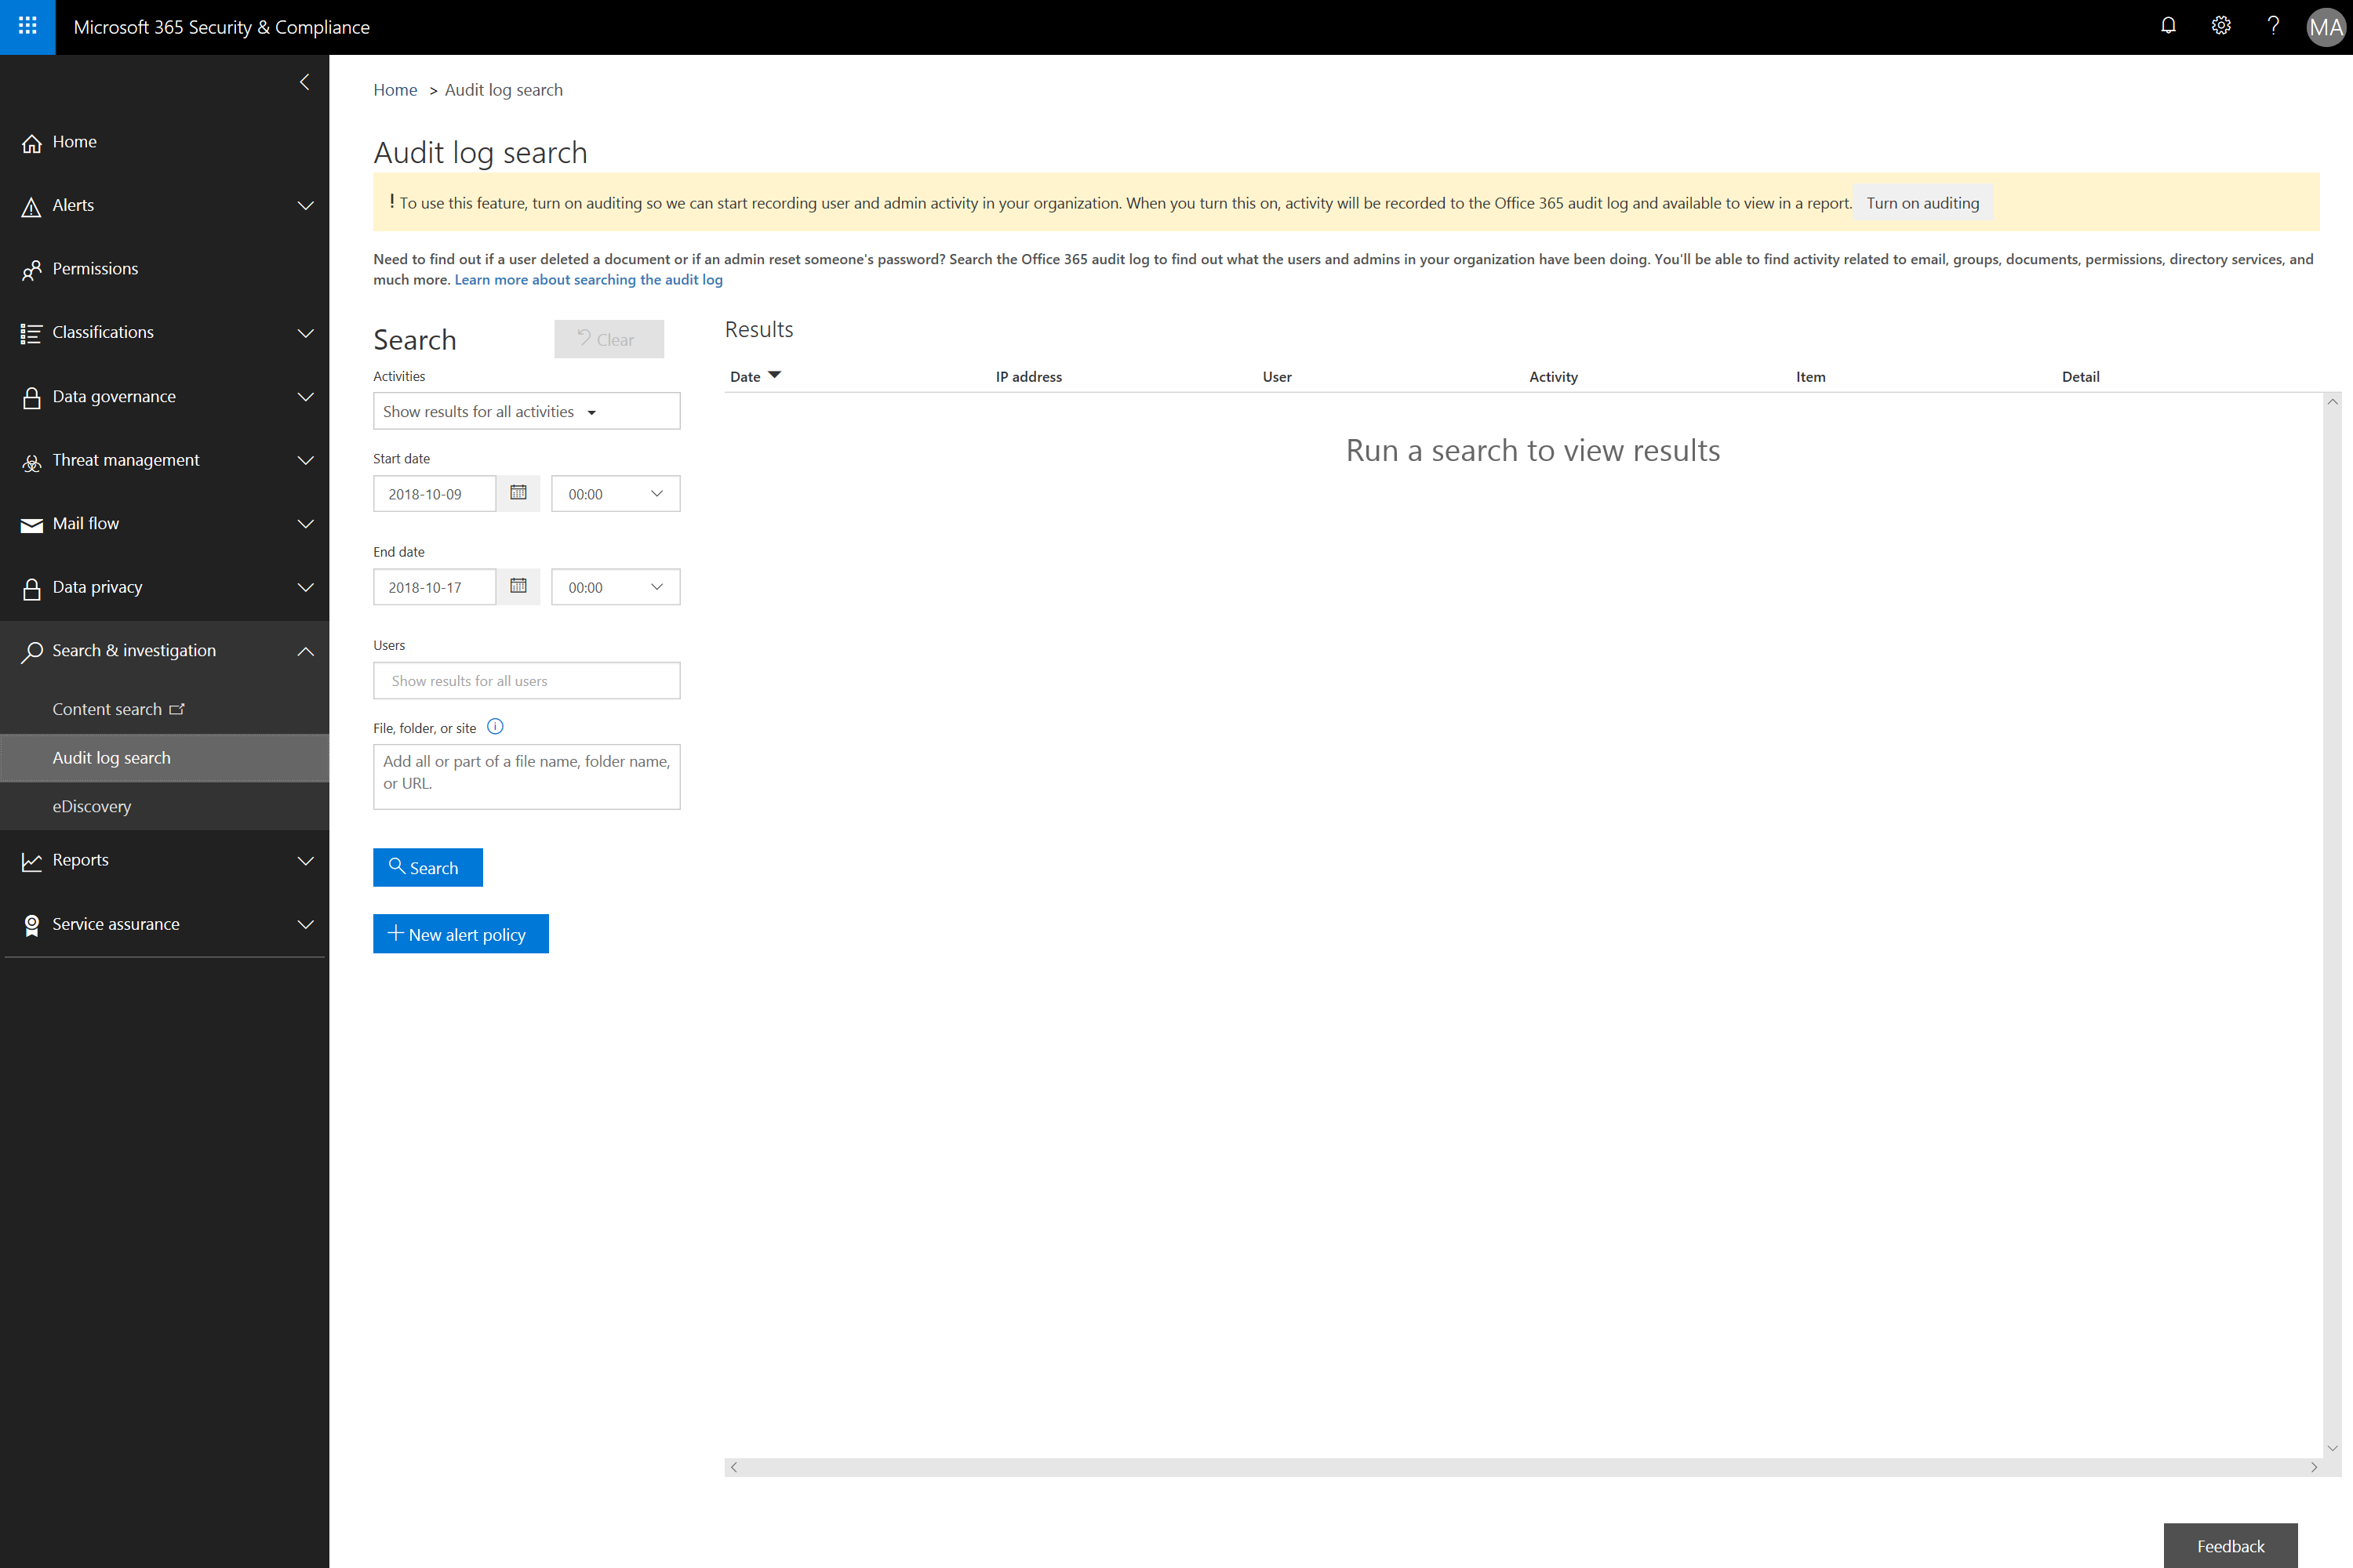
Notes:
If Audit Logging is not enabled, turn it on by selecting Turn on auditing

Slide 44
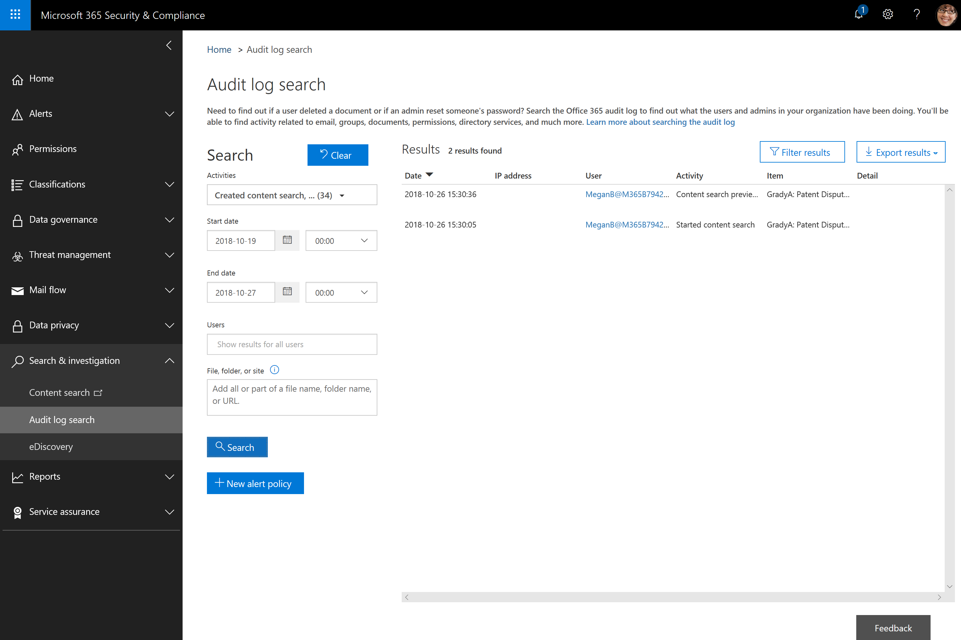
Notes:
Megan is going to run an audit log search to provide an audit trail of all eDiscovery activities is a certain period.
Under Activities she selects eDiscovery Activities to automatically select all of the individual audit categories related to eDiscovery.
Megan selects an appropriate data range for her search
Finally Megan reviews the results in the preview pane and Exports the results for her report.

Slide 45
Key places to find content
All content that is linked through out this document can be found at these sites. It’s important to note that when in doubt, go to the Microsoft 365 Business Partner Page.
Microsoft SMB Tech Community (aka.ms/smbtc): Forum for technical discussion & questions. The place to find experts.
Microsoft 365 Business Service Description (aka.ms/M365BSD)
The place to answer all your questions on the product and what is included
Microsoft 365 Launchpad (aka.ms/partnerlaunchpad):
This the hero tool for partners to identify a solution, create and offer and close the deal with customers
Microsoft 365 Scholarship Program (https://www.microsoft.com/microsoft-365/partners/business/scholarship)
This is the campaign site for the Microsoft 365 Business Scholarship Program, running until March 30, 2019
Guided Product Tour (https://testdrive.office.com/en-us/business/small-business-solutions)
A resource for partners to take customers through product value, without needing to prepare a full demo
Licensing Deck (aka.ms/m365bld)
A resource for partners to compare different licensing SKUs
Notes:
This brings us to the end of this module, so as a quick call to action you can revisit what was covered in module 1 in the partner programs section, and use the resources to build your skills, and build out offers to take to your customers.

Slide 46


Next steps
  Review Microsoft 365 Business service description
  Utilize the Microsoft 365 Business Scholarship program & CSP incentives to drive sales
  Build a security offer on top of the license using Launchpad
  Reference the Microsoft 365 Business technical deployment guide for basic technical questions

Slide 47
Thank you
Notes:
Thank you for watching module six of the Microsoft 365 Business technical fundamental series.

