Slide 1
Microsoft 365 Business
Technical Fundamentals
Module 5: Deploy and manage Windows 10 devices
Speaker Name
Date
Notes:
Welcome to module 5 of the Microsoft 365 Business technical fundamental series.

Slide 2
Microsoft 365 Business Deployment overview steps
Step 1
Step 2
Step 3
Step 4
Configure users
& policies
Deploy Office 365 Workloads & Clients
Deploy & manage Windows 10
Management & Troubleshooting
Notes:
<click>

Slide 3
Deployment Step 3 | Deploy & Manage Windows 10 devices
Step 1
Step 2
Step 3
Step 4
Configure users
& policies
Deploy Office 365 Workloads & Clients
Deploy & manage Windows 10
Management & Troubleshooting
Notes:
In this module we will be discussing the deployment and management of Windows 10 devices.

Slide 4

Key takeaways
Microsoft 365 Business supports On-premises
Active Directory
  You can deploy Microsoft 365 Business for customers with on premises Active Directory and local resources. For that, you can configure the Windows device in two ways:
  Option 1
  Azure AD Joined Device
  A configuration where the Windows 10 device is joined to Azure AD while Azure AAD Connect is enabled
  Option 2
  Hybrid Azure AD Joined Device
  A configuration where the Windows 10 device is joined to both Azure AD and on-prem AD while Azure AAD Connect is enabled
Notes:
Here are the key takeaways for this module
We can configure Win10 devices in two ways for customers utilizing on-premises Active Directory
The first is to continue to use the on-premises Active Directory to manage users that are synchronized to Microsoft 365 Business and devices that are joined and managed directly by Azure AD. This is called Azure AD Joined Device
The second is to manage users the same way and also leave the devices joined to the local Active Directory with additional management capabilities being delivered by Azure AD and Intune. This is called Hybrid Azure AD Joined Device

Slide 5

Deploy, configure, and manage Windows 10
Windows 10 Management in Microsoft 365 Business
Windows 10 device is connected to
Microsoft 365 Business through Azure AD
Device inherits the pre-configured device security and management settings in Microsoft 365 Business.
Benefits
SSO to Azure managed SaaS apps & services like Office 365
Centralized management & deployment of policies to PCs, Macs and mobile devices
Uniform configuration of latest Windows, which is more secure
Consistent security profile that follows the user identity across devices & apps
Device under Microsoft 365 Business management
Notes:
Windows 10 management in M365B is when the Windows 10 Device is connected to Microsoft 365 Business through Azure AD
The device inherits the pre-configured device security and management settings in Microsoft 365 Business.
This gives number of administration benefits:
First, it enables seamless SSO to Azure managed SaaS apps & services like Office 365 from any Windows device. Your users don’t see additional authentication prompts when accessing work resources. The SSO functionality is even when they are not connected to the domain network.
Second, there is the centralized CLOUD management and deployment of security policies that spans users and devices. For example, the Windows Defender settings applied centrally cannot be turned off by the user on their windows 10 pro device. If you have a new device, as soon as it connects into Azure AD, the device policies are applied, saving you time and effort
Third, it brings all your windows 10 devices to a standard configuration of windows with the latest feature updates and cumulative updates, which provides the most secure version of windows thus reducing vulnerabilities in your customer environments.
Fourth, It helps enable a consistent security profile that follows the User’s Identity, so security policies transcend devices –whether work owned or BYOD. Essentially a single security policy helps you manage data/access on work-owned or BYOD personal mobile devices

Slide 6

Key concept: Azure AD Join
When you Azure AD Join your Windows device, it gives you the benefits of deploying & managing work-owned devices from the cloud, i.e., Microsoft 365 Business
Join devices to Azure AD
7/8.1 Pro
10
Pro
Upgrade or Update to
Windows 10 Pro (1703 or later)
Sign-in with AAD account
Device under Microsoft 365 Business management
How to Azure AD join a device
How it works
Upgrade to Windows 10 Pro
Sign in with user’s Microsoft 365 Business credential or Azure AD account
Intune auto-enroll is enabled with Azure AD join
(if device policy configured in setup wizard)
Subscribed features (Eg. Setup Wizard Security Features) and management capabilities are now accessible
Notes:
Since we’ll be using referencing Azure AD join throughout this module, it might be useful to go into detail of what is means from an M365B perspective.
So how you AAD join a device?
First you have to upgrade existing devices to Win 10 pro 1703 or later
If you have devices on Win 7 or 8.1 Pro, you get a free upgrade to Win 10 Pro with your M365B subscription. If you have Home devices, you’ll need to purchase an upgrade from Home to Pro first and then upgrade your devices to Windows 10 Pro
Once your Device is on Win10 Pro, you’ll simply need to Sign in With User’s M365B credential or Azure AD credential
Once you successfully sign in to a device with the AAD credential of the user, the device is then AAD Joined and is auto-enrolled into Intune which comes with your M365B subscription.
Once the device is auto-enrolled into Intune, the policies that we enabled in the Setup wizard now apply to the device

Slide 7
Windows deployment
Pre-requisites
Deployment
Autopilot
Notes:
In order to leverage these capabilities, we need to ensure we might the pre-requisites.

Slide 8
Microsoft 365 Business — Pre-requisites
Windows 7 Pro
Windows 8 Pro
Windows 8.1 Pro
iOS 8.0
or later
Mobile Management Solutions
Android 4.0
or later
Windows devices
Mobile devices
Notes:
Windows 10 Business is a set of cloud services and device management capabilities that complement Windows 10 Pro and enable the centralized management and security controls of Microsoft 365 Business.
Getting to Windows 10 Business is a straightforward—though multi-step—process. It begins with upgrading devices to Windows 10 Pro 1703. Once the upgrade is complete, the device needs to be joined to the company’s Azure Active Directory (or Azure AD) account. With those two steps completed, the device—assuming the user is licensed for Microsoft 365 Business, of course—automatically completes the update to Windows 10 Business and comes under Microsoft 365 Business management.
Before you get started, however, there are a few prerequisites to bear in mind. The Windows devices you want to upgrade must already be running Windows 7, 8/8.1 or 10 Pro (before completing the baseline upgrade to Windows 10 Pro Creators Update).
Finally, all devices must be removed from any existing mobile management solutions—MobileIron, AirWatch, etc.
<click>
DON’T READ
Apple mobile devices must be running iOS 8.0 or later.
Android mobile devices must be running Android 4.0 or later, including Samsung Knox Standard 4.0 and higher. A full list of supported devices is available on docs.microsoft.com. Look under Enterprise Mobility + Security > Intune. In the left-hand menu, go to Introduction > How To > Supported configurations.

Slide 9
Windows deployment overview
Upgrade to Windows 10 Pro Creators Update
Connect device to Azure AD
Verify upgrade to Windows 10 Business
Notes:
At a high level, upgrading devices to Windows 10 Business is a three-step process. First, the device is upgraded to Windows 10 Pro 1703.
<click>
Then the device is connected to Azure Active Directory, which in turn will automatically trigger the update to Windows 10 Business.
<click>
Finally, the upgrade to Windows 10 Business is verified manually on the user’s Windows device. Let’s take a closer look at the deployment process now.
<click>

Slide 10
Windows deployment
Pre-requisites
Deployment
Autopilot
Notes:
If we need to upgrade the devices to Windows 10 Pro, we have multiple options depending on our starting point and requirements.

Slide 11
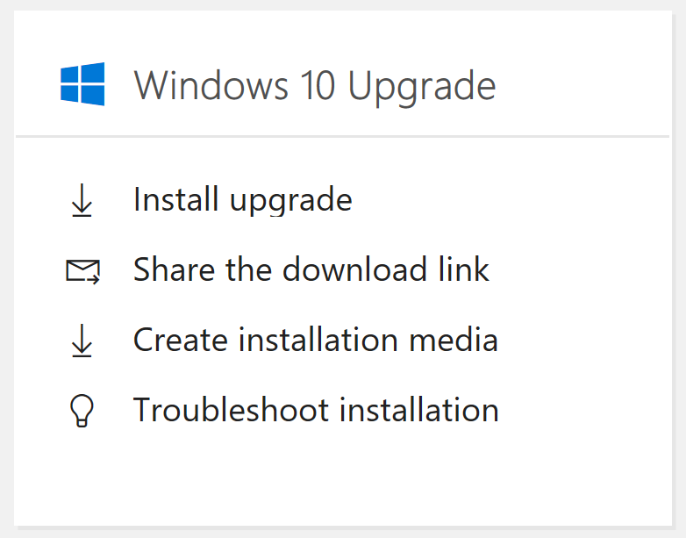
Deployment process
Microsoft 365 Business
Join devices to Azure AD
Optional
Modify baseline configuration
10
Pro
CSP
7/8.1 Pro
Windows 10 Enterprise Subscriptions
Purchase CSP subscriptions
and assign to
user accounts
(in Partner Center)
Upgrade or Update to
Windows 10 Pro (1703 or later)
Log into devices with Azure AD user account
Configure Windows 10 Enterprise edition features
New Windows 10 Pro devices can be re-imaged back to baseline Windows 10 Pro state via this process
Subscribed features and management capabilities now accessible
Notes:
Step 1: Let’s start right from the beginning, adding the Microsoft 365 Business subscription to the customer tenant and assigning seats to users. Create new customer tenants and/or new user accounts as necessary. <click>
Step 2. Upgrade or update end-user devices to Windows 10 Pro version 1703 or later. Upgrade devices on Windows 7 or Windows 8.1 Pro via the options listed in the Windows 10 Upgrade “card” in the Microsoft Admin Center. Update Windows 10 Pro devices to version 1703 or newer via Windows Update. <click>
Step 3a. Windows CSP subscriptions—including Microsoft 365 Business—require Azure Active Directory, If the customer has a CSP subscription with Microsoft, Azure AD is already in place. If not, each user’s Windows device will need to be connected to Azure AD.. <click>
Step 3b. Log in to updated/upgraded device via Azure AD with Azure AD user accounts. <click> At this point, devices are enrolled into the Azure AD tenant and management policies are applied. <click>
Step 4a. A number of device security settings are pre-configured in Microsoft 365 Business. This means users enrolling devices with Microsoft 365 Business subscriptions should see immediate benefit and increased security at first login. There are additional settings in the Microsoft Admin Center that can be configured as needed. <click>
Step 4b. If you have customers with Windows 10 Enterprise subscriptions you may need to configure the additional security and management features in their subscription. If they have Microsoft 365 Business, they will still be managed. <click>

Slide 12
Paths to Windows 10 Pro
Boot to USB/DVD options
Upgrade (keep files, apps, and settings)
Custom (install Windows only [keep nothing])
May require manual re-input of OEM license key to activate
Windows 7 Home
Windows 8 Home
Windows 8.1 Home
Windows 10 Home
Windows 10 Pro Pack
Not included; purchase from Microsoft Store @ USD$99 per device
USB
DVD
Windows 10 Pro
OR
Windows 7 Pro
Windows 7 Ultimate
Windows 8 Pro
Windows 8.1 Pro
In-place upgrade
In-place upgrade options
Keep files, apps, and settings
Keep files only (discard apps and settings)
Keep nothing (discard files, apps, and settings)
Windows XP,
Vista, etc.
Windows Ent./LTSB
Notes:
Let’s take a look at the upgrade paths to Windows 10 Pro.
There are two upgrade paths to Windows 10 Pro for devices still running Windows 7 or 8.1: in-place or boot to USB/DVD.
There are no upgrade paths for devices running Windows Vista, Windows XP, or older versions of Windows. And there are no upgrade paths to Windows 10 Pro for devices running Enterprise, Education, or LTSB editions of Windows.
The Windows 10 Upgrade “card” in the Microsoft Admin center links to the Windows media creation tool (MCT): https://www.microsoft.com/en-us/software-download/windows10/
Click the blue Download tool now button to launch the MCT.
The MCT will ask if you want to upgrade the device that the MCT is running on (if you answer Yes, it will begin an in-place upgrade) or Create installation media.
Create installation media provides two further options: create an ISO disc image or create a bootable USB drive. The ISO disc image, along with the files on the bootable USB drive, can be used for an in-place update when executed from within Windows.
When performing an in-place upgrade, three options are presented:
Keep files, apps, and settings (keeps all files, apps, and settings and just upgrades the operating system).
Keep files only (discards apps and settings, but keeps files and upgrades the operating system).
Keep nothing (discards apps, settings, and files, and upgrades operating system, returning device to default first-run state).
When performing a boot to USB/DVD upgrade, two options are presented:
Upgrade: similar to an in-place upgrade—keeps apps, files, and settings.
Custom: choose this option for a wipe-and-reload “clean” install of Windows 10, discarding all files, apps, and settings. With a wipe-and-reload, there is no option to revert back to the previous Windows installation, since nothing is retained.
When performing a wipe-and-reload installation of Windows 10, the original Windows 7/8/8.1 OEM license key may need to be re-entered in order to activate the device license.
Let’s close on upgrade paths with a final note on Home devices. Devices running Windows 7/8/8.1 Home editions can use this process to upgrade to Windows 10; however, these devices will upgrade to Windows 10 Home not Windows 10 Pro. Windows 10 Pro is the edition required to deploy a Windows CSP subscription, including Microsoft 365 Business. Therefore, an additional step is required when upgrading from Home—an upgrade to Windows 10 Pro via the Windows 10 Pro Pack available in the Microsoft Store for USD$99 per device.
Let’s take a look at how you can get Windows 10 Pro updates distributed from the Microsoft Admin center. <click>

Slide 13
Getting to Microsoft 365 Business management of device from current state
Current Customer State
Customers in Microsoft 365 Business
No Active
Directory
Azure AD joined device
On-prem
Active Directory
Notes:
Some customers do not use Active Directory (work groups, no management, etc)
Other customers may use Active Directory
Depending on their current state, there are some options for the end state: <click>
No AD: Azure AD Joined Device <click>
On-prem AD: Azure AD Joined Device w/ Azure AAD Connect Tool <click>
In certain instances of on-prem AD: Hybrid Azure AD Joined Device
Let’s start with the scenario of a customer with no AD <click>

Slide 14
How to deploy Windows 10 with Microsoft 365 Business for Customers with No AD
Step 1
Step 2
Step 3
10
Pro
AAD Join
Upgrade to Windows 10 Pro
Sign-in with AAD account
Device under
Microsoft 365 Business management
Notes:
This step is similar to the standard AAD join we covered in the Key concept slide. As there is no AD, the Windows 10 Pro device can simply connect to AAD by signing in with the AAD or M365B credentials and get under M365B Management

Slide 15
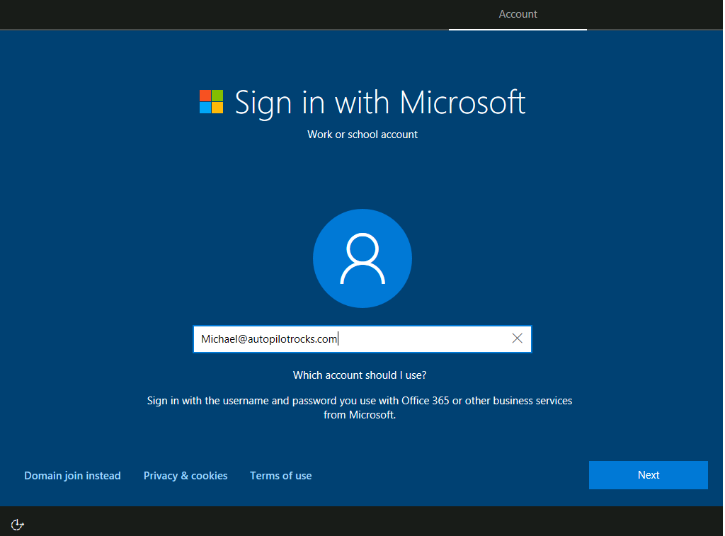
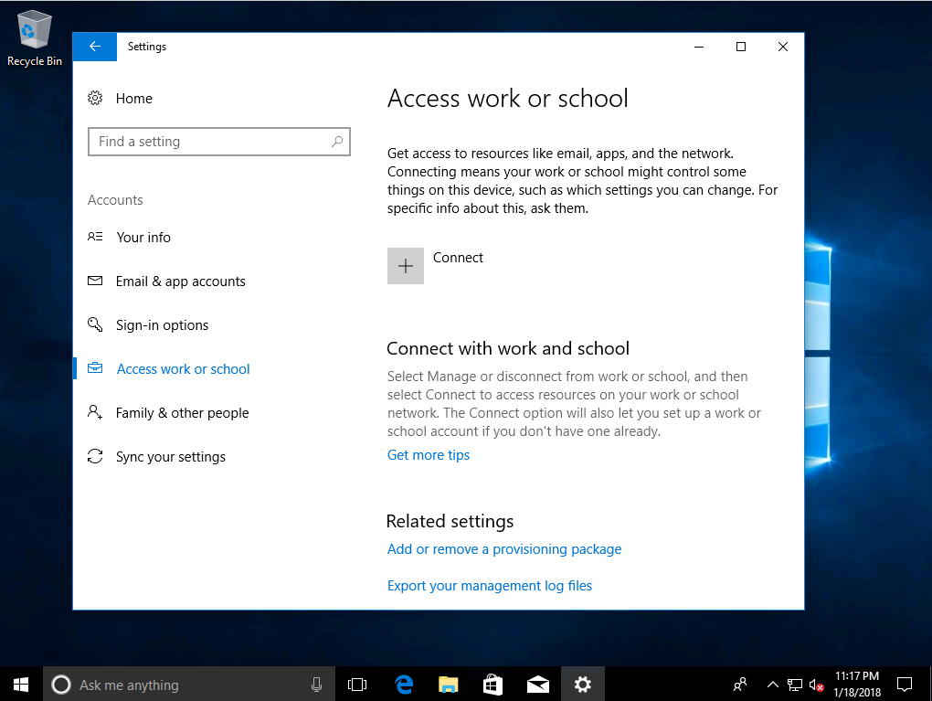
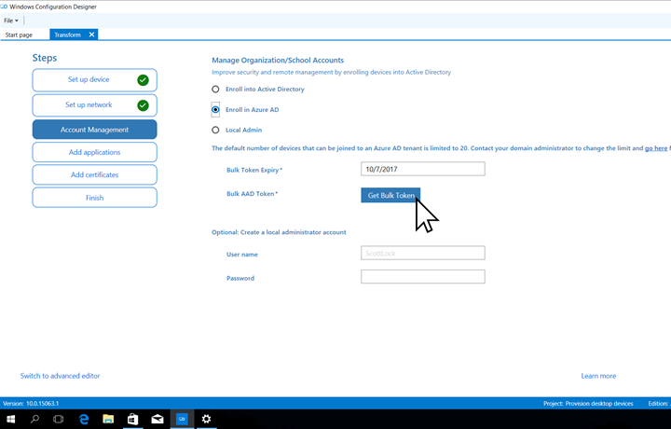
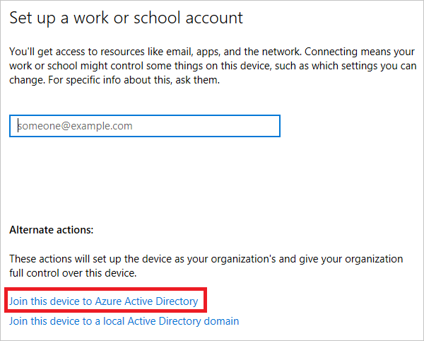
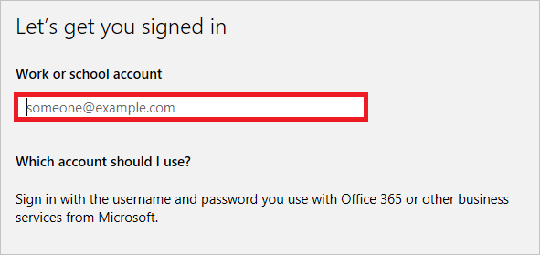
Different methods to Azure AD Join
Autopilot/Windows OOBE
(new device)
Join from Settings
(existing device)
Join Via
Provisioning Package
Notes:
There are three different methods you can use to join your Windows 10 devices to Azure AD.
The most common method is using out-of-box experience offered as default or when devices are enabled for Autopilot, where you sign in using your Azure AD account.
Another method is using Settings app, you go to Accounts, then Access work or school, Connect and in the Alternate actions choose Join this device to Azure Active Directory.
Another option is using a provisioning package

Slide 16
Getting to Microsoft 365 Business management of device from current state
Current Customer State
Device Config in Microsoft 365 Business
No Active
Directory
Device is Azure AD joined
On-prem
Active Directory
1. Device is Azure AD joined with AAD Connect enabled
2. Device is Hybrid Azure AD joined with AAD Connect
2 options
Notes:
For customers That do have AD, as mentioned there are two options. Let’s explore Option A: Where the Device is joined to AAD AND AAD Connect is enabled

Slide 17
For customers with AD
Option 1: Device is Azure AD joined with AAD Connect enabled
Overview
Intune
Extend your on-premise AD to Azure AD using Azure AD Connect
Azure AD join a Win 10 device
Brings device under Microsoft 365 Business management
On-premises resources like File shares,
LOB apps, printers are accessible when the AD is in line of sight of the device
Azure Active Directory
Azure AD join
Azure AD connect tool
10 Pro
Windows 10 Pro device
Active
Directory
Benefits
Enables Single-Sign-On (SSO) to Azure AD apps even when your device is not connected to corporate network
Accelerates move to cloud based infrastructure while reducing on-premises footprint
Provides self service experience for joining devices from any location, remote branch office
LOB apps
File shares
Printers
Notes:
For Customers with AD, our recommended device configuration is to join Azure AD. The process of joining a device to Azure AD as outlined earlier is very straightforward. A common concern we here from customers for Azure AD Join is around access to on-premise resources like File shares, LOB apps, printers, ..etc.
It is important to understand that by doing Azure AD join, the device will continue to have access to your company on-premise resources as long as the device has a line of sight to our AD. When you provide user creds on an Azure AD Join device, it will authenticate against both Azure AD and on-premise AD and will have both:
Azure AD Primary Refresh Token (PRT) to get access to cloud resources and
Kerberos Ticket Granting Ticket (TGT) to get access to on-premise resources
There are numerous benefits to having a device perform an Azure AD Join:
You can minimize your on-premises footprint, reduce your total cost of ownership to manage devices by moving from a complex to implement and maintain GPO technology to a much simpler MDM based modern management technology in the cloud using Microsoft Intune
With Azure AD Join, you get a self-service model that enables your users to join their devices from any remote branch office as long as they have connectivity to the internet
A key end user productivity benefit with Azure AD Join is that it enables SSO across both on-premise and cloud apps
A key capability here is that a Azure AD joined Windows 10 device will ‘prime’ itself to work seamlessly with legacy on-premises resources in this scenario when a user signs in with their Azure AD account that’s synchronized with Azure AD Connect. The device does need to be joined to the local Active Directory to connect to local resources.

Slide 18
For Customers with AD - Device Deployment steps for
Option A: Azure AD joined device (With AAD Connect)
Step 1
Step 2
Step 3
Step 4 (optional)
10 Pro
LOB Apps
File shares
Printers
Upgrade to Win 10 Pro
  Upgrade OD to Win 10 Pro creators update
Enable AAD Connect
  Synchronize identities
Join device to Azure AD
  Sign in and verify Microsoft 365 Business credentials
Run MMAT Tool to get Configuration Service Providers (CSPs) for existing GPOs
Devices can access local resources like LOB apps, file shares, printers when Azure AD Connect is enabled
Caveats of Azure AD Joined Device Deployment Method
AAD Join creates a new profile; Profile needs to be manually migrated
Some GPOs may not map to Intune
Win 32 apps relying on machine authentication won’t work
Printer path works; AD Printer discovery does not work
Notes:
If we break down the steps, we have
Upgrarding devices to Windows Pro 1703 or later
Enabling AAD Connect
Joining devices to Azure AD
Optionally we can run MMAT on existing AD joined devices to get an understanding of the current gpo settings that have been applied in the organisation, and gain an understanding of how we can start mapping these against Windows 10 MDM capabilities.
These steps will allow devices to access local network resources such as line of business applications, file share and printers when AAD connect is enabled
Some of the things you need to be aware of when Azure AD joining a device…
New profiles are created, and you may need to move files and settings from the old profile to the new profile
Some GPO settings may not have equivalents under Windows MDM capabilities
Win32 apps that rely on machine authentication will not work
Printer discover via AD will not work for Azure AD joined devices.

Slide 19
Demo:
For Customers with AD, Option 1 Device is Azure AD Joined (with AAD Connect)
Notes:
Let’s take a look at setting up AAD Connect to enable Azure AD joined scenarios.
NOTE TO PRESENTERS: Doing a live demo will likely prove difficult, if not impossible, so present the following screenshot click-through. <click>

Slide 20
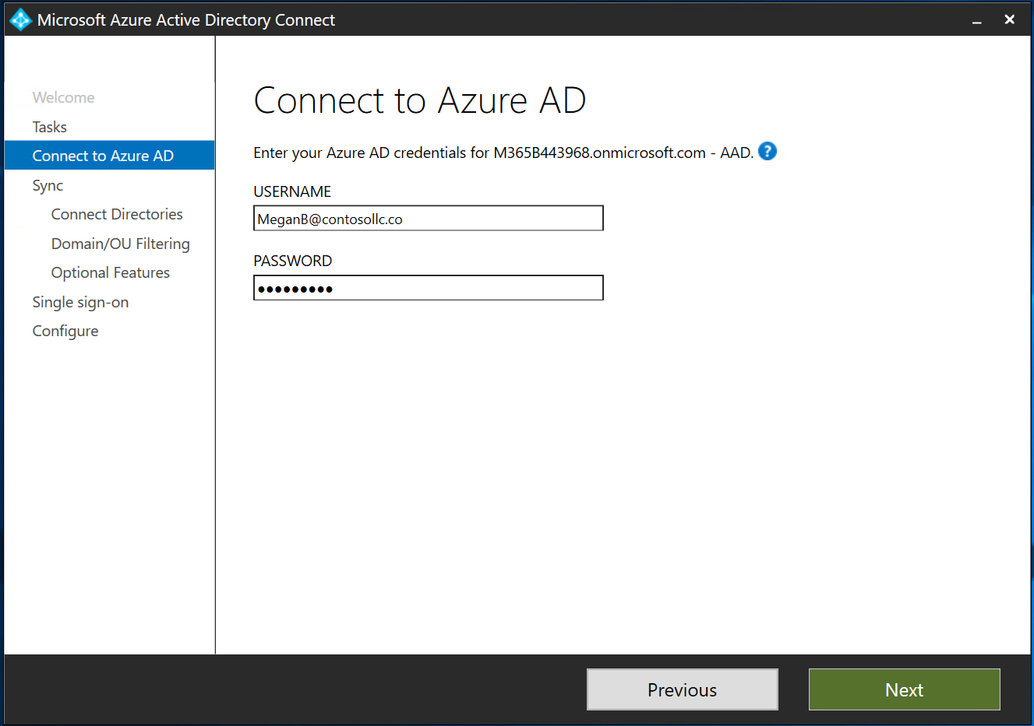
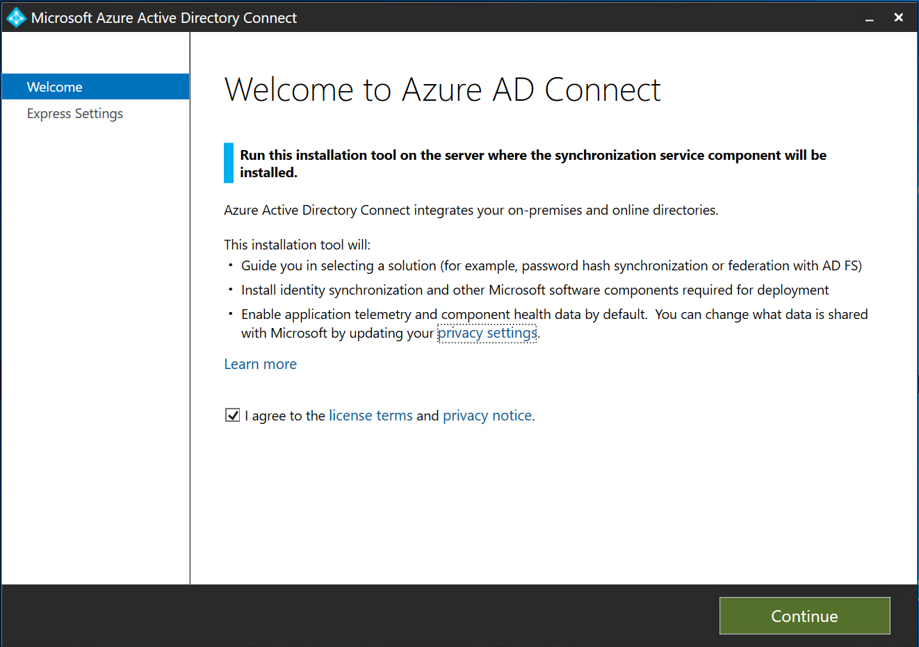
Notes:
After installing AAD Connect, you will need to configure it.
The first step is to accept the license agreement and press Continue <click>
NOTE: These demo steps to install Azure AD Connect are the same for Hybrid Azure AD Join. Hybrid will have additional steps to configure the service connection point object and Group Policy after install.
To ensure the best AAD Connect experience, use the latest version that is available for download.

Slide 21
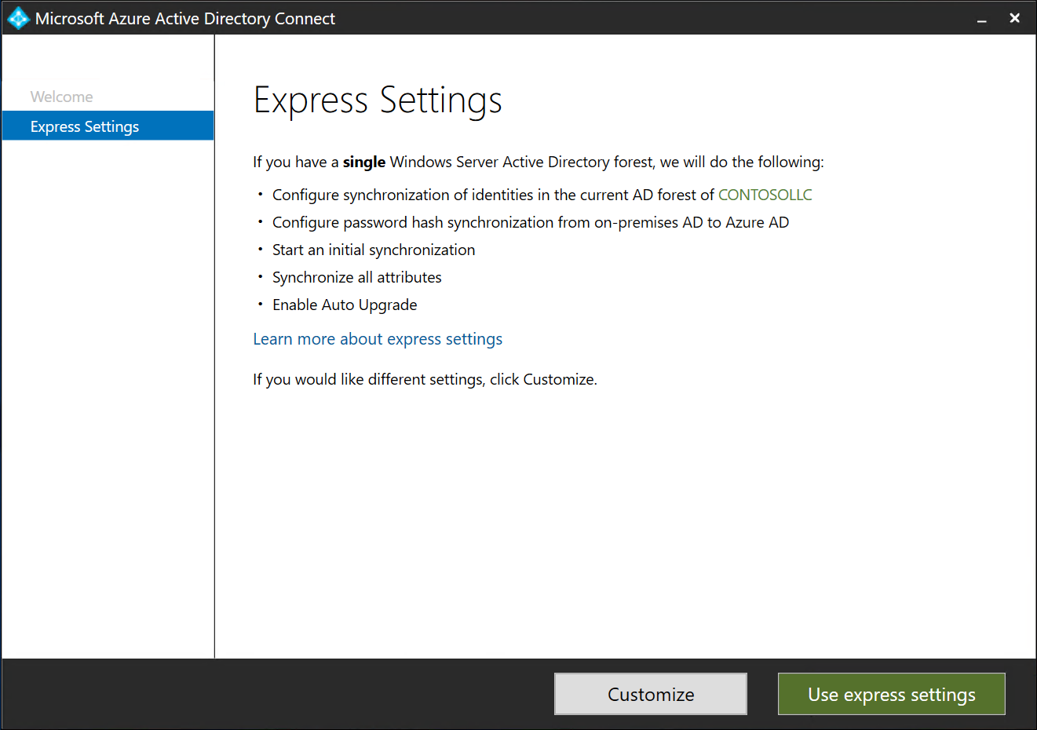
Notes:
Now we have the option to use Express Setting or to Customize.
Express Settings will work for this scenario. For the example, we will select customize to show you all the options as well as allow us to specify which portions of the local Active Directory we want to synchronize. Let’s get started by pressing Customize. <click>

Slide 22
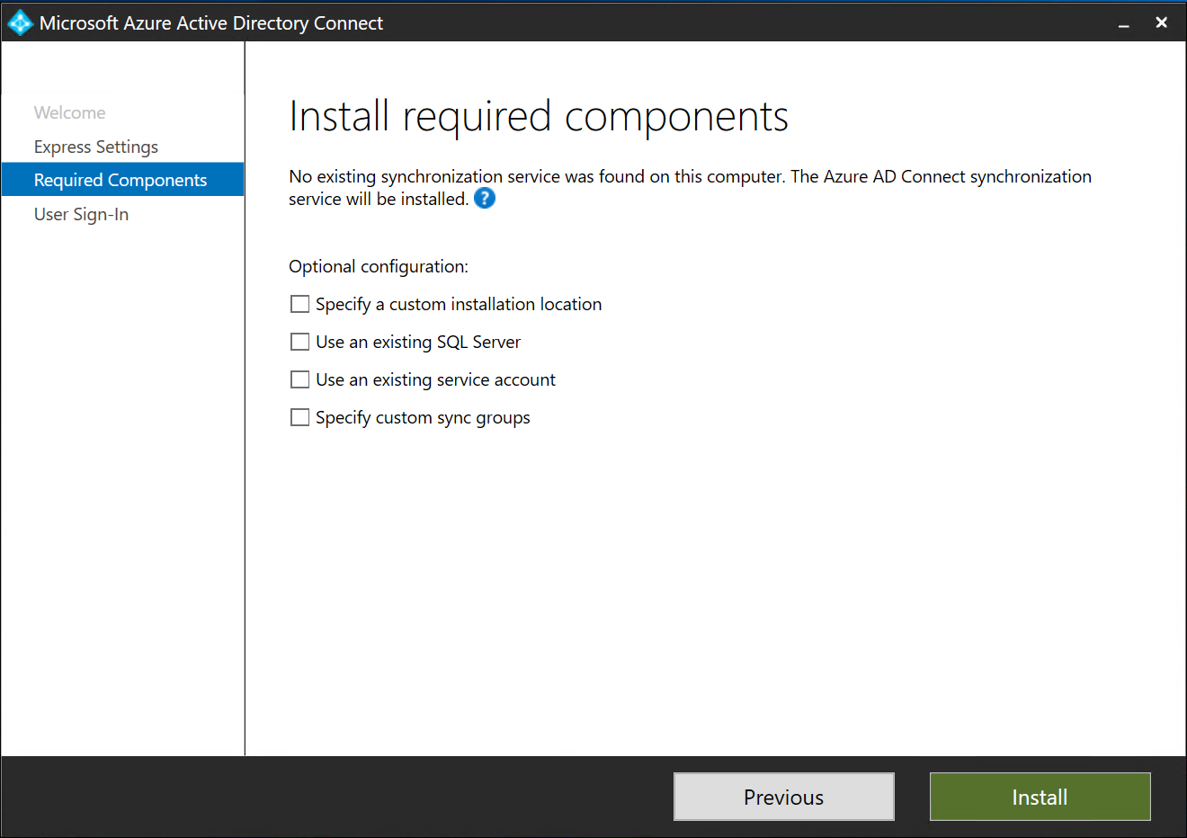
Notes:
We do not need to configure any of these configuration options, so we will simply press Install to continue <click>

Slide 23
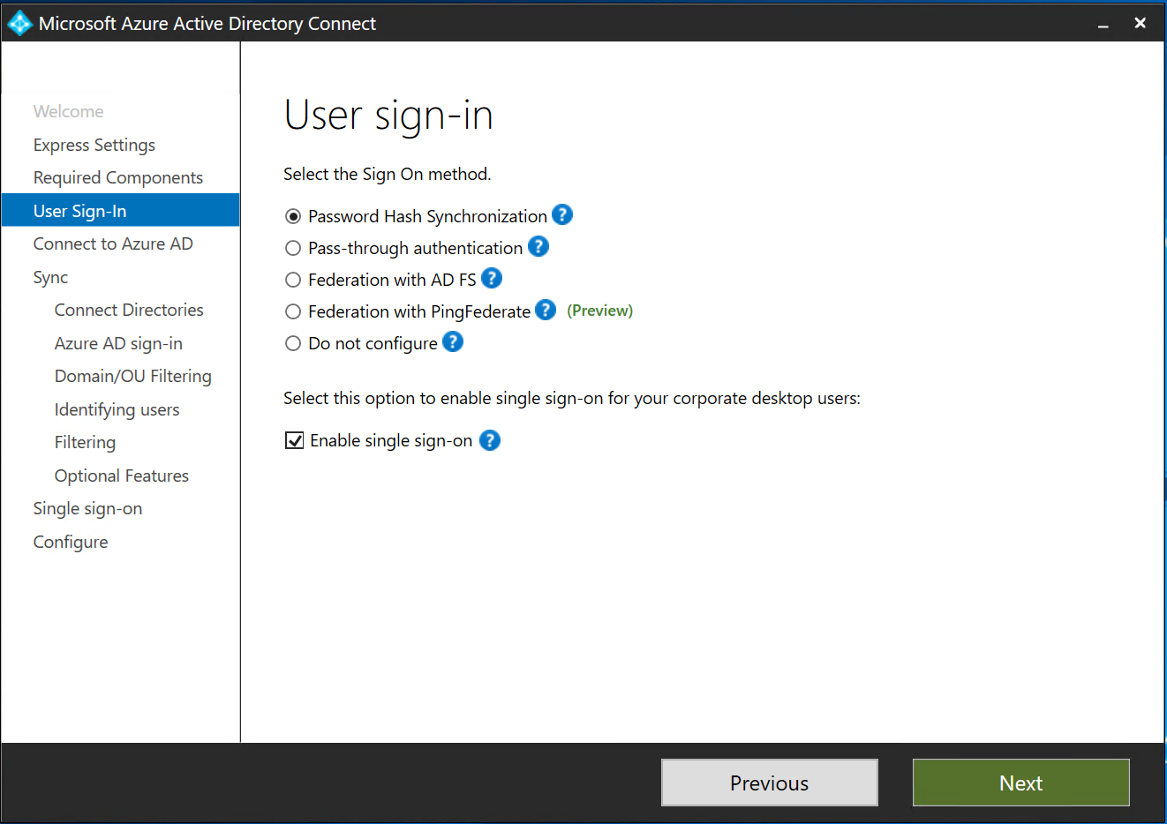
Notes:
Now we will configure the Sign Method for users synchronized with Microsoft 365 Business
These options are very important. We highly recommend you choose Password Hash Synchronization for most SMB scenarios.
Pass-through and Federation with AD FS are both supported; however, we don’t recommend those for SMB because they introduce extra complexity and there is also usually no additional benefits for using these more complex methods for most SMB customers.
It is also important to understand the Password Hash Synchronization does not store or send clear-text passwords to the cloud. Only a hash is transmitted so the user password remains secure.
For the Azure AD Join scenario, we do not need to check the box for Enable single sign-on if all devices will be joined to Azure AD. If you’re going to have a mix of devices or leave some devices connected to the local directory, you may want to select this box so users with devices joined to the local AD have a single sign-on experience when accessing Microsoft 365 Business.
The AADJ joined devices will get single sign-on to M365B regardless if this box is checked or not. <click>
For more detailed information on Azure Active Directory deployment plans, including Password Hash Sync, and Pass-Through authentication visit https://aka.ms/deploymentplans

Slide 24
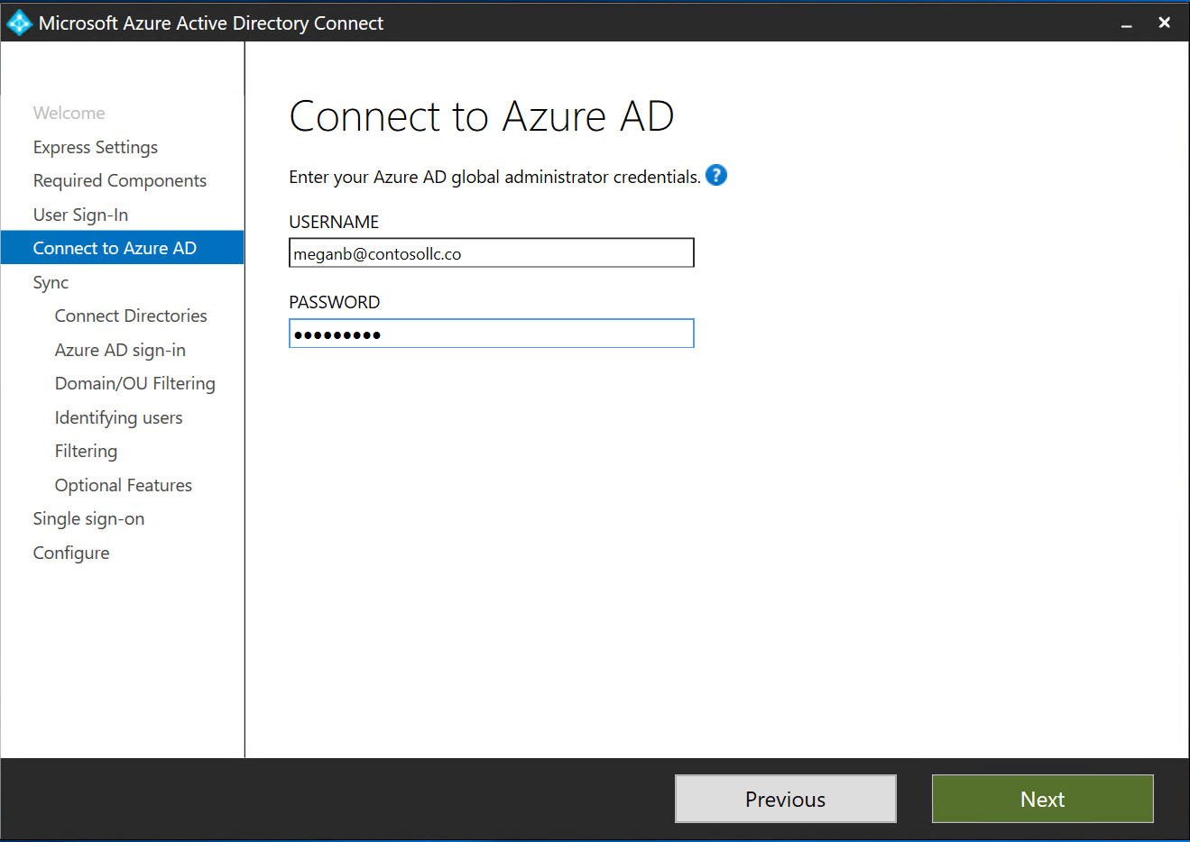
Notes:
Now we will sign into Microsoft 365 Business with a global admin account so we can configure the tenant for synchronization

Slide 25
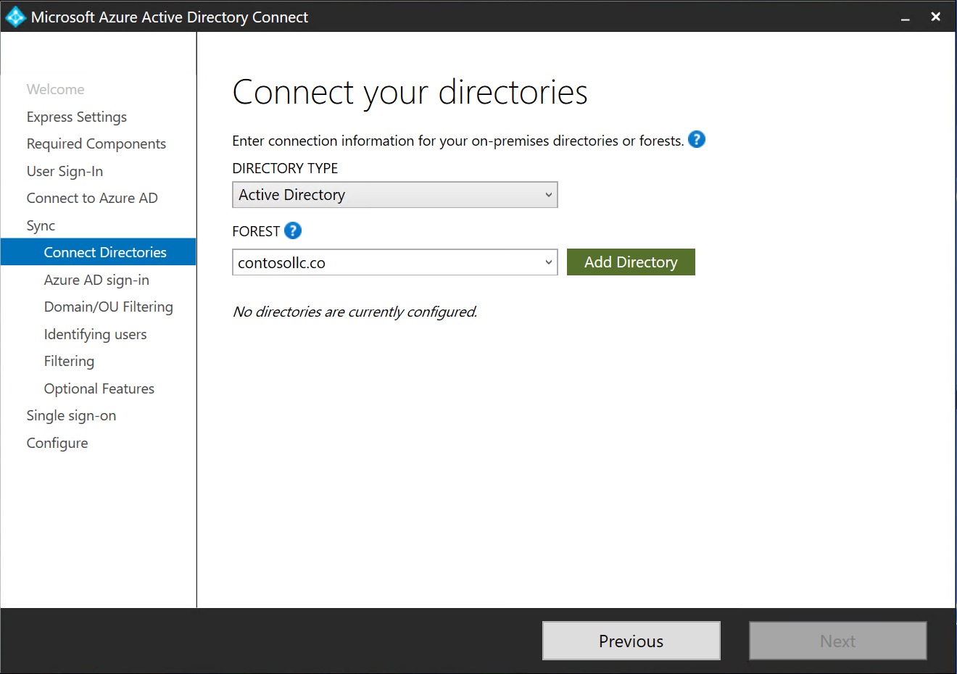
Notes:
Then you will add your local directory. Most SMB customers will have one forest; however, you can synchronize to more than one if necessary.
In this example, out Forest, contosollc.co, is automatically chosen and we will click Add Directory to choose it for synchronization with Microsoft 365 Business.

Slide 26
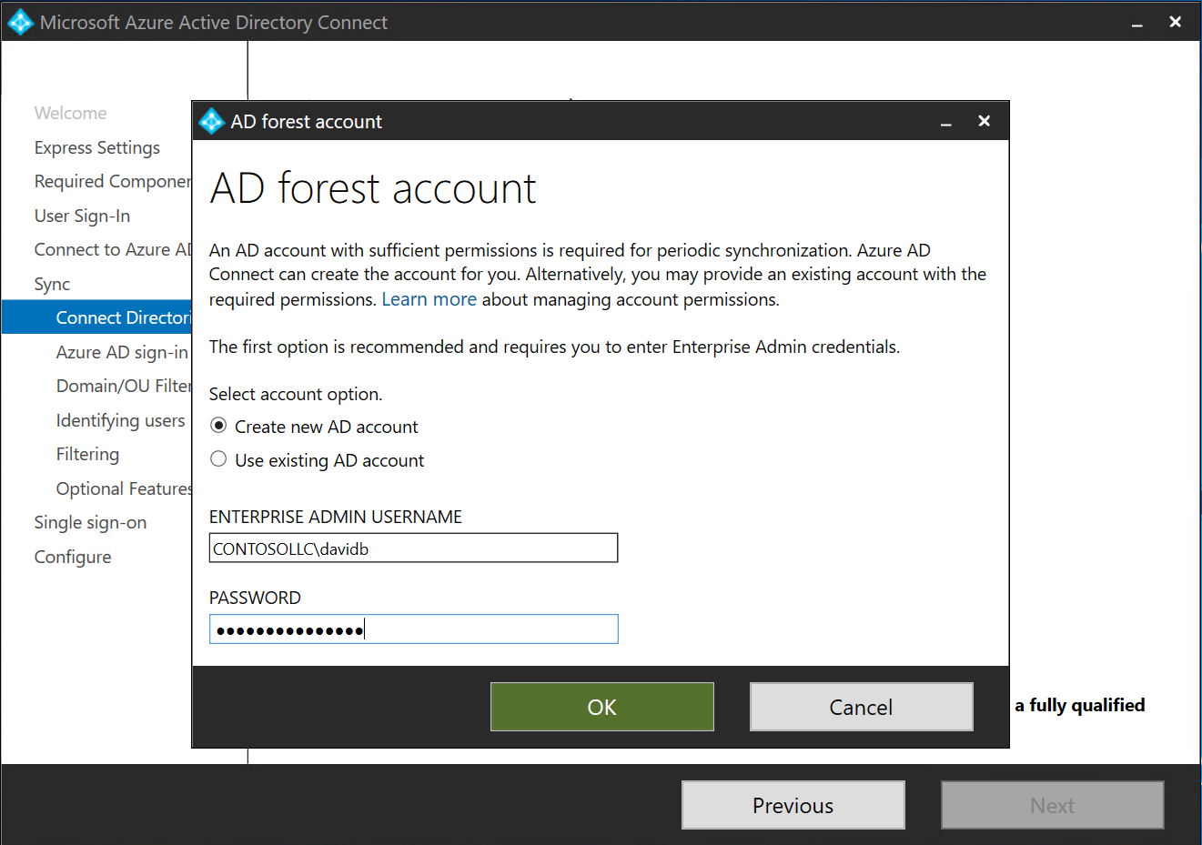
Notes:
Azure AD Connect requires an account in the local AD to perform synchronization tasks.
We will choose Create new AD account to allow the installer to create the account, associated groups, and configure appropriate permissions for us. You will find the account in the default users container and it starts with AAD_
We will also specify an Enterprise Admin username and password to create this account and click OK to continue <click>

Slide 27
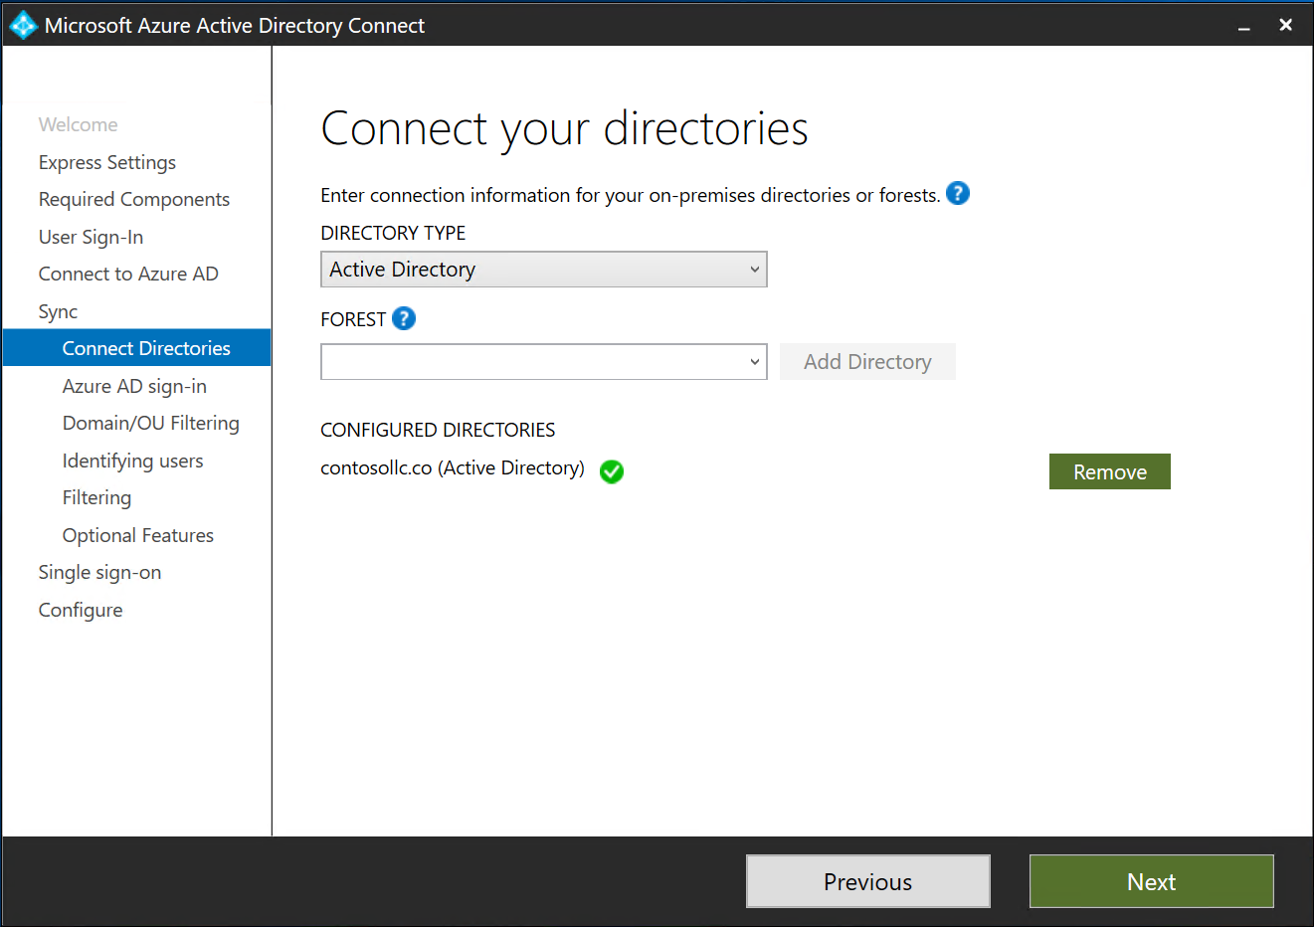
Notes:
Now we will confirm that the correct directory is configured and press Next <click>

Slide 28
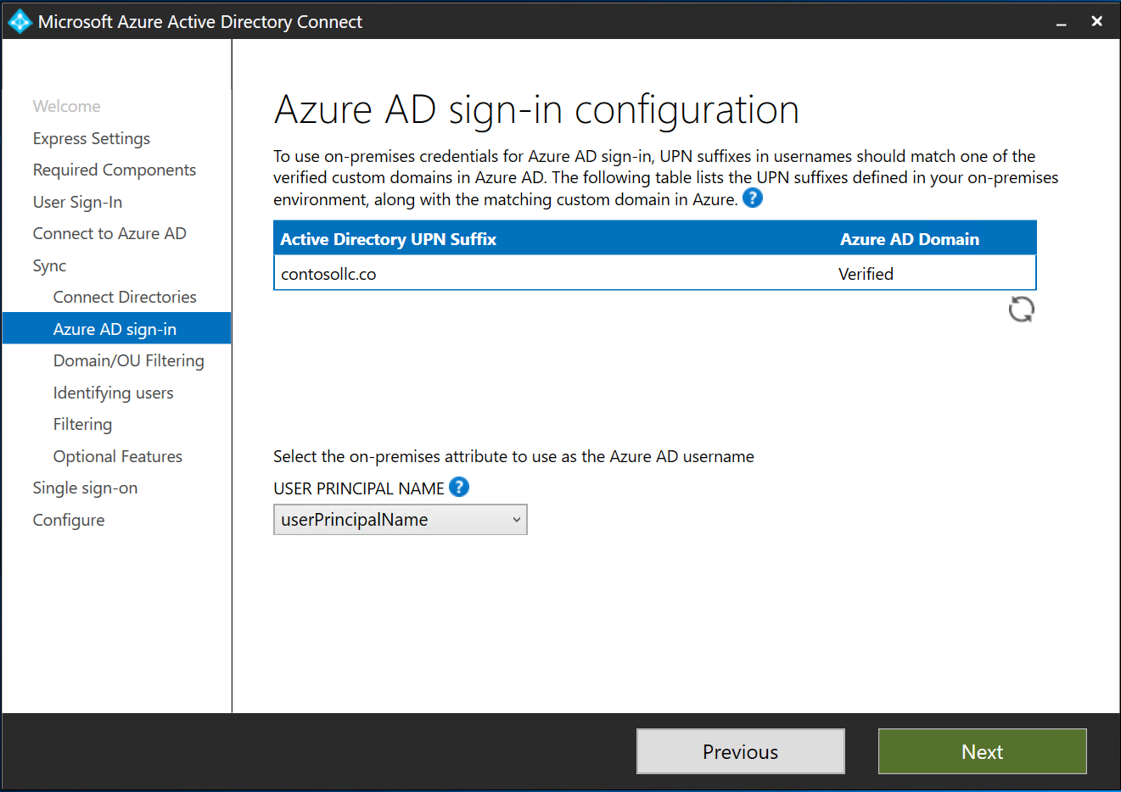
Notes:
Next we need to specify which attribute we will use as the Azure AD username.
We recommend using userPrincipalName. For most organizations, this will match the users’ email address which makes it simple and easy for users to remember.
In this example, the UPN suffix in use in our local AD matches our Azure AD Domain, which is the most common scenario. If your customer has not configured their UPN or it doesn’t match, we recommend fixing that before proceeding.
You can manually fix UPN in Active Directory or run a simple PowerShell script for this. Make sure you do this correctly and test before making changes to users in a production system.
Click Next to continue <click>

Slide 29
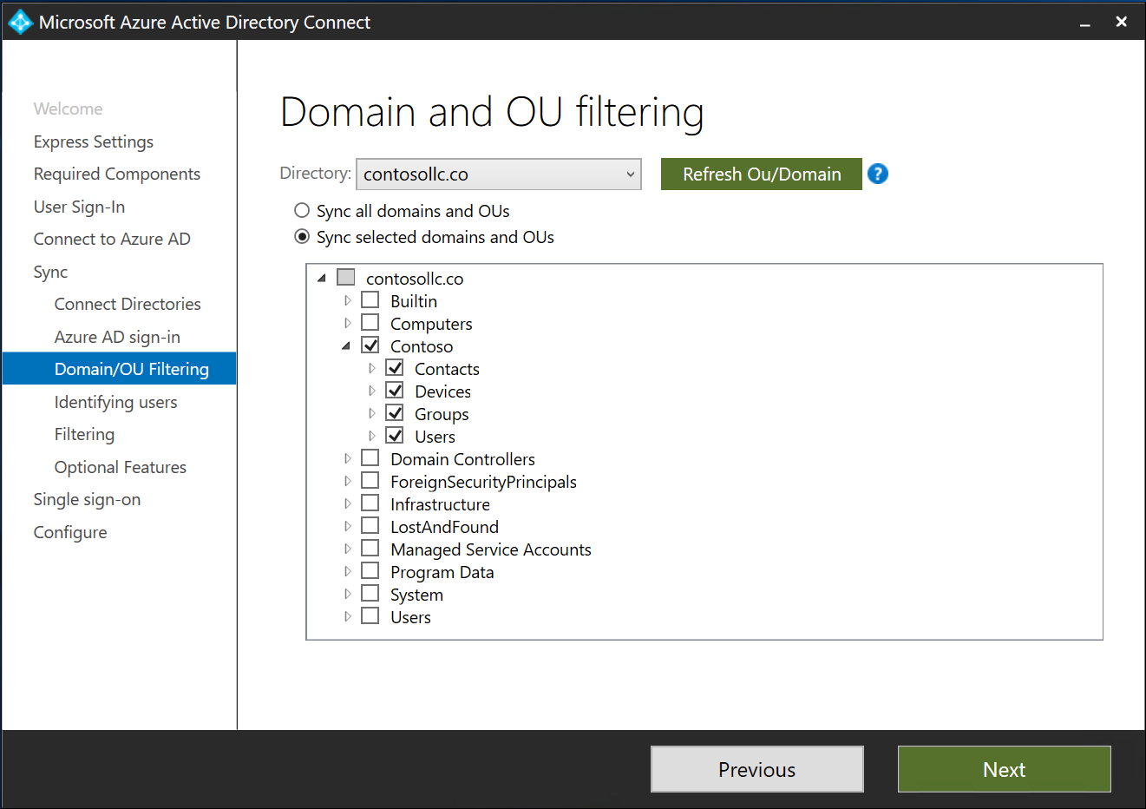
Notes:
Here we are taking the optional step of specifying which Organizaitonal Units (OU) and Containers to synchronize. It’s important to include all locations where users and devices exist. If you are not sure, you may sync the entire directory.
In this example, Contoso has a well-organized directory and all of the production users, groups, and computer objects exist under the parent OU Contoso
I’ll click on Sync selected domains and OUs <click>
Then I will click on the arrow to the left of contosollc.co to expand the list
Then I will unselect contosollc.co and select the Contoso OU
I’ll expand the Contoso OU to show the nested OUs selected
After configuring Domain and OU filtering the way I want it, I will click Next to continue <click>

Slide 30
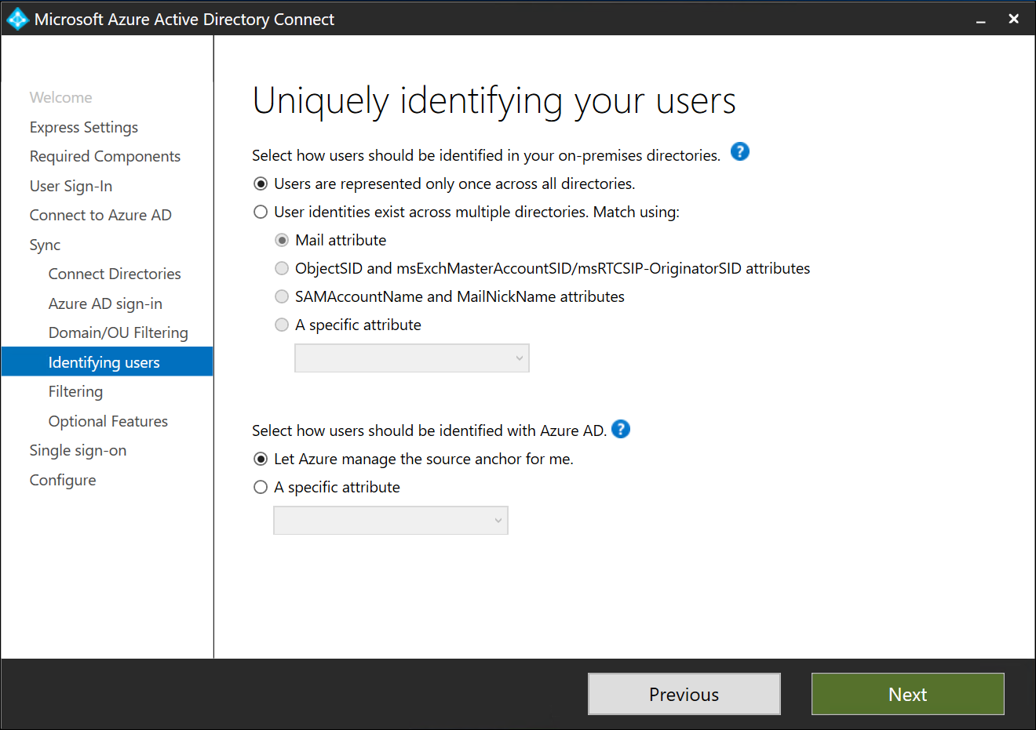
Notes:
Now we will specify how users are identified in on-premises directories and Azure AD.
The default options are suitable for most SMB and Enterprise scenarios.
If you have users represented in multiple synchronized on-premises directories (not common) choose an attribute that should be used to match the users
We recommend that you Let Azure manage the source anchor. This must be unique and cannot change over the lifecycle of the user object
Click Next to continue <click>

Slide 31
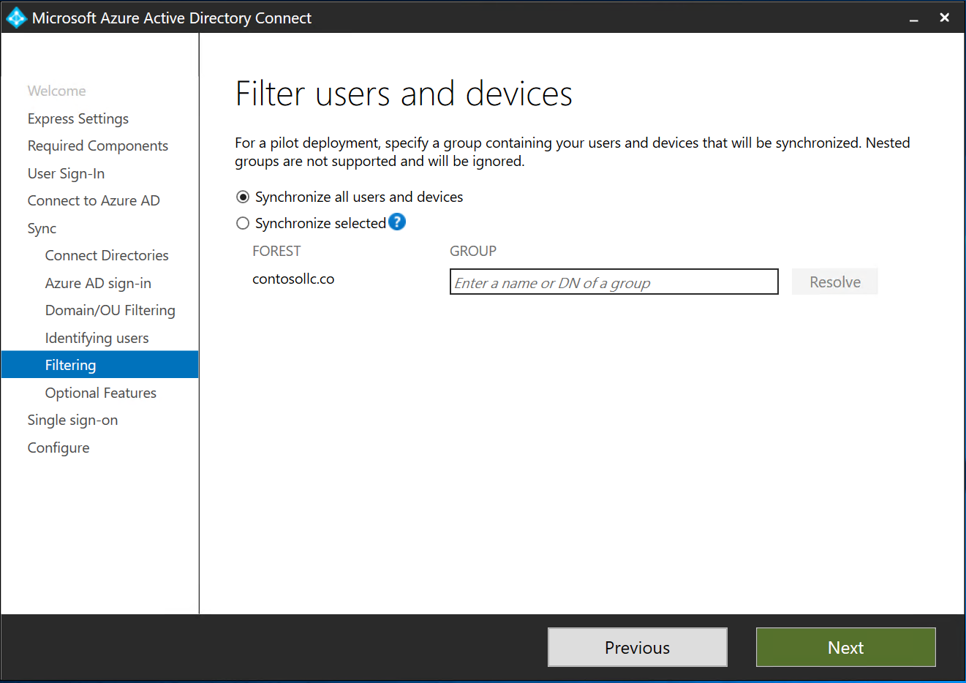
Notes:
We have the option to filter users and devices that are members of a specified group. This can be useful to testing a pilot deployment.
In this case, we’re comfortable synchronizing everyone and every device under the Contoso OU selected earlier.
Click Next to continue <click>

Slide 32
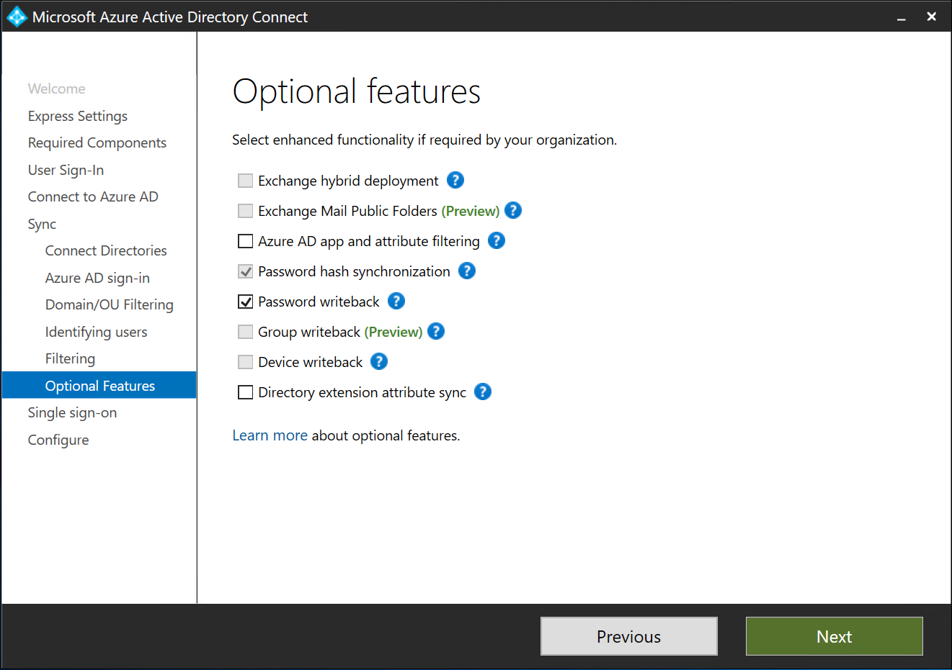
Notes:
THIS SLIDE HIDDEN UNTIL FEATURE ANNOUNCED
We have the option to commit password changes made in Microsoft 365 Business back to the local AD. In this case, we would like this functionality and select Password writeback. (NOTE: This is new functionality added to M365B in Fall 2018)
Click Next to continue <click>

Slide 33
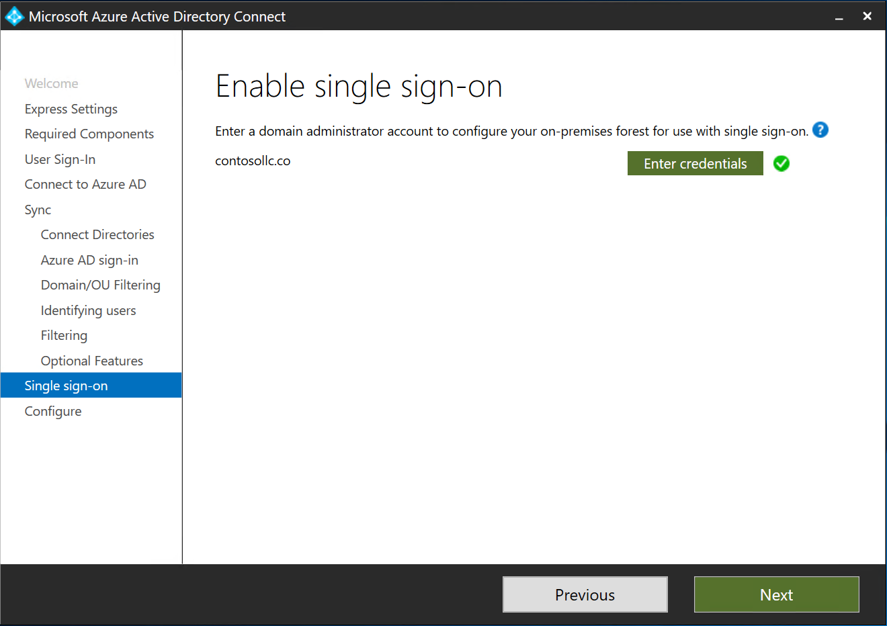
Notes:
The Azure AD Connect installer will configure our local AD for single-sign on because we selected that option earlier. To do this, the installer needs credentials of a domain administrator.
Azure Active Directory Seamless Single Sign-On (Azure AD Seamless SSO) automatically signs users in when they are on their corporate devices connected to your corporate network.
When enabled, users don't need to type in their passwords to sign in to Azure AD, and usually, even type in their usernames.
This feature provides your users easy access to your cloud-based applications without needing any additional on-premises components.
Click Next to continue <click>
Previous notes below – pretty sure this isn’t accurate, but keeping in just in case
The Azure AD Connect installer will configure our local AD for single-sign on because we selected that option earlier. To do this, the installed needs credentials of a domain administrator.
This ensures that users signed into Azure AD Joined devices can still access local resources such as file shares, printers, and Line of Business applications.
The way this works is that the AAD joined Windows 10 devices will recognize that the user signed in is synchronized to the on-premises directory. The device will prime itself with the necessary NTLM and Kerberos tokens needed for access to local domain resources even though the device is not a member of the domain anymore. Pretty cool, huh? Note – this doesn’t apply to Hybrid Azure AD Joined devices (We’ll go over this next) because they are still members of the domain.
We already entered our domain credential in an earlier step. If you did not do that, you have the option to do so here.
Click Next to continue <click>

Slide 34
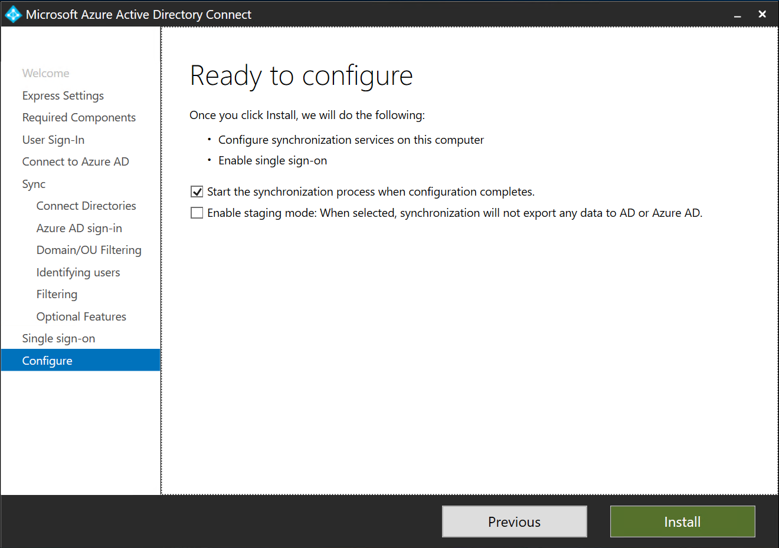
Notes:
We’re almost done!
We want synchronization to start as soon as possible so we will leave the default options checked.
Staging mode is not commonly used in SMB environemtns. It will configure the underlying synchronization engine, but to not sync so that it can be used as standby solution for higher availability. We will not select that option.
Click Next to Install and allow Azure AD Connect to synchronize <click>

Slide 35

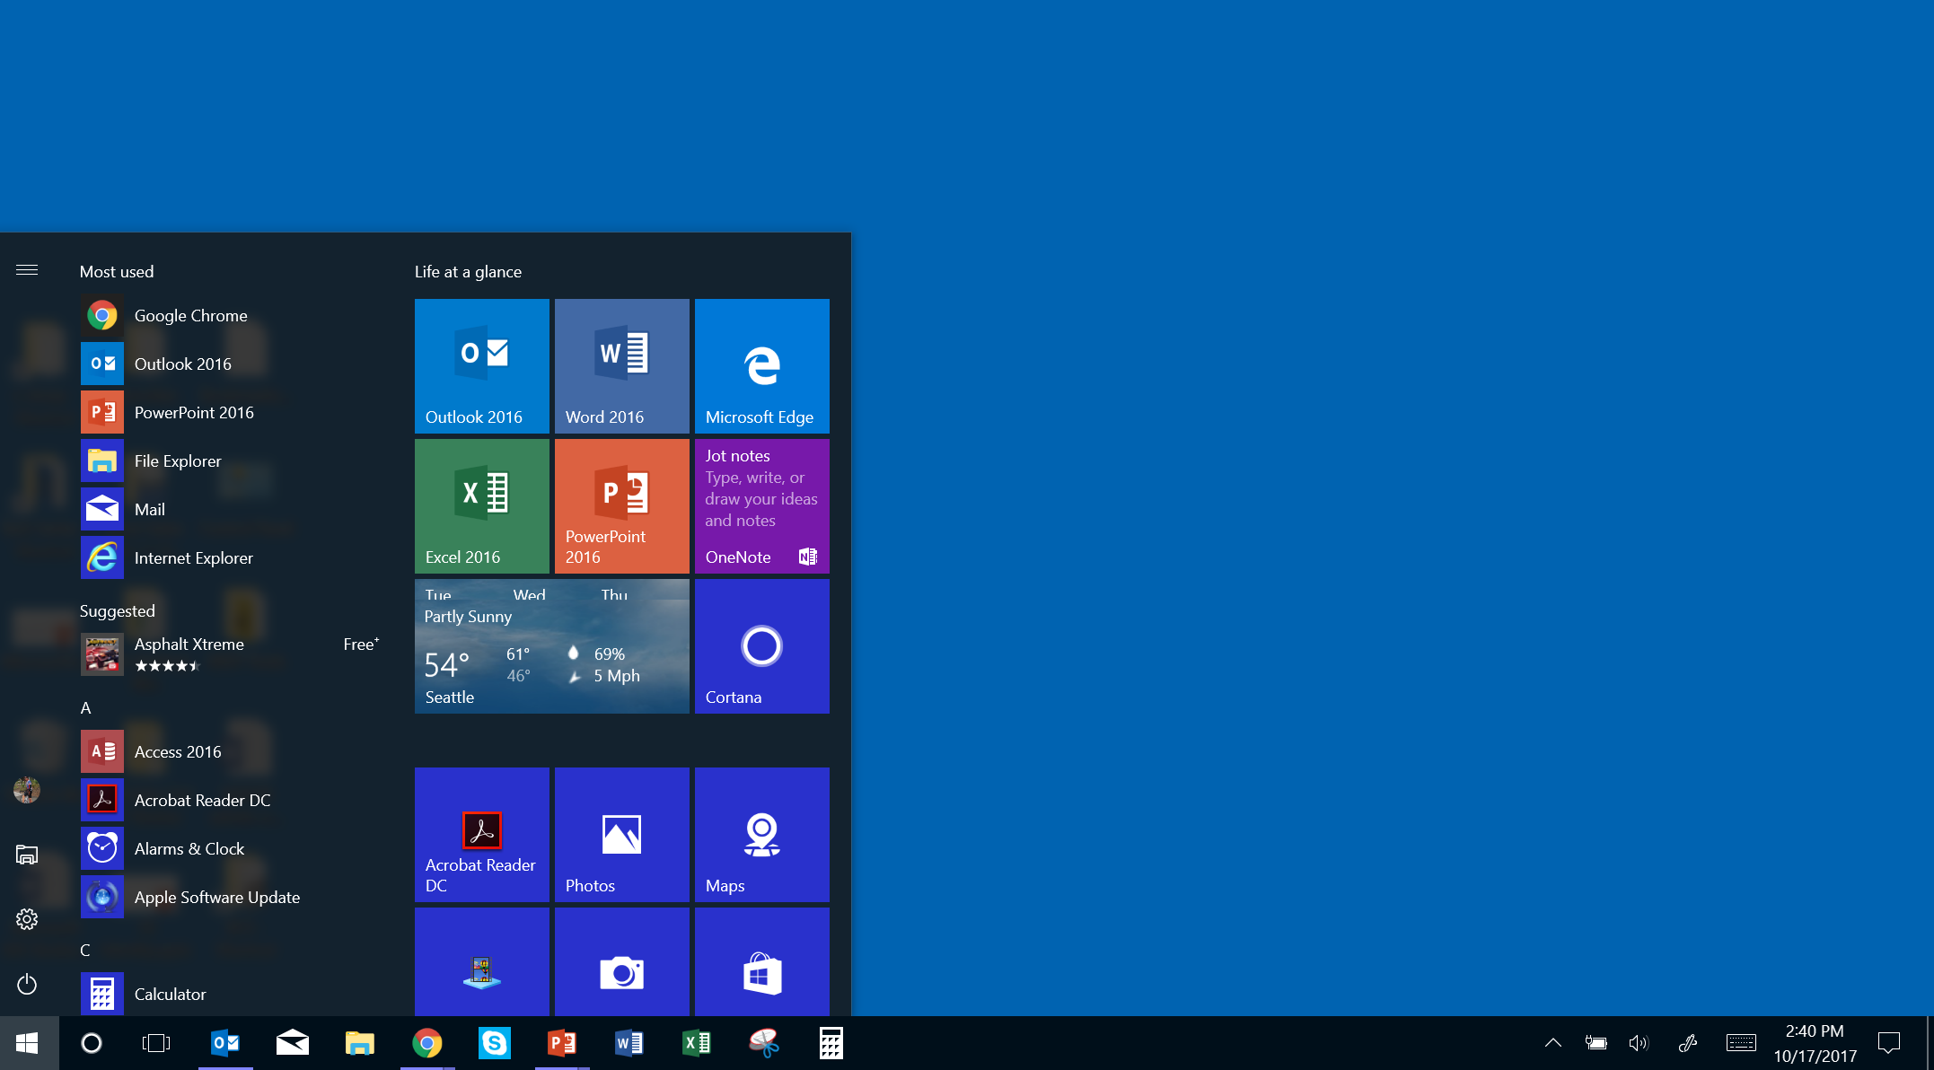
Activating Windows 10 Business—existing device
Click Settings
Notes:
Before joining Windows devices to Azure Active Directory, all the devices must have been already upgraded to Windows 10 Pro Creators Update or already running Windows 10 Pro Creators Update. Once the devices are joined to Azure AD, they will automatically be upgraded to Windows 10 Business, which is part of your Microsoft 365 Business subscription.
So, how do we join an existing Windows 10 Pro 1703 or above to Azure AD? We begin by clicking the Start button in the lower-left corner of the Windows desktop and then clicking the Settings icon. <click>

Slide 36
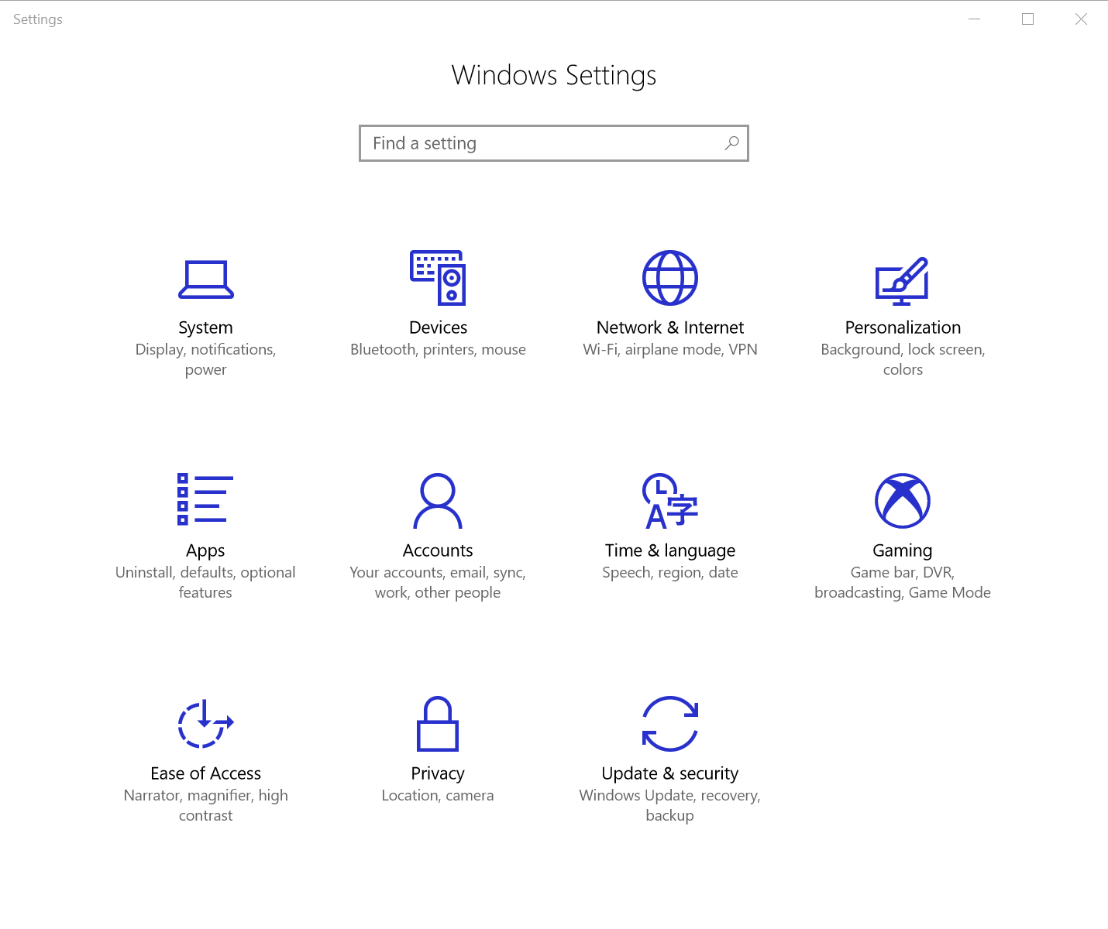
Activating Windows 10 Business—existing device
Click Accounts
Notes:
From the Settings page, click Accounts. <click>

Slide 37
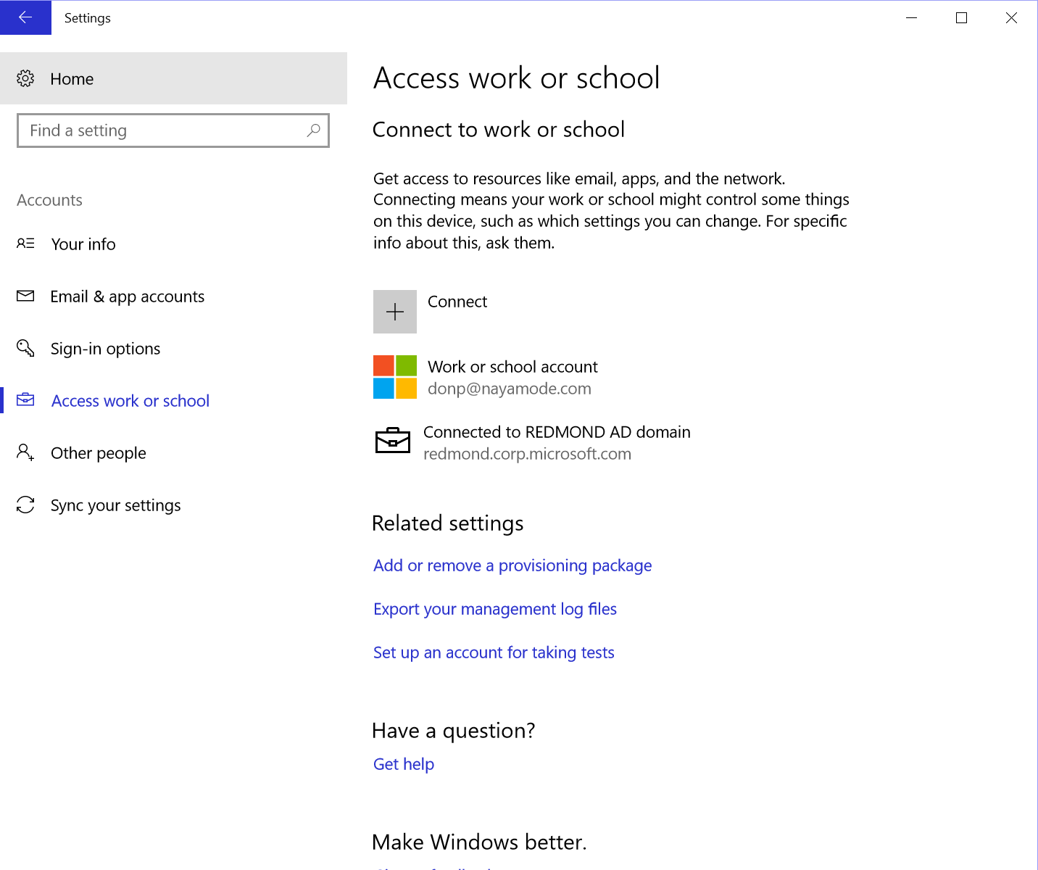
Activating Windows 10 Business—existing device
First, click Access work or school …
… and then click Connect
Notes:
Click Access work or school <click>, and then click Connect. <click>

Slide 38
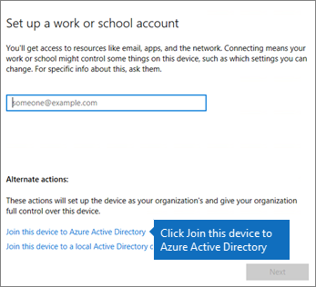
Activating Windows 10 Business—existing device
… and then click Join this device to Azure Active Directory
Notes:
On the Set up a work or school account dialog box, under Alternate actions, click Join this device to Azure Active Directory. <click>

Slide 39
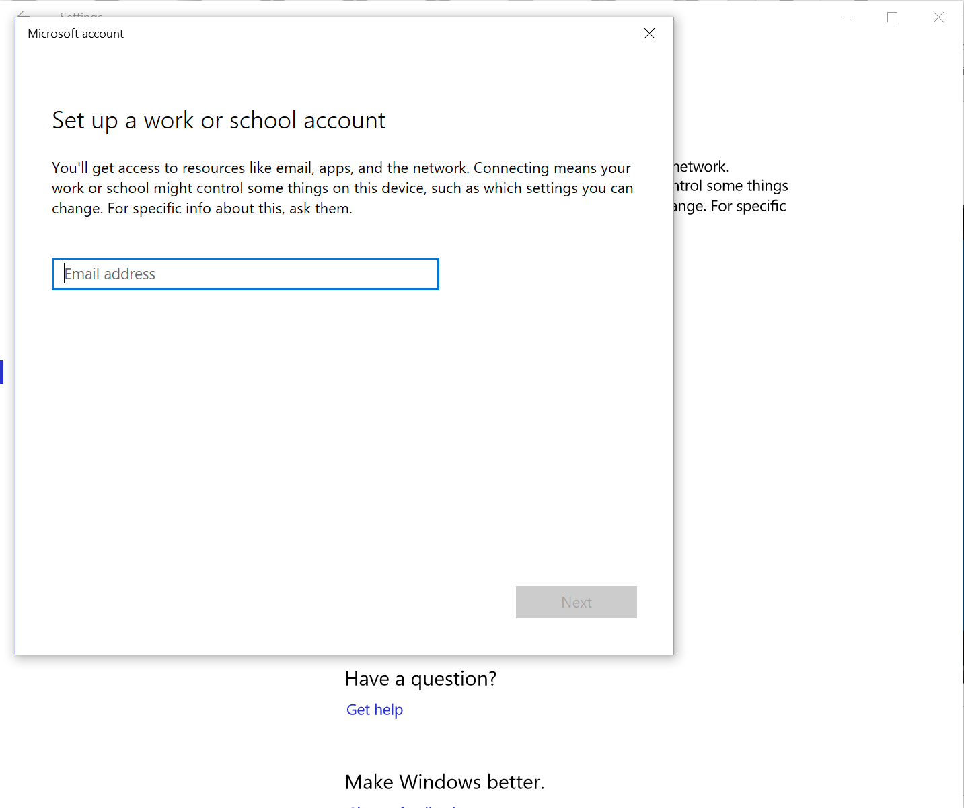
Activating Windows 10 Business—existing device
Enter the user email address with the Microsoft 365 Business domain
Notes:
Enter the mail address with the company’s Microsoft 365 Business domain, and click Next. On the “Enter password” page, enter the password and then click Sign in.
On the “Make sure this is your organization” page, verify that the information is correct, and click Join. <click>
<click>

Slide 40
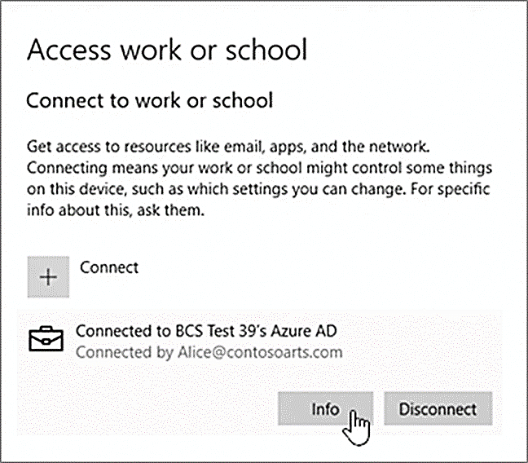
Activating Windows 10 Business—existing device
Confirm the device is connected to Azure Active Directory
Notes:
To verify the device is connected to Azure AD, confirm the user’s sync status. Go back to the “Access work or school” page, under Settings, and then click in the “Connected to <organization name>” area to expose the Info and Disconnect buttons. Click Info to see the synchronization status—you are looking to see that the device shows as Connected. <click>

Slide 41
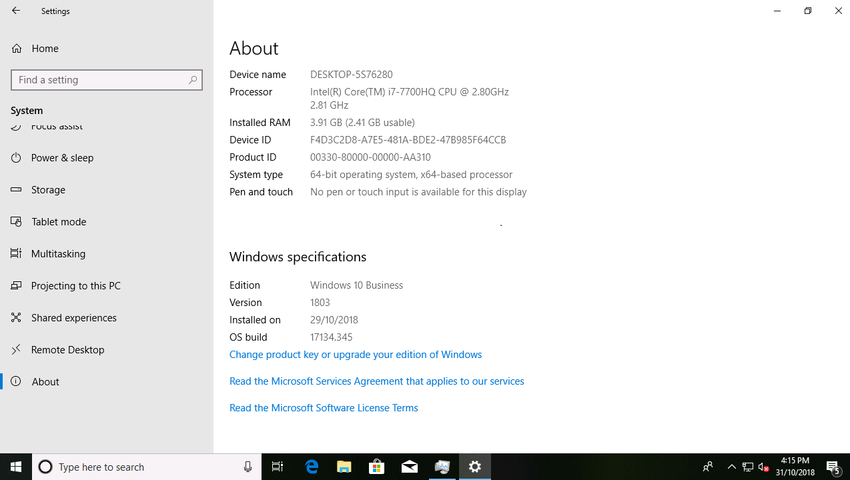
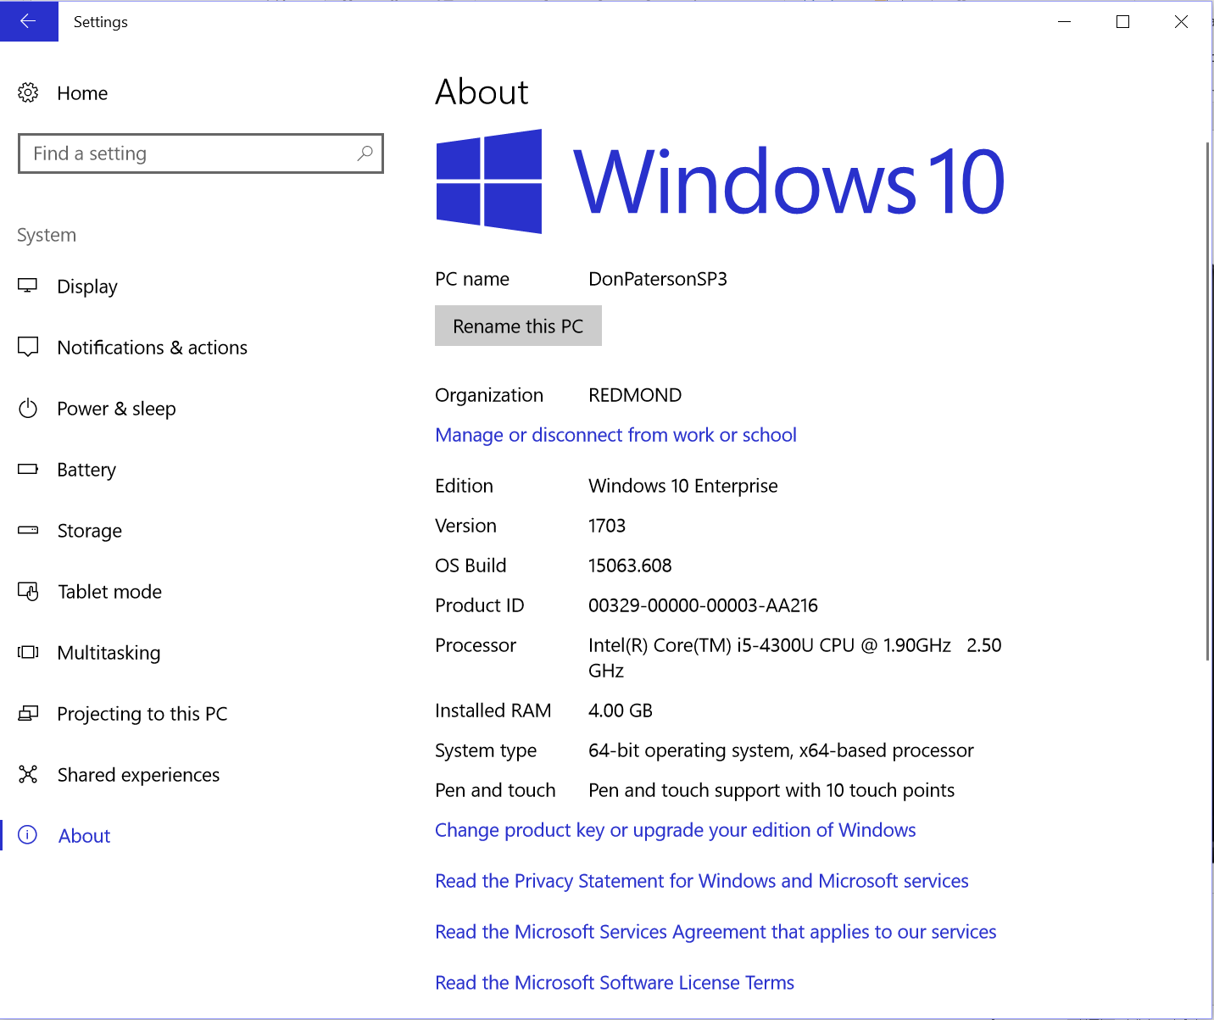
Activating Windows 10 Business—existing device
Once the upgrade is complete, Edition should show as Windows 10 Business
Changed to Windows 10 Business
Alice’s PC
ContosoArts.com
Business
Notes:
Finally, verify the device has completed its upgrade to Windows 10 Business by going to Settings … System … and then About. Confirm that Edition shows Windows 10 Business. <<click>

Slide 42
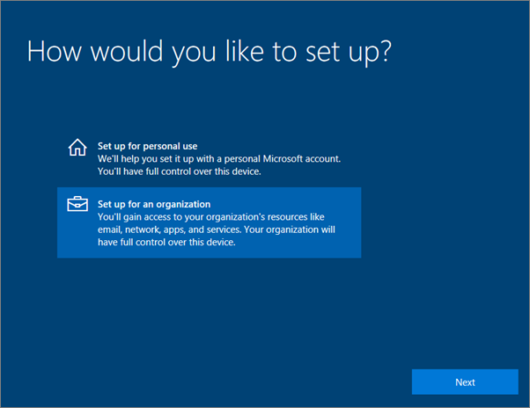
Activating Windows 10 Business—new device
Notes:
Before we close, let’s have a quick look at the process for joining to Azure AD a brand new device running Windows 10 Pro Creators Update, or for a device that was upgraded to Windows 10 Pro Creators Update but is going through Windows 10 device setup for the very first time.
There are just a few quick steps to complete. First, the user will go through Windows 10 device setup until he/she gets to the “How would you like to set up?” page. In the Windows session later today, we’ll talk about how you can use Autopilot in Microsoft 365 Business to dramatically reduce the number of setup steps a user has to go through here.
Once the user gets to this page, he/she chooses Set up for an organization, which then prompts for the username and password for Microsoft 365 Business. Then the user just completes the Windows 10 device setup.
<click>

Slide 43
Activating Windows 10 Business—new device
Confirm the device is connected to Azure Active Directory
Notes:
Once initial setup is completed, you can verify that the device is connected to Azure AD by following the process we outlined just a few moments ago. That is, go to the “Access work or school” page under Settings. Click in the “Connected to <organization name>” area to expose the Info and Disconnect buttons, and then click Info to get your synchronization status. That’s it! <click>

Slide 44
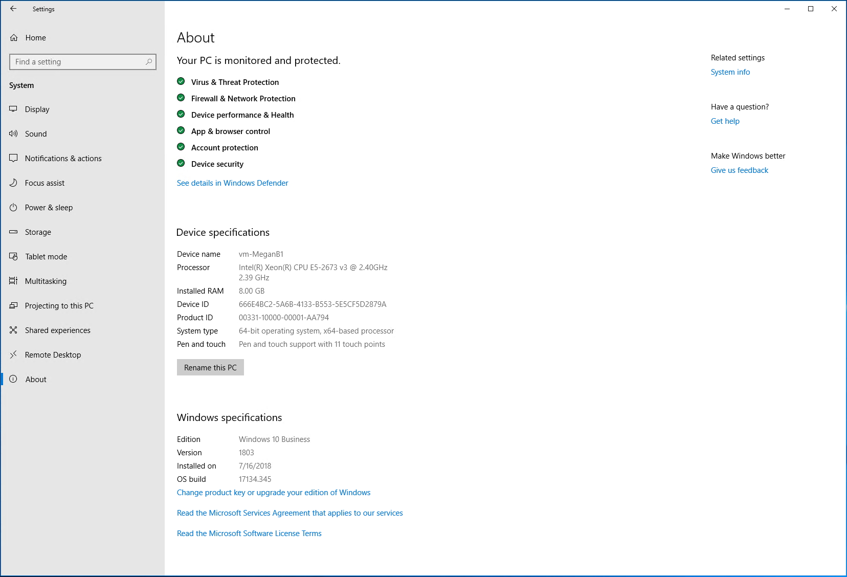
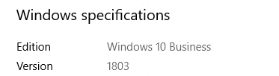
Activating Windows 10 Business—new device
Notes:
Finally, just as you saw for the existing device process, you can verify that the device has completed its upgrade to Windows 10 Business going to Settings … System … and then About. Confirm that the Edition shows Windows 10 Business.<click>

Slide 45
For Customers with AD - Device Deployment steps for
Option A: Azure AD joined device (With AAD Connect)
Step 1
Step 2
Step 3
Step 4 (optional)
10 Pro
LOB Apps
File shares
Printers
Upgrade to Win 10 Pro
  Upgrade OD to Win 10 Pro creators update
Enable AAD Connect
  Synchronize identities
Join device to Azure AD
  Sign in and verify Microsoft 365 Business credentials
Run MMAT Tool to get Configuration Service Providers (CSPs) for existing GPOs
Devices can access local resources like LOB apps, file shares, printers when Azure AD Connect is enabled
Caveats of Azure AD Joined Device Deployment Method
AAD Join creates a new profile; Profile needs to be manually migrated
Some GPOs may not map to Intune
Win 32 apps relying on machine authentication won’t work
Printer path works; AD Printer discovery does not work
Notes:
Now that we have completed the Windows 10 Pro deployments, configured AAD Connect and joined the devices to Azure AD, we can take a look at some of the additional areas that might need attention for the customer.

Slide 46
User profile migration
Caveat of AAD Joined Device Method
When a device Azure AD joins, it creates a new profile and doesn’t reference any existing profile
User profiles typically include
Guidance for profile migration
Device state | AAD joined state
New device | No profile migration needed
Local/ workgroup | Profile migration needed
Domain joined device | Profile migration needed
Favorites
Local files
Browser settings
Cached credentials
Outlook caches (autofill)
Some third-party app settings
Start menu configuration
Manual Copy/Paste or Find a tool to migrate Profiles,
Remaps existing files and settings to new profile
Preserves all cache
Limited Offer to Use Laplink Tool
Partners can use Laplink Tool to migrate Profiles from Local/WG accounts through Nov 2018
Download Laplink PCmover Profile Migrator from http://aka.ms/profilemig
Free to Microsoft 365 Business users connected to Azure Active Directory through November 15, 2018.
Notes:
With user Profile Migrations, you won’t have to worry about profile migration in the long term, and it’s a one time thing effort for each user and/or device.
You can use one of the many profile migration tools that exist, and depending on the timing of the migration you may be able to take advantage of the Laplink Pcmover Profile migration as referenced onscreen.

Slide 47
Group Policy Objects (GPOs)
Caveat of AAD Joined Device Method
Some existing GPOs may not have comparable CSPs in Intune
GPOs typically used in SMB
Guidance: Map a path to management in Microsoft 365 Business
Mapping drives
Start menu customization
Desktop background customization
Screen saver customization
Configure registry settings
Have more? Tell us @SMB Tech Community (aka.ms/smbtc)
Run the MMAT tool to get CSPs for comparable policies in Intune
Migrate those GPOs that have the CSPs in Intune
Evaluate the necessity of those that don’t and report to Microsoft
To download MMAT Tool: https://www.microsoft.com/en-us/download/details.aspx?id=45520
Notes:
Let’s look now at Group Policy Objects. GPOs are used to control the user’s PC experience and enable lots of experience customization while also providing some security control. Truth be told, however, this technology is now 20+ years old and is not at all aligned to support a new identity and management paradigm with users accessing files and data from anywhere. It simply wasn’t designed for today’s mobile workforce.
So, when thinking about moving a customer to Microsoft 365 Business, there are a few fundamental questions about GPOs that need to be answered.
- Is the customer even using GPOs? If no, you are good to go! This is often the case is businesses with fewer than 20 seats.
- If yes, then Run the MMAT too to get the CSP for comparable policy in Intune. If a comparable CSP doesn’t exist in Intune really evaluate the need for that GPO.
Report to Microsoft what’s really important for your customers to have consistency in security profiles that follows the user with enforcement across the user’s devices, and the ability to access and manage policies from the cloud.
The tool will gather GPO applied on a device and produce a report to indicate whether there is equivalent MDM support available
MDM Migration Analysis Tool (MMAT) is updated for newly added MDM policies
MMAT is a tool IT Pro can run at any Win7, Win8.1, or Windows 10 domain joined machine to find out what group policies your org configured in the device and report which have MDM support in latest Windows client release and corresponding MDM setting names.
You can download the tool at: https://aka.ms/mmat

Slide 48
Legacy Win 32 apps
Caveat of AAD Joined Device Method
Win 32 Apps requiring AD Machine Authentication won’t work
Apps that work
Apps that don’t work
Guidance
Apps that Support:
NTLM, Modern Auth, Kerberos TGT
Win 32 Apps that require AD Machine Authentication
Evaluate the necessity of Machine auth legacy app; Move to App that supports modern Auth if possible
Notes:
Win32 apps requiring AD Machine authentication are not very common., and most apps rely on user authentication and these works well in Azure AD Join scenarios.

Slide 49
Printing
Caveat of AAD Joined Device Method
Some printing scenarios are not supported:
Printing scenarios that work
Printing scenarios that don’t work
Guidance
Direct Printer Path
AD Printer Discovery
Notify users of direct printer path where possible
Use a Powershell script from Intune to map the printer
Utilize Hybrid Cloud Printing
(requires AAD Premium P1 add-on)
Notes:
Most SMB users print directly to a printer or a print server. This works just fine in the Azure AD Join scenario.
AD Printer Discovery is a feature that helps find a printer based on a PC’s current network location, and this option isn’t available for Azure AD joined devices, so you could use one of the methods listed on the slide instead.
Hybrid Cloud printing requires the Azure AD App Proxy, which is available with AADP P1.

Slide 50
What if these remediations are insufficient?
Caveats of Azure AD joined device Deployment Method
AAD Join creates a new profile; Profile needs to be manually migrated
Some GPOs may not map to Intune
Win 32 apps relying on machine authentication won’t work
Printer path works; AD Printer discovery does not work
Deploy with Option 2: Hybrid Azure AD joined device config
Notes:
If any of the caveats mentioned before apply to your customer, or if you customer simply prefers to keep their devices joined to Active Directory for now, there’s good news. Hybrid Azure AD joined devices are fully supported in Microsoft 365 Business.

Slide 51
Getting to Microsoft 365 Business management of device from current state
Current Customer State
Customers in Microsoft 365 Business
No Active
Directory
Device is Azure AD joined
On-prem
Active Directory
1. Device is Azure AD joined with AAD Connect
2. Device is Hybrid Azure AD joined with AAD connect
2 options
Notes:
For Customers with an existing AD, Consider Option 2: Hybrid Azure AD Joined Device
This will simplify Windows deployment for existing Windows 10 devices because the user profile will not need migration
Also – it is entirely possible to run a mix of Azure AD Joined and Hybrid devices. For example, a customer may choose to use Hybrid for existing devices and Azure AD Join for all new devices.

Slide 52

For Customers with AD, Option 2:
Device is Hybrid Azure AD Joined
Overview
Intune
Extend your on-premise AD to Azure AD using Azure AD Connect
Device is joined to both on-premises AD and Azure AD
Can be MDM enrolled and brought under Microsoft 365 Business management
Azure Active Directory
Azure AD joined
Azure AD Connect Tool
10 Pro
AD domain joined
Windows 10 Pro Device
Active
Directory
Benefits
Provides automatic device registration once you have configured device option using Azure AD Connect
Enables Single-Sign-On (SSO) to both on-premise and cloud resources
LOB apps
File shares
Printers
Notes:
If you have existing Domain joined devices then consider using the Hybrid Azure AD joined Device Configuration – If you don’t want to deal with the hassles of unjoining a domain. The only difference between this diagram and the one we showed before is the Windows 10 device’s membership to Active Directory (outlined in red)

Slide 53
Remember 4 things for Hybrid Azure AD
1
2
3
4
Azure AD Connect
Service Connection Point
Group Policy
Group Policy
To sync domain computer objects to Azure AD
To prepare domain computers to join Azure AD
To join domain computers to Azure AD
To enroll domain computers in Intune
Notes:
There are 4 critical components to getting Hybrid Azure AD to work.
Azure AD Connect is required for the scenario. Express configuration will work; however, you may way to use the Custom configuration to specify which portions of the directory to sync, and enable single sign-on.
The service connection point (SCP) is critical for this scenario. The easiest way to create it is by using the PowerShell module AdSyncPrep.psm1 that comes with Azure AD Connect. It is in the ADPrep folder in the Azure AD Connect installed directory (\Program Files\Microsoft Azure Active Directory Conn
We need a group policy setting to join domain computers to Azure AD - Register domain joined computers as devices
We need a group policy setting to automatically enroll domain computers joined to Azure AD into Intune -Enable automatic MDM enrollment using default Azure AD credential
Both group policy settings can be configured in the same group policy object.

Slide 54
Demo:
For Customers with AD, Option 2 Device is Hybrid Azure AD Joined
Notes:
Let’s take a look at the steps involved in configuring a customer’s environment for Hybrid Azure AD Joined.
NOTE TO PRESENTERS: Deliver the content on as a live demo. The screenshot click-through is provided as your demo script, but can also be used where access to the demo environment (demos.microsoft.com) is unavailable.

Slide 55
Notes:
We need to Install and Configure Azure AD Connect.
The install steps are exactly the same steps as we did setting up Azure AD Connect for AADJ.
NOTE: Refer back to demos slides for Azure AD Join if you want to go over it again. We’re just showing the last slide from the install here.

Slide 56
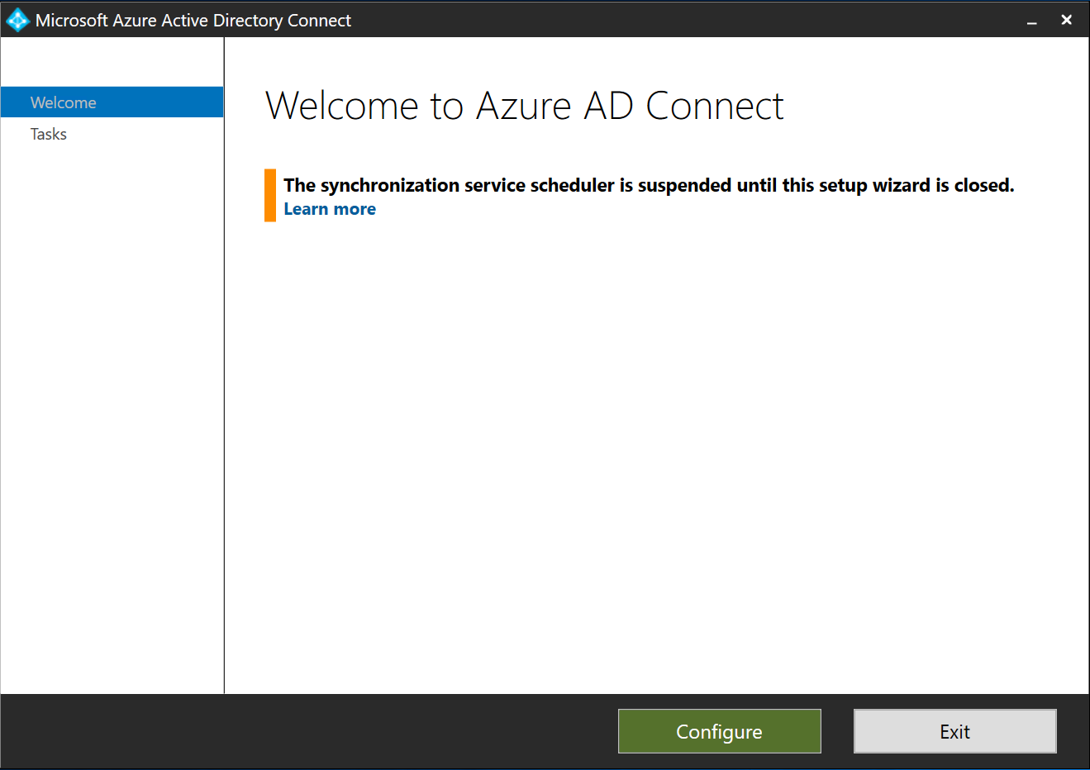
Notes:
We must now prepare the local Active Directory for Hybrid Azure AD joined devices
Start the Azure AD Connect app on the server where you installed in previously.
Click Configure <click>

Slide 57
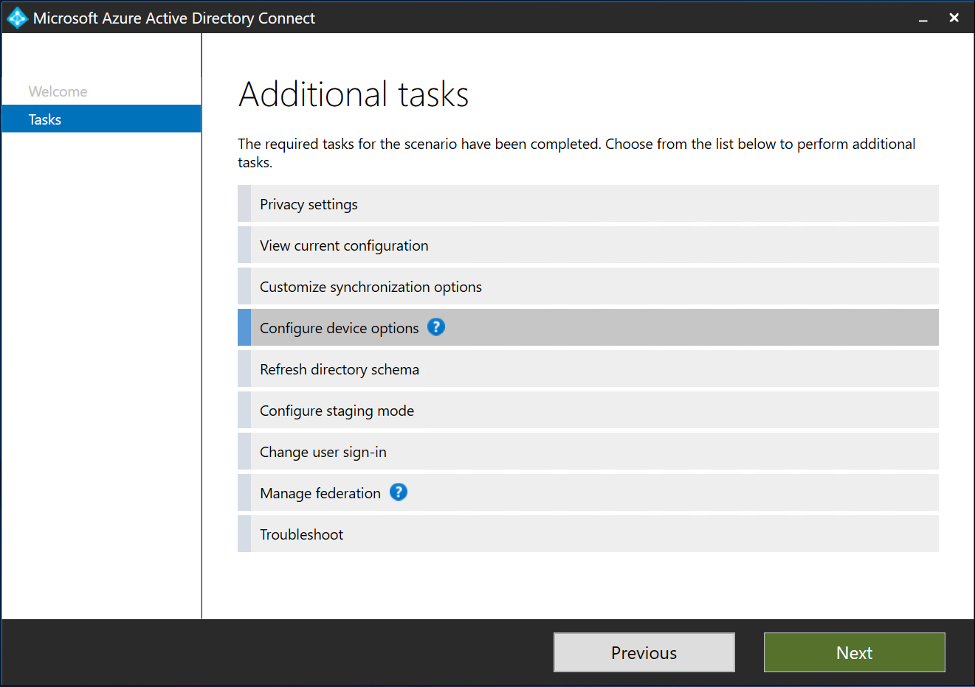
Notes:
Click Configure device options in order to configure device registration for Hybrid Azure AD Connect
Click Configure <click>

Slide 58
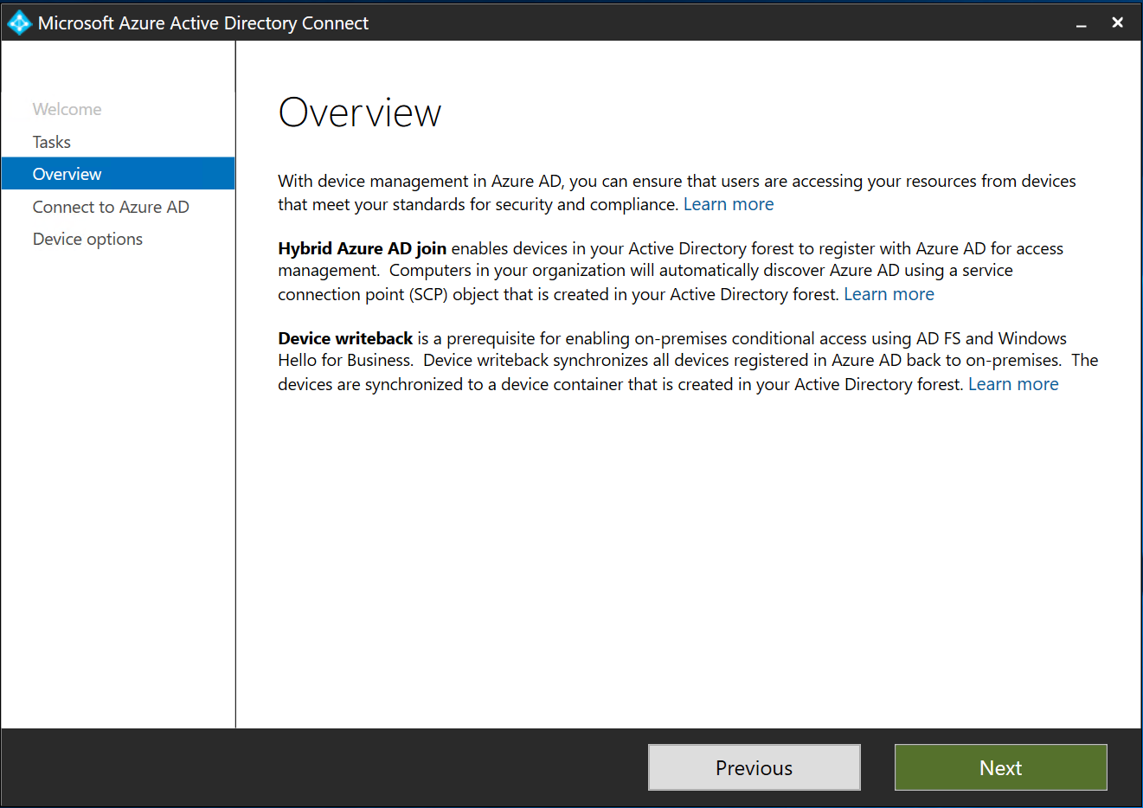
Notes:
We will click through the overview page
Click Next <click>

Slide 59
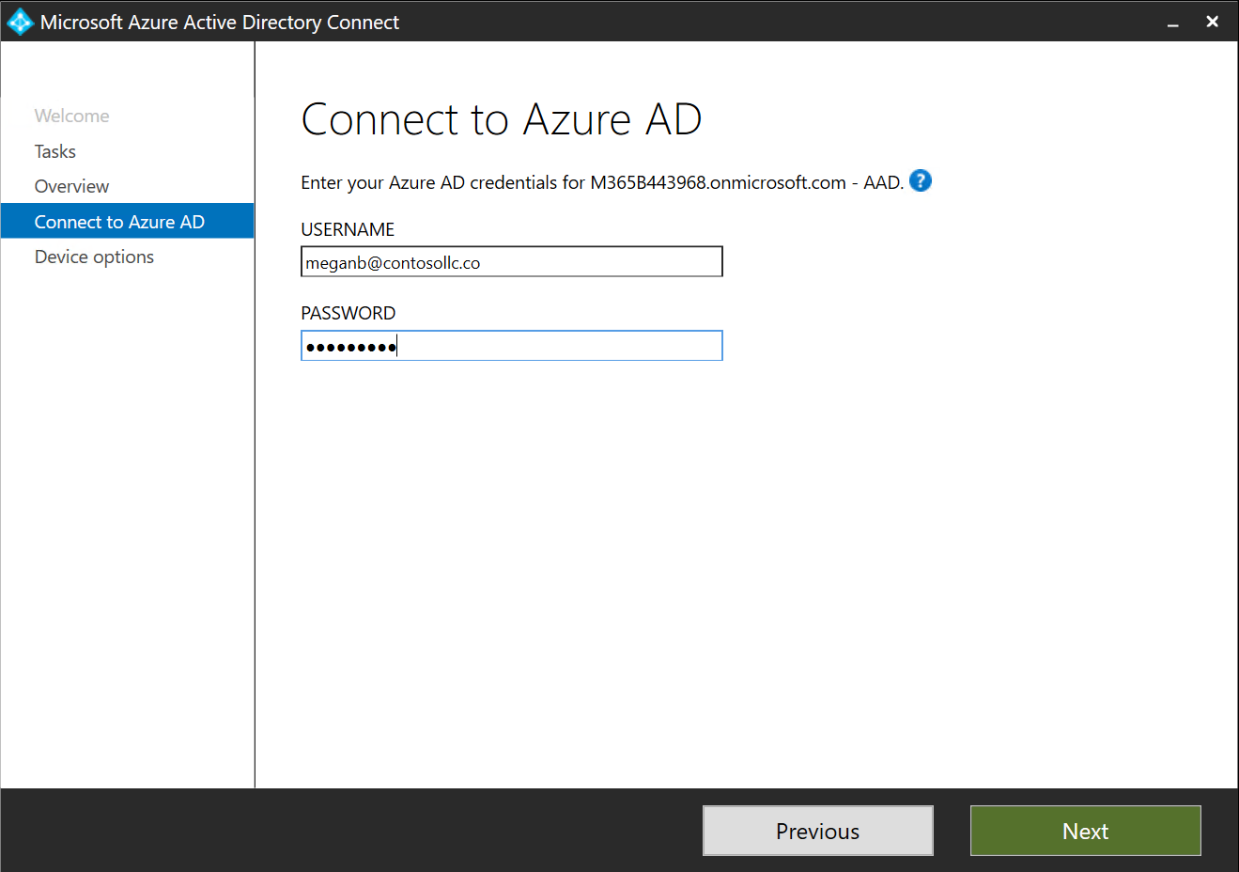
Notes:
Enter credential for a global administrator in Microsoft 365 Business
Click Next <click>

Slide 60
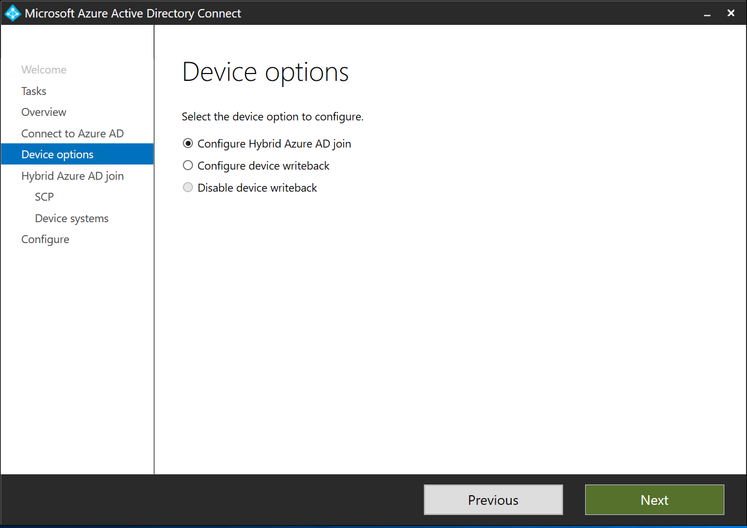
Notes:
Here we will make the selection to configure Hybrid Azure AD Join.
NOTE: Device writeback requires Azure AD Premium and is not included in Microsoft 365 Business
Click Next <click>

Slide 61
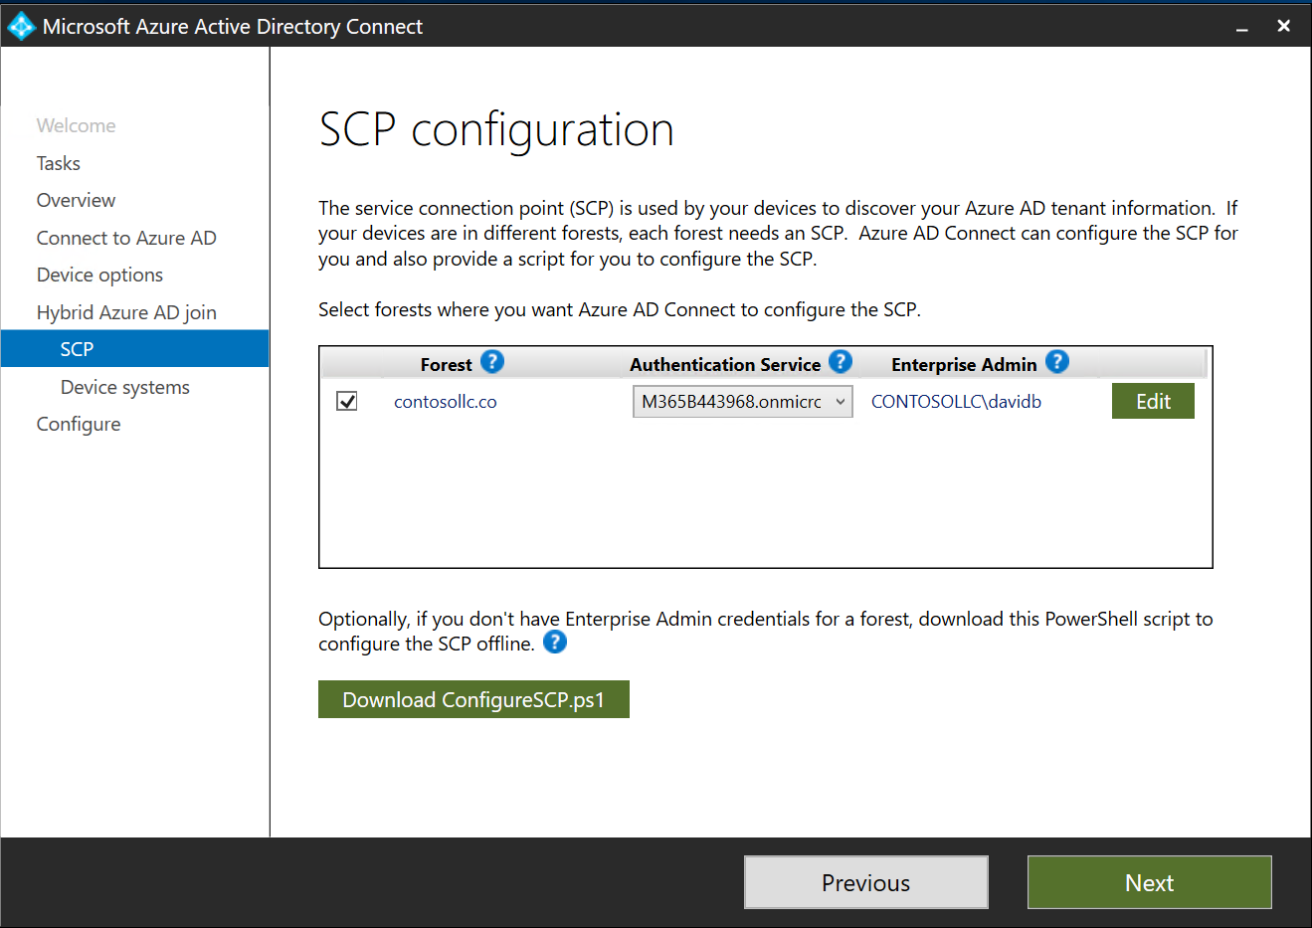
Notes:
Hybrid Azure AD Join requires a Service Configuration Point (SCP) object to be created in the Configuration Naming Context of the local AD.
We can select our Forest and press Add to specify an Enterprise Admin account so that Azure AD Connect can create this SCP object for us.
If we do not have an Enterprise Admin credential, we can download a PowerShell script to give to an Enterprise Admin to complete this task offline.
We see Edit on the demo slide here because we’ve already added the Enterprise Admin. Before the admin credentials are added, the button will show Add
Click Next <click>
NOTE:

Slide 62
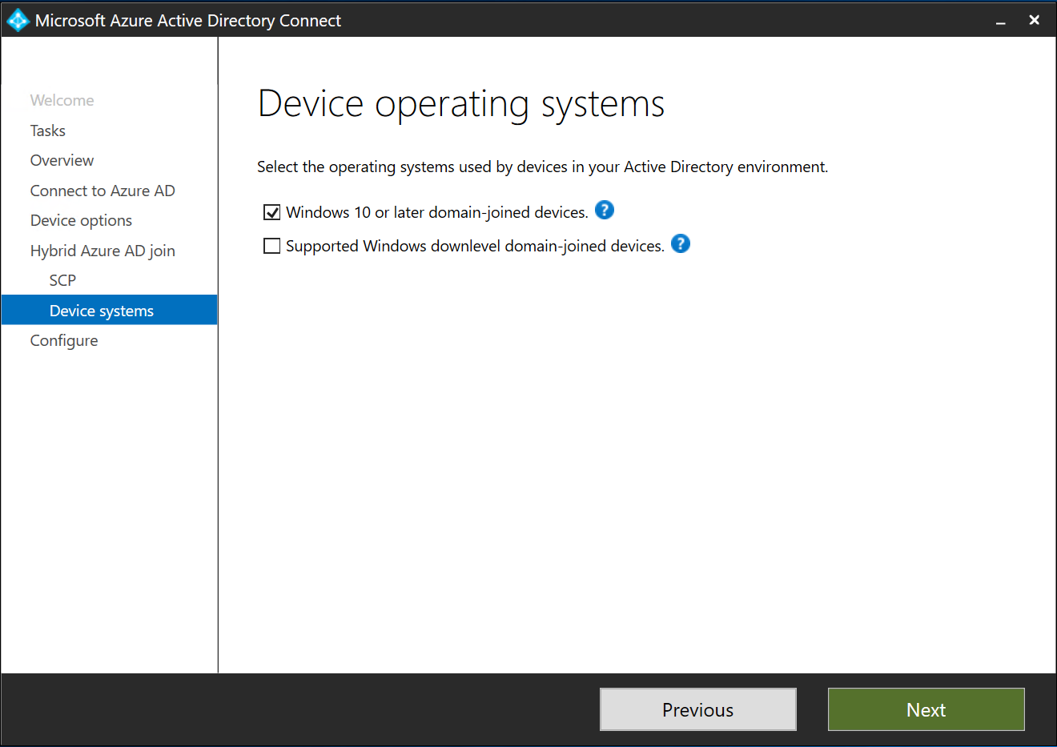
Notes:
In our example, we’re only using Windows 10 or later domain-joined devices, and this is recommended for most SMB scenarios.
If we have a requirement for hybrid AAD for Windows 7 Pro or Windows 8.1 Pro devices for a customer with a longer migration, we can support those with the second checkbox.
Click Next <click>

Slide 63
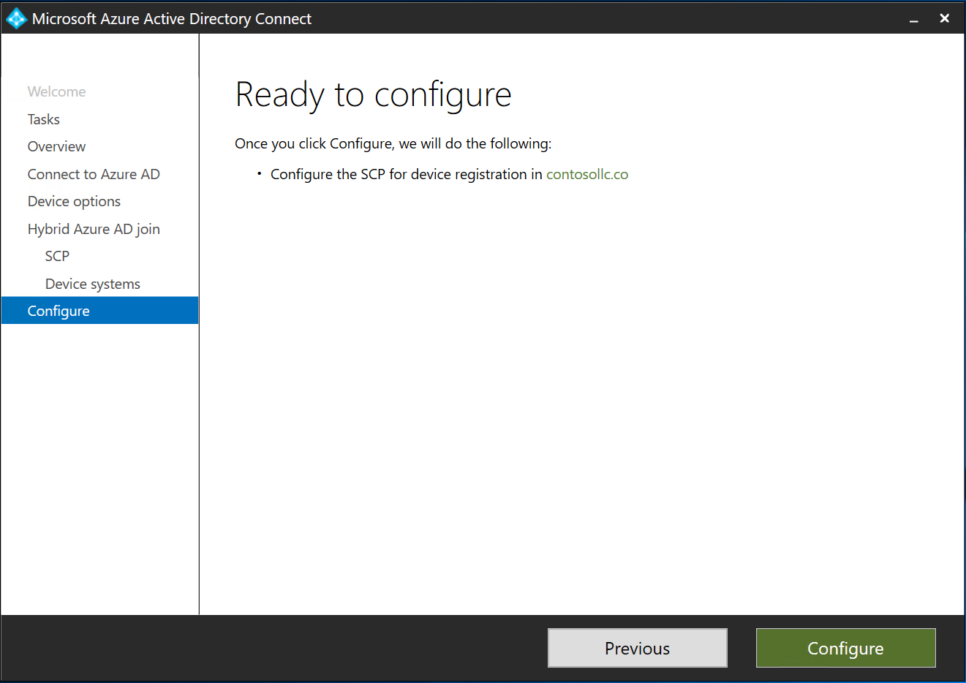
Notes:
That’s it for the SCP configuration necessary to support Hybrid Azure AD Joined Devices.
Because we configured seamless single sign on with theprevious AAD Connect walkthrough we don’t need to configure that again here.
Click Configure <click>

Slide 64
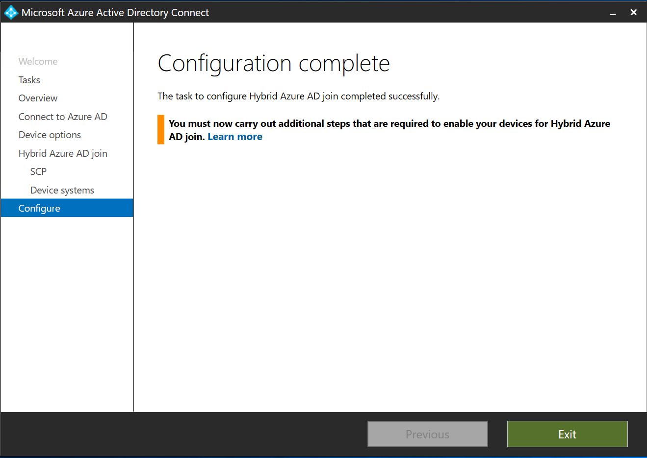
Notes:
This last page informs us that additional configuration is required. For SMB customers, this typically means we’re going to create a Group Policy Object (GPO) that has two settings configured. The first will automatically join domain computers to Azure AD. The second will automatically enroll these devices in Intune. We’ll do this next.
Other items to consider that are supported, but not typical for SMB customers include:
Configure controlled rollout so that only some devices join Azure AD
Configure network with device registration endpoints
Implement WPAD for Windows 10 devices if your customer requires the use of a outbound Internet proxy server
Configure the SCP in any forests that were not configured by Azure AD Connect
Configure any federation service that was not configured by Azure AD Connect
Configure support for Windows down-level devices (Especially not recommended for SMB customers because down-level devices may provide additional exposure to cyber threats)
Enable Azure AD Seamless SSO for Windows down-level devices
Set Azure AD policy for Windows down-level devices
Add Azure AD endpoint to Windows down-level devices
Install Microsoft Workplace Join on Windows down-level devices
Click Exit <click>

Slide 65
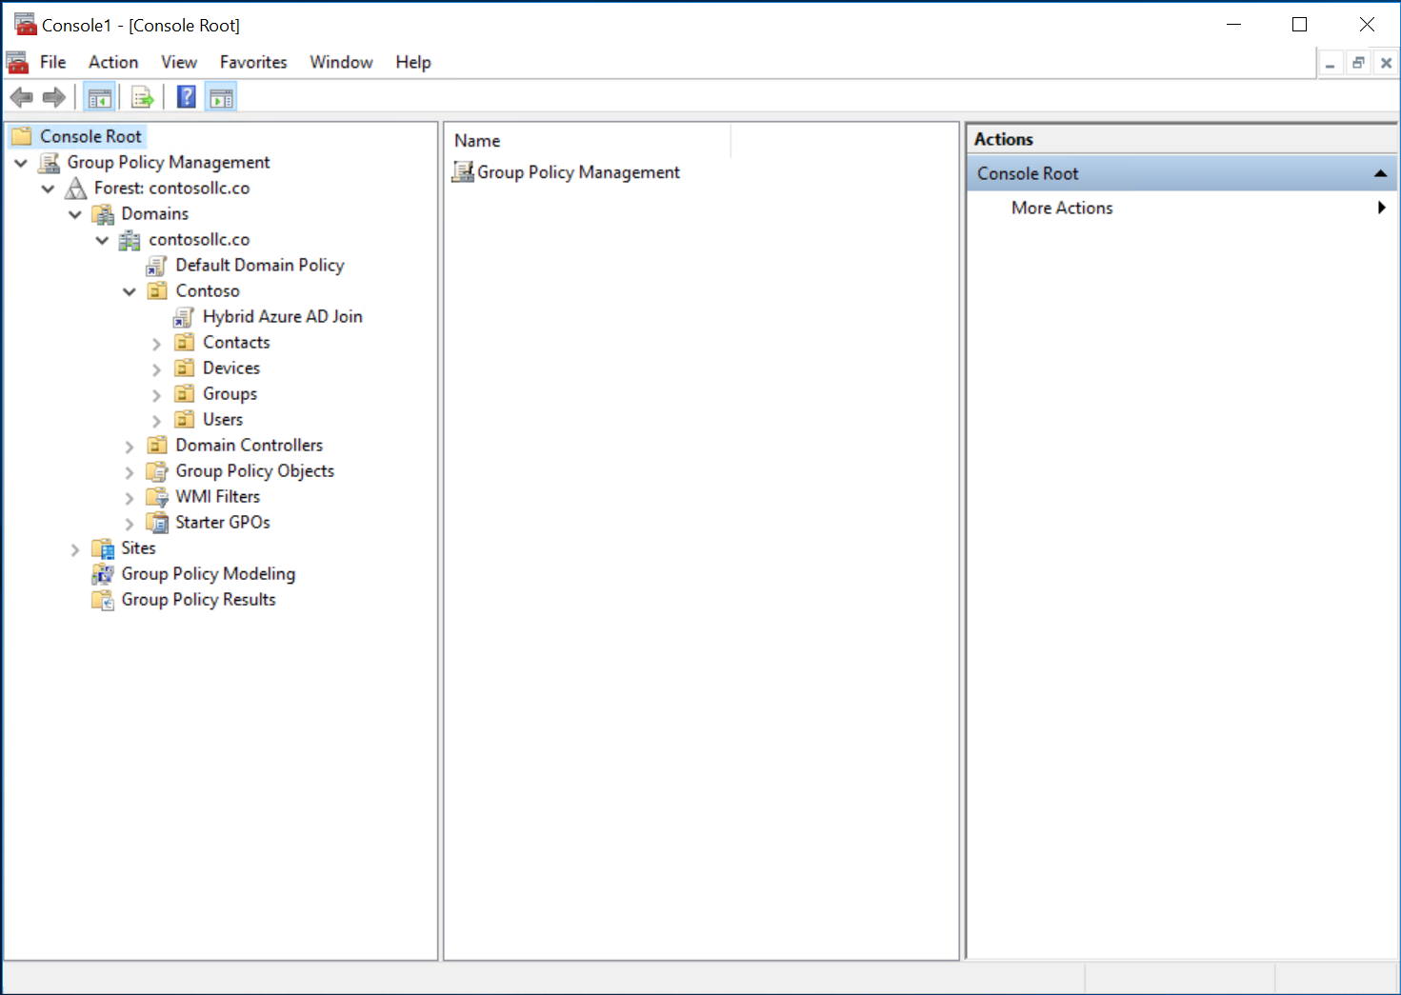
Notes:
We’ll create a GPO for Azure AD join and Intune Enrollment here. In this case, I have linked a new GPO called Hybrid Azure AD Join to the Contoso Organizational Unit because all of my devices are organized under this OU.
You must have a good understanding of your customers AD structure before doing this step. If you are unsure, use Express settings to synchronize the entire directory. It may cause extra objects to sync to the cloud, but this doesn’t cause any problems.

Slide 66
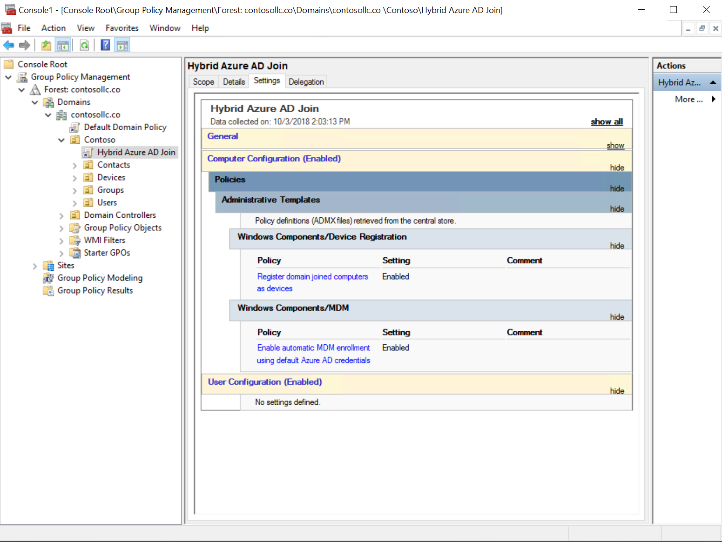
Notes:
Both required settings for Hybrid Azure AD Join can be set in one GPO
Register domain joined computers as devices is set to Enabled
Enable automatic MDM enrollment using default Azure AD credentials is set Enabled
IF YOU DO NOT SEE THESE POLICY OPTIONS: This means that the computer running the Group Policy Management console has an outdated set of ADMX templates. To fix this:
Download: Administrative Templates (.admx) for Windows 10 April 2018 Update (1803) or newer:
https://www.microsoft.com/en-us/download/details.aspx?id=56880
Install the templates on the computer you are using to create the GPO by copying to the appropriate folder *OR*
Install the templates in a central repository for your domain by creating a Central Store in the SYSVOL folder on a Windows domain controller.
Once you create the store on one DC, it will replicate to other DCs and the Group Policy Management console will use the updated templates automatically

Slide 67
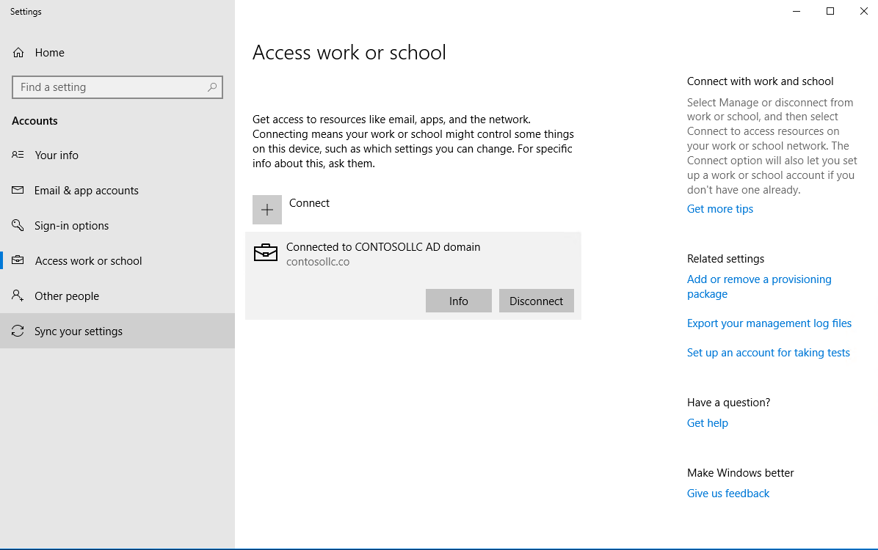
Notes:
This screen shows the AD Joined device connected to the local domain

Slide 68
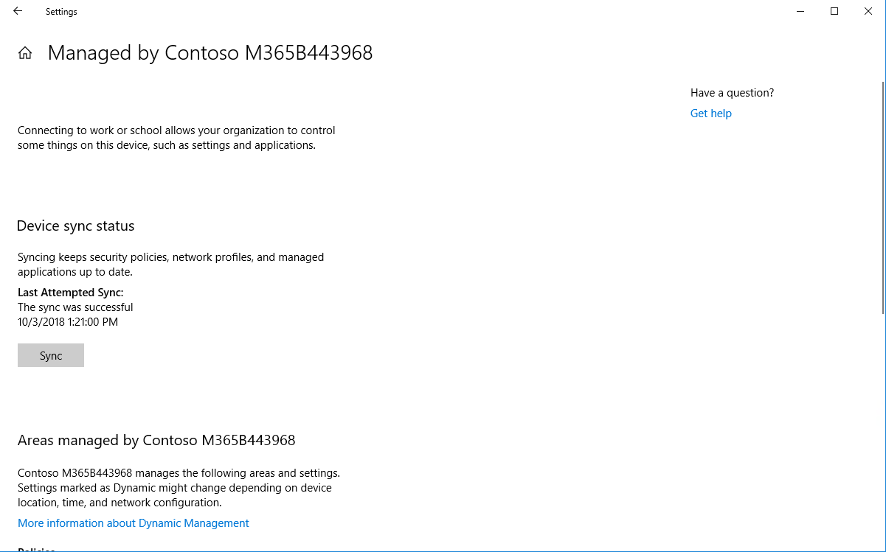
Notes:
If we click Info, we can see that the device is joined to Azure AD and managed by Microsoft 365 Business (Intune)
The device wil synchronize automatically with Intune. If we want, we can press the Sync button to perform a manual sync.

Slide 69
Device deployment steps for Hybrid Azure AD joined device
Step 1
Step 2
Step 3
10 Pro
Upgrade to Win 10 Pro
  Upgrade OD to Win 10 Pro creators update
Enable AAD Connect
  Synchronize identities and then select “Configure device options” from “Additional tasks” screen
Allow PC to access device registration endpoints
  If using outbound authentication proxy, then machine context must be allowed
Detailed setup instructions: http://aka.ms/hybridaadj
Notes:
Let’s review the steps required for Hybrid Azure AD Joined devices.
Step1:
Upgrade to Win 10: (1709 or higher is minimum supported version as of 10/23/2018). This doesn’t work with older versions of Windows. Our recommendation is to use the latest build available.
Step 2:
Install and Configure Azure AD Connect and make sure the domain devices are in scope for synchronization.
Create the SCP Object using AAD Connect
Create a GPO policy with the two required settings. One to join the devices to Azure AD and the other to enroll the devices in Intune
Step 3:
The devices must be able to access the Microsoft 365 Business device registration endpoints after they boot up and before the users logs in.
One common caveat is that some customers have proxy or firewall restrictions on the network that might interfere with this.
If using outbound authentication proxy, then machine context must be allowed.
Microsoft maintains both online documentation and a web service that dynamically lists all IP addresses and ports required to access their cloud services.

Slide 70

Microsoft’s guidance is to use
Azure AD Join whenever practical
Azure AD joined device config is the preferred path for non domain joined devices
Hybrid Azure AD joined device config is the preferred path for existing domain joined devices
Always consider Azure AD Join first
Consider Using both: Hybrid Azure AD joined device config for existing domain devices and Azure AD joined devices for new devices or device refresh
Notes:
Microsoft’s guidance is use to Azure AD Joined Device config with AAD connect because of the simplicity, reduction in on-prem foot print and the ability to manage remote workers and mobile devices.
If you do have scenarios that require hybrid joined devices, you can use those alongside azure AD joined devices.

Slide 71
Special cases
 | Guidance
SCCM | If customer plans on continuing use of SCCM then use Hybrid Azure AD Joined configuration
Notes:
Typically SSCM is used to deploy software updates and install applications in larger organisations, but some larger SMB customers may have this deloyed. For customers with SCCM, ensure they are aware that they can set up co-management with Intune, and start migrating policies from on-prem to cloud based management.

Slide 72
Windows deployment
Pre-requisites
Deployment
Autopilot
Notes:
For the final section of this module we will discuss Windows Autopilot.

Slide 73
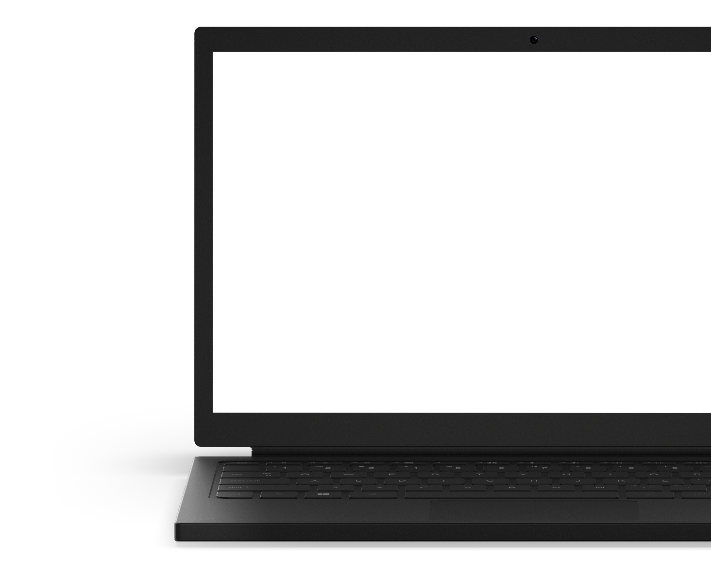
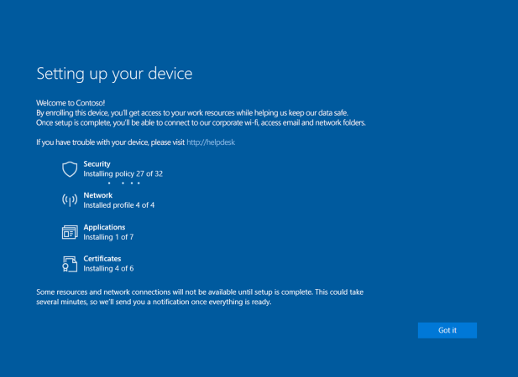
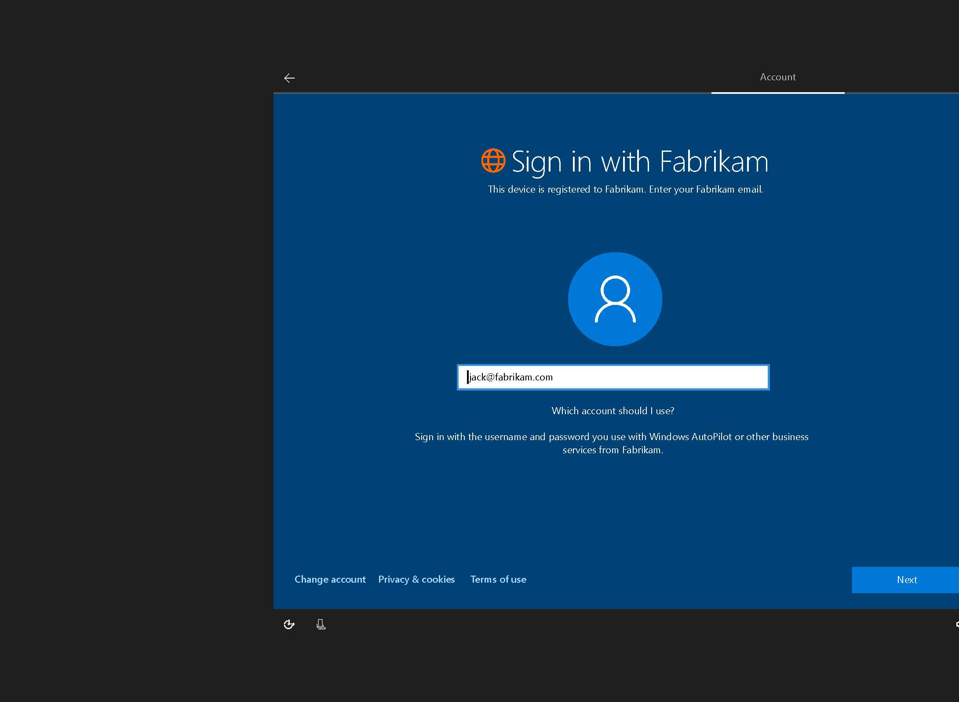
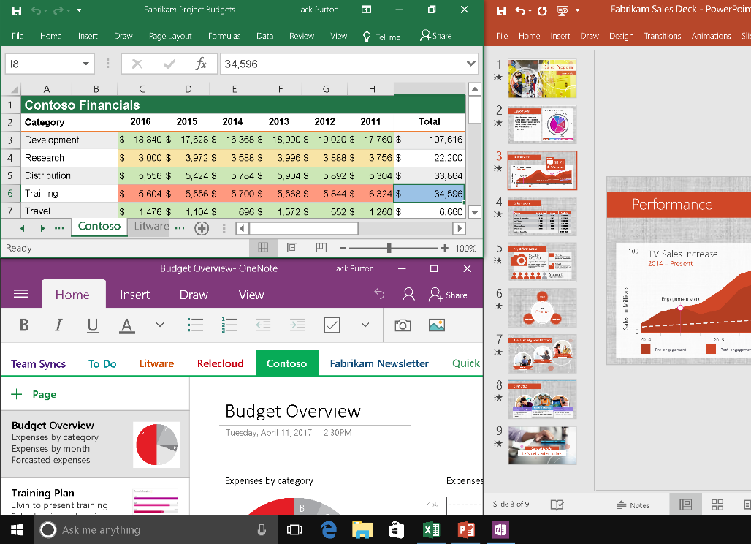
Windows Autopilot
From the box to enterprise ready, quickly and easily.
Quickly and easily transform new Windows devices. From the time a device is first unboxed and turned on, Windows Autopilot gets it configured and managed from the cloud, with no IT or end user effort required.
Traditional or modern, you choose
Windows Autopilot supports joining devices to Active Directory, registering them in Azure Active Directory (Azure AD), and enrolling them in mobile device management (MDM).
The experience keeps getting better.
Windows Autopilot supports additional user personalization and suppressing End User License Agreement (EULA) to improve end user experience.
Stay informed during the whole process.
Devices being provisioned via Windows Autopilot display status to let the user know that configuration is proceeding.
Notes:
Traditionally, IT pros spend a lot of time on building and customizing images that will later be deployed to devices with a perfectly good OS already installed on them. Windows Autopilot introduces a new approach.
From the users' perspective, it only takes a few simple operations to make their device ready to use. From the IT pros' perspective, the only interaction required from the end user is to connect to a network and to verify their credentials. Everything past that is automated.
Windows Autopilot allows you to:
Automatically join devices to Azure AD.
Auto-enroll devices into MDM services, such as Microsoft MDM Provider (requires an Azure AD Premium subscription).
Restrict the administrator account creation.
Create and auto-assign devices to configuration groups based on a device's profile.
Customize OOBE content specific to the organization.
<click>

Slide 74
Introducing Windows Autopilot Deployment
Windows Autopilot Deployment service
Upload
device IDs
Configure profile
Existing devices
Self-
deploy
Device IDs
Harvest device IDs
Hardware vendor
IT admin
Ship
Deliver direct to employee
Employee unboxes device, self-deploys
Notes:
Included in Microsoft 365 Business, Windows Autopilot enables devices to be pre-registered and pre-configured via the cloud, allowing partners to deploy a new device with no IT intervention required. Deployment on a new device using Autopilot begins with the handoff of device IDs from the hardware vendor, or OEM. These IDs are then associated to the customer and the device configuration profile set via the Microsoft Partner Center or the Microsoft Admin center directly. The device itself can ship directly to the customer, who will enjoy a faster, simpler, first-run experience, thanks to Autopilot.
<click>

Slide 75
Autopilot prerequisites
Microsoft MDM
solution
Windows 10 Pro v1703 +
Notes:
Devices must be registered to the organization.
Devices have to be pre-installed with Windows 10 Pro, version 1703 or later.
Devices must have access to the Internet.
Devices must be connected to Azure AD.
Devices must be under management – in this case, via the solution is Microsoft 365 Business.
<click>

Slide 76
Key places to find content
All content that is linked through out this document can be found at these sites. It’s important to note that when in doubt, go to the Microsoft 365 Business Partner Page.
Microsoft SMB Tech Community (aka.ms/smbtc): Forum for technical discussion & questions. The place to find experts.
Microsoft 365 Business Service Description (aka.ms/M365BSD)
The place to answer all your questions on the product and what is included
Microsoft 365 Launchpad (aka.ms/partnerlaunchpad):
This the hero tool for partners to identify a solution, create and offer and close the deal with customers
Microsoft 365 Scholarship Program (https://www.microsoft.com/microsoft-365/partners/business/scholarship)
This is the campaign site for the Microsoft 365 Business Scholarship Program, running until March 30, 2019
Guided Product Tour (https://testdrive.office.com/en-us/business/small-business-solutions)
A resource for partners to take customers through product value, without needing to prepare a full demo
Licensing Deck (aka.ms/m365bld)
A resource for partners to compare different licensing SKUs
Notes:
As mentioned in previous modules, there are a variety of resources available to help you get started in learning more about Microsoft 365 Business.

Slide 77
Thank you
Notes:
Thank you for watching module 5, deploy and management windows 10.

